Slide 1
Dr. I. Arul Rayappan
Associate Professor of Physics,
St. Joseph’s College (Autonomous),
Tiruchirappalli-620 002.
Embedded System
and
Internet of Things

Slide 2
Electronics Today
Microprocessor – Computers
Microcontroller – Embedded System
Digital Signal Processor (DSP)- Mobile
Filed Programmable Gate Array (FPGA)-Industrial application
VLSI- in all Above Cases
All these electronics are simply Called as Programmed Electronics

Slide 3
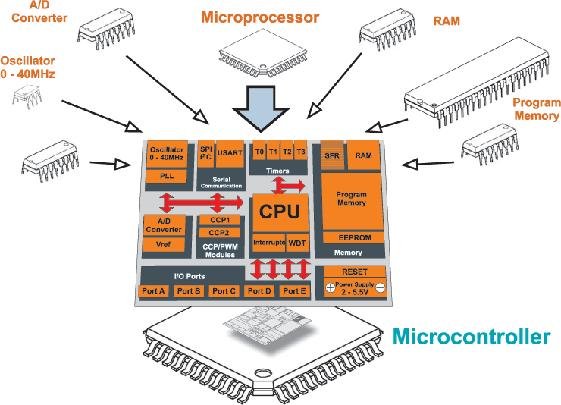
Microprocessor
All about your computer

Slide 5
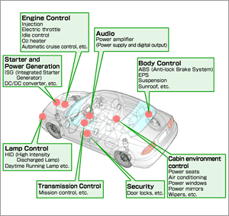

Slide 7
Internet of Things (IoT)
The Internet of Things (IoT) is a scenario in which objects, animals or people are provided with unique identifiers and the ability to transfer data over a network without requiring human-to-human or human-to-computer interaction.

Slide 8
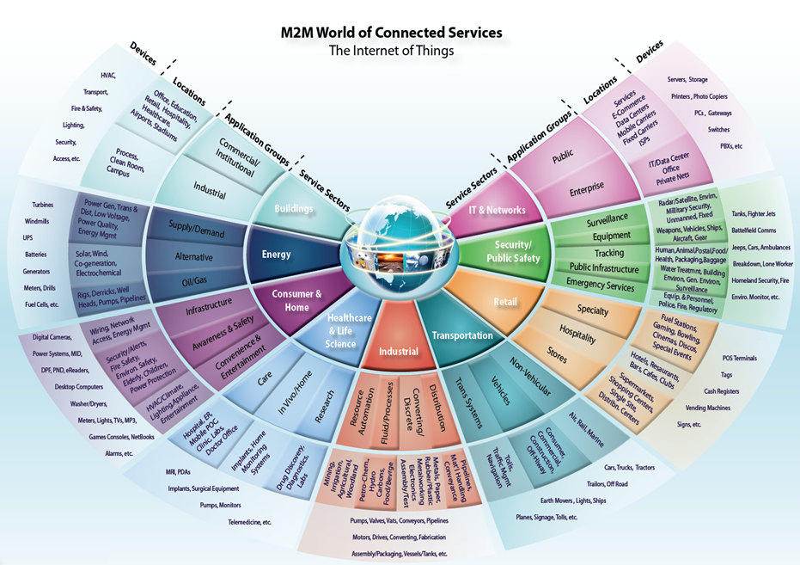

Slide 10
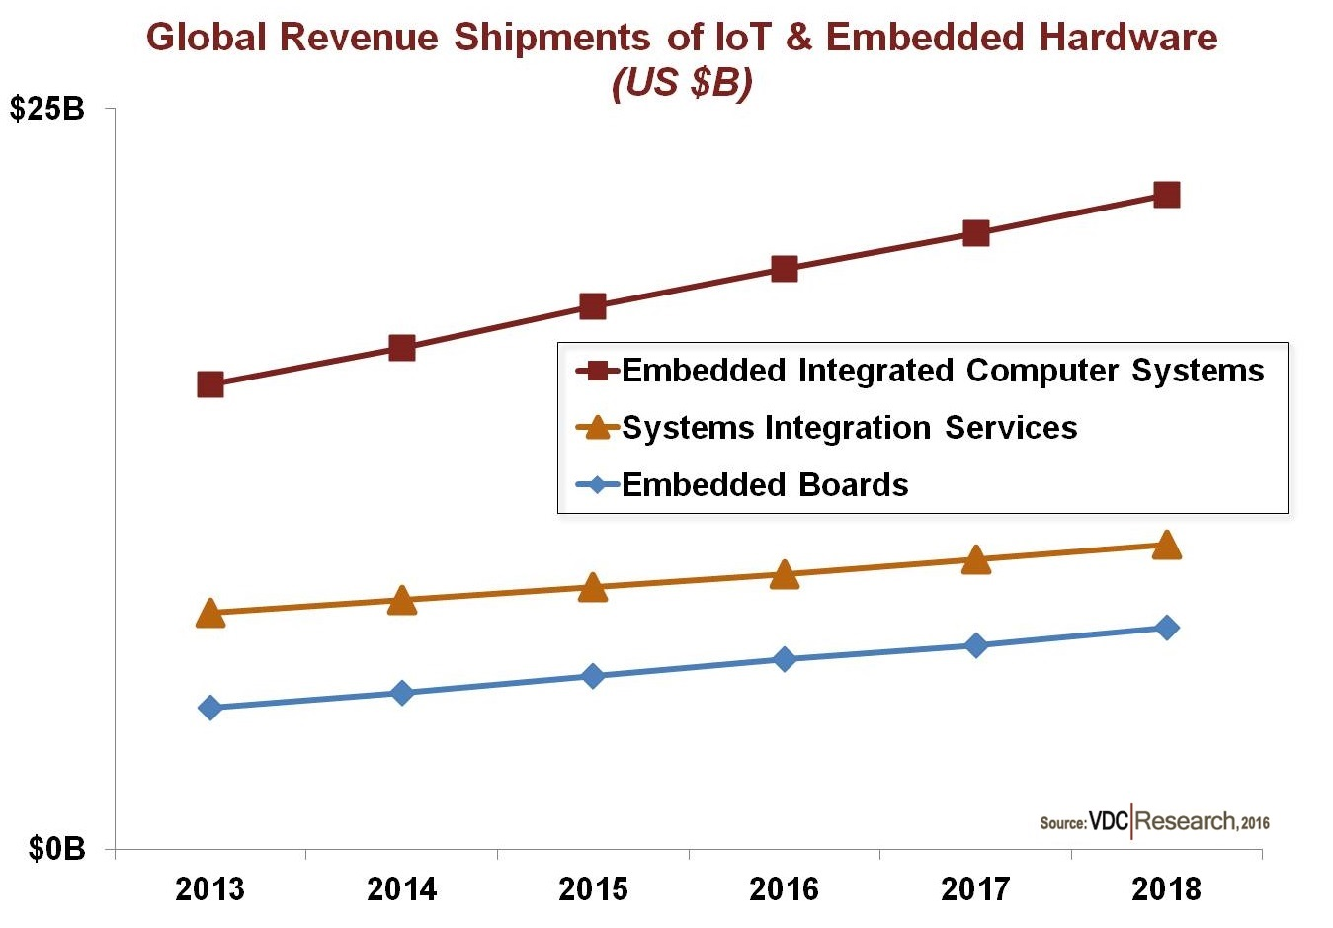

Slide 11
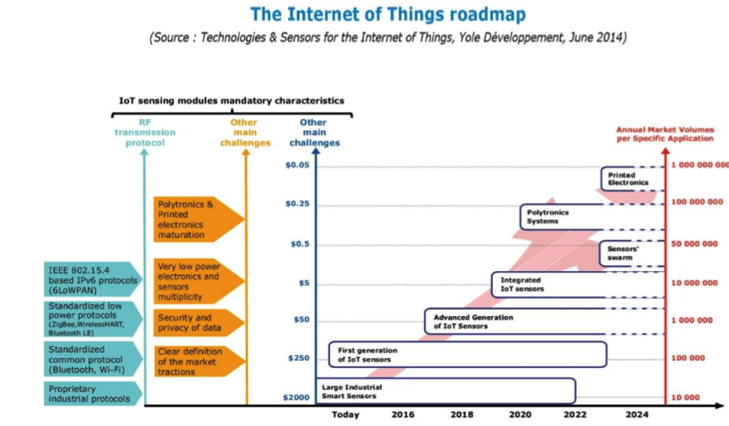

Slide 12
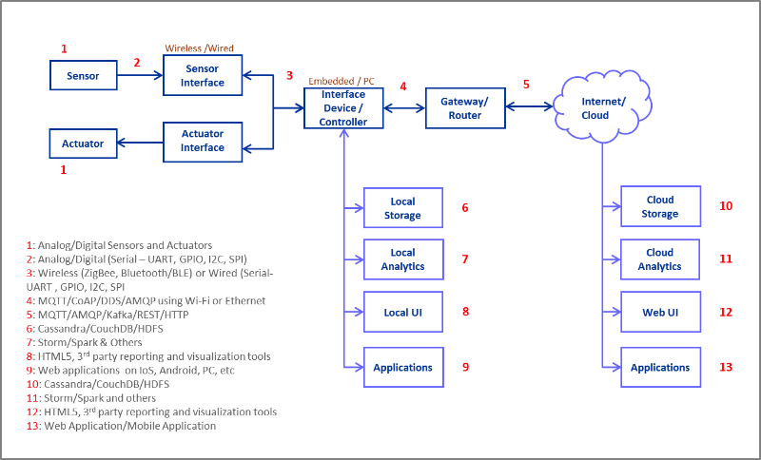

Slide 13
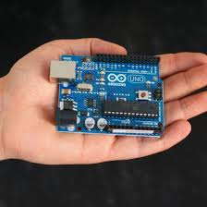
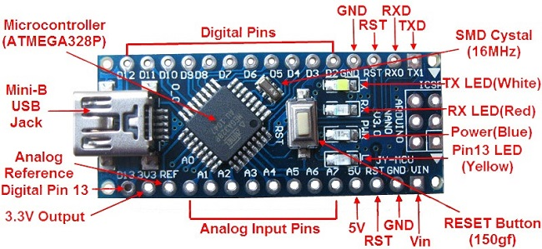
Arduino Board

Slide 14
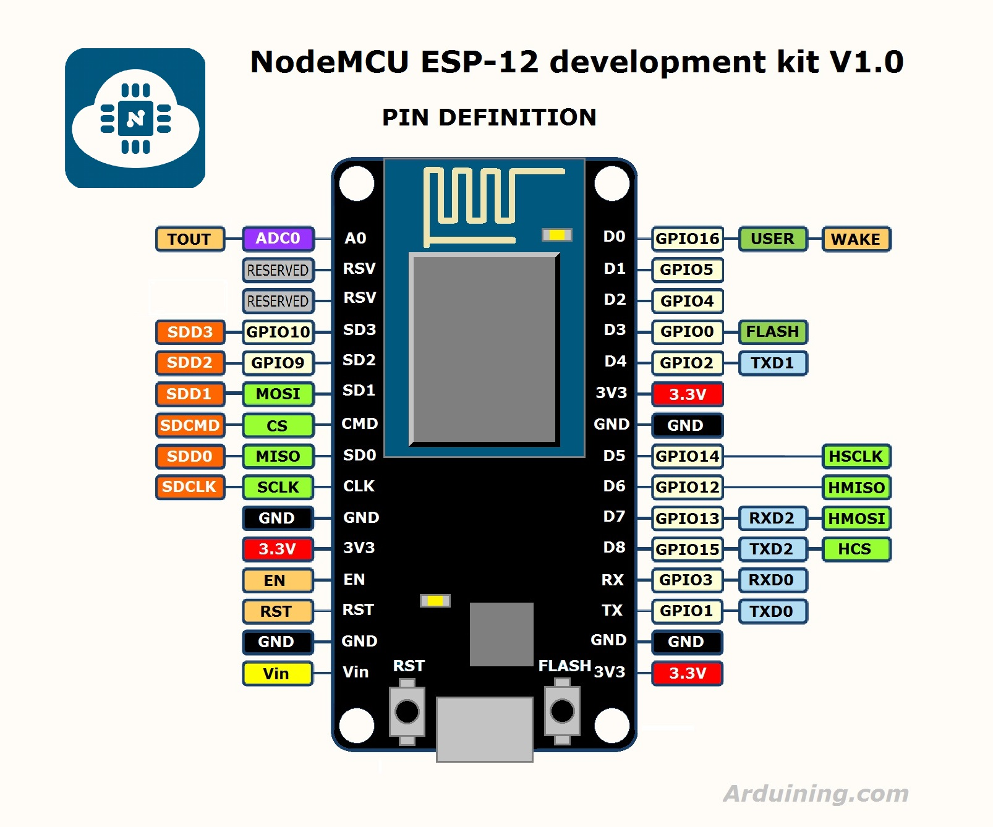

Slide 15
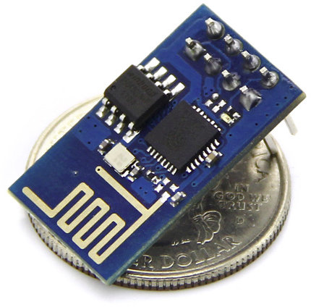
ESP8266

Slide 16
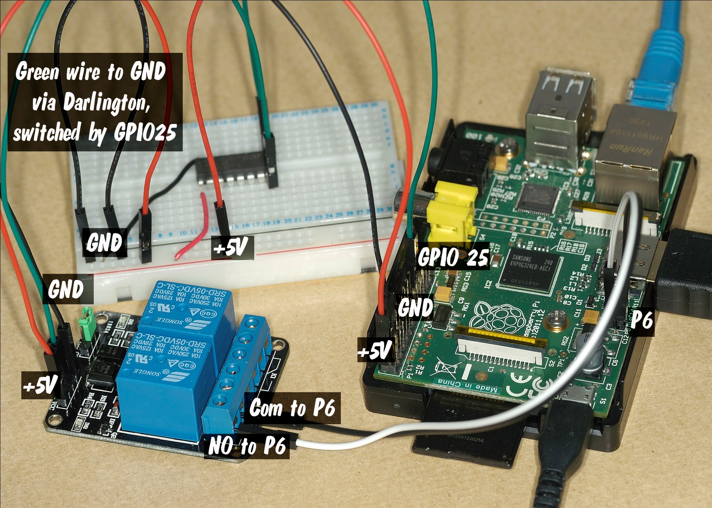

Slide 17
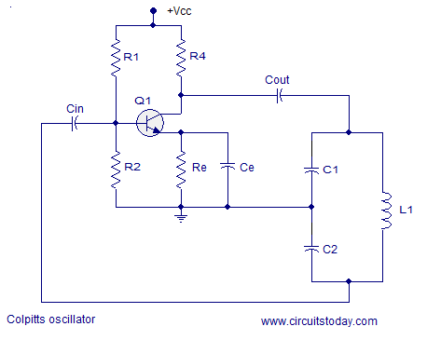

Slide 19
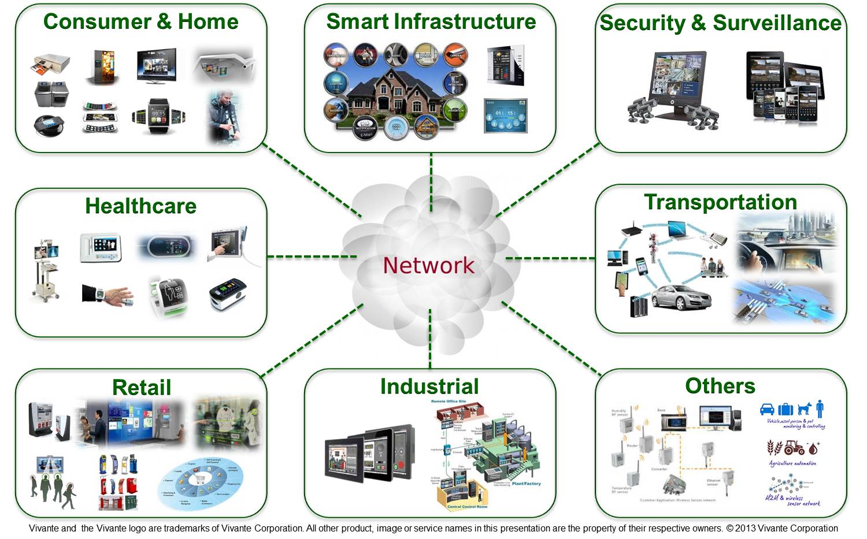

Slide 20
What to study for Iot
Basic electronics
Some idea about microcontroller
Arduino programming
Android programming
Python
Linux
Single board computers
Raspberry pi
Beagle Bone Black Ti
Intel edison kit

Slide 21
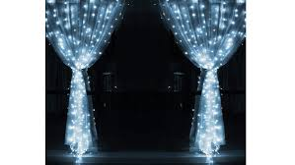
Thank You

