Slide 1
Addressing Modes
in
8051 MC
S. Lourduraj
Asst. Prof. of Physics
St. Joseph’s College.

Slide 2
Addressing Mode MC 8051
Method of specifying the data to be operated by the instruction
CPU can access the data in various ways.
-- data could be in reg./Memory/immediate value.
Is a way the MC to access data / operand from internal memory /external memory (or)Register specific Ports.
The use of efficient modes of a program (addressing mode) will increase the processing speed of CPU as well as processing time can be shortened.

Slide 3
Types of Addressing Modes
Register Addressing Mode
Direct Addressing Mode
Register indirect Addressing Mode
Immediate Addressing Mode
Indexed Addressing mode

Slide 4
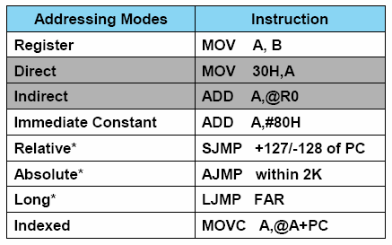
Type of Addressing Mode MC 8051

Slide 5
1. Register Addressing mode
- Instruction will specify the name of the Reg. in which data is available
This addressing instruction involves information transfer between registers (at least one of the R0-R7 register involved)
Source & Destination reg.’s match in Size:
Eg: MOV A, R0 MOV R2, A ADD A, R5
Eg: MOV R4, R5 (Invalid Instruction)
Size of Source & Destination will vary:
Eg: MOV DPTR, A (Error) MOV DPTR, #12A3H
MOV R2, DPL
MOV R1, DPH

Slide 6
1. Register Addressing mode
Example:
ADD A, R7 ; add content of A with the content of R7
MOV R0,#00 ; move data 00 to the register R0
DJNZ R3, LOOP ; Decrement content of R3 and Jump if Not LOOP
MOV R0, A ; The instruction transfers the content of accumulator A into the R0 register.

Slide 7
2. Direct Addressing mode
The Address of the data is directly specified in the instruction
The entire 128 bytes of RAM can be accessed with memory locations 30H to 7FH
Eg:
Eg:
MOV A, P3 ; Transfer the contents of Port 3 to the accumulator
MOV A, 020H ; Transfer the contents of RAM location 20H to the accumulator
MOV P1, AA H ; Transfer the contents of A to Port 1
MOV 20H, 40H ; Transfer the contents of the address 40H to the address 20H
ADD A, 55H ; Add the contents of A with the contents of the address 55H
MOV R0, 40H
MOV R4, 7FH
MOV 40H, A
MOV R2, #5
R2=05H
MOV B, 2
MOV 4, 2 (OR) MOV R4, R2
MOV A, 7
OR
MOV A, R7 (OR) MOV A, 7

Slide 8
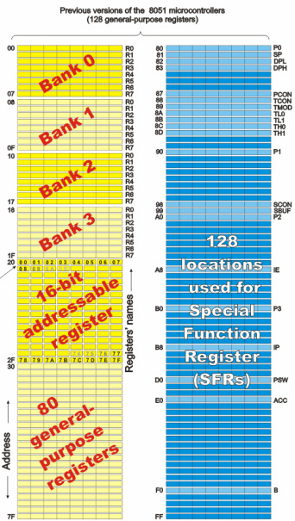
Addressable memory used by direct addressing mode
from 00 to 7F and also address specified by special register
Valid memory Address for Direct
Addressing Mode
P1(80H),
P1(90H),
P2(A0H),
P3(B0H) &
PSW(D0H)
PSW(D0H)

Slide 9
3. Register Indirect Addressing mode
A register is used to hold the effective address of the operand.
This register, which holds the address, is called the
Pointer register and is said to point to the operand.
Only registers R0, R1 and DPTR can be used as pointer registers.
R0 and R1 registers can hold an 8-bit address where as
DPTR can hold a 16-bit address.
DPTR is useful in accessing operands which are in the
external memory.

Slide 10
3. Indirect Addressing mode (cont’d)
Examples:
MOV @ R0, A ;Store the content of accumulator into the memory location pointed
to by the contents of register R0. R0 could have an 8-bit address, such as 60H.
MOV A, @R0 ; move the contents of RAM at location designated by R0 into accumulator A
Eg:
MOV P1, #0xFF H Let P1: 0000 0100b (OR) 04 H
MOV A, P1 A = 04H
MOV R0, # 050H R0 = 50 H
MOV @R0, A Add. of Memory
0050 H = ------
MOV A, @R0 A = ---H

Slide 11
MOVX A, @ DPTR ; Transfer the contents from the memory location pointed to by DPTR into the accumulator.
DPTR could have a 16-bit address, such as 1234 H.
INC @R1 add one into the content designated by the R1

Slide 12
Example
MOV A, #55H A= 55h
MOV R0, 40H R0 40H= ( xx )
MOV @R0, A 40H = --- H
INC R0 R0 = 41 H
MOV @R0, A 41 H = ---H
INC R0 R0 = 42H
MOV @R0,A 42H = ----H
INC R0 R0 = 43H
MOV @R0, A 43 H= ----H
Advantages of reg. Indirect addressing Mode:
Looping is most efficient & Block data transfer
Limitations: need to access the external RAM

Slide 13
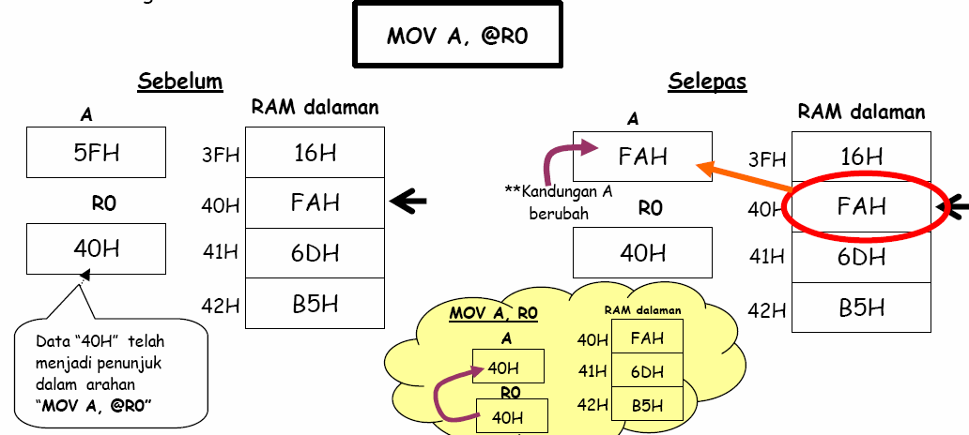
3. Indirect Addressing mode (cont’d)

Slide 14
4. Immediate Addressing mode
This mode of addressing uses either an 8- or 16-bit constant value as
t he source operand
This constant is specified in the instruction, rather than in a register or a memory location
The destination register should hold the same data size which is specified by the source operand
Examples:
ADD A, # 030H ;Add 8-bit value of 30H to the accumulator register (which is an 8-bit register).
MOV DPTR, #0FE00 H ;Move 16-bit data constant FE00H into the 16-bit Data Pointer Register.

Slide 15
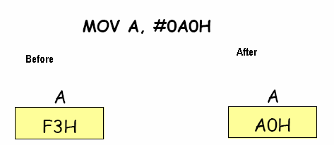
Examples:
MOV A, # A0H ; data A0H transfer to the A
ADD A, # 4EH ; add the contents of A with the data 4E H & store in Acc. A
CJNE A, # 20H, LOOP ; compare the data 20H with content of Acc (A),
jump to LOOP if the value not equal to zero.
4. Immediate Addressing mode (cont’d)

Slide 16
5. Indexed Addressing mode
On-Chip ROM access
The Indexed addressing is useful when there is a
need to retrieve data from a look-up table
A 16-bit register (data pointer/program counter – DPTR/PC) holds the base address and the accumulator holds an 8-bit displacement or index value
The sum of these two registers forms the effective address for a JMP or MOVC instruction

Slide 17
Indexed Addressing mode (cont’d)
Example:
MOV A, #08H ; Offset from table start
MOV DPTR, #01F00H ; Table start address
MOVC A, @ A+DPTR ; Gets target value from the table start address + offset and puts it in A.
(Contents of A are added to the 16 bit reg. DPTR to form the 16 bit address of need data )
(A) { (A=00) + (Add. Of content) }
After the execution of the above instructions, the program will branch to address 1F08H (1F00H+08H) and transfer into the accumulator the data byte retrieved from that location (from the look-up table)

Slide 18
ORG 0000
MOV DPTR, #200H
CLR A
MOVC A, @A+DPTR
MOV R0,A
INC DPTR
CLR A
MOVC A,@A+DPTR
MOV R1, A
INCR DPTR
CLR A
MOVC A,@A+DPTR
MOV R2, A
HERE: SJMP HERE
ORG 0200H
MY DATA: DB “ SLR”
END.

Slide 19
Program to understand the concept of LOOK –UP table with INDEXED ADDRESSING MODE
ORG 0000
MOV DPTR, #300H
MOV A, #0FFH
MOV P1, A
BACK:
MOV A, P1
MOVC A, @A+DPTR
MOV P2 ,A
SJMP BACK
ORG 300H
SQR_Table: DB 0, 1, 4, 9, 16, 25, 36, 49, 64, 81
END.
MEMORY LOCATIONS IN ROM | 307CONTENTS
300 | 00
301 | 01
302 | 04
303 | 09
304 | 10 Equivalent to 16
305 | 19 Equivalent to 25
306 | 24 Equivalent to 36
307 | 31 Equivalent to 49
308 | 40 Equivalent to 64
309 | 51 Equivalent to 81

Slide 20
Thank You

