Slide 1
statistics
P. Julia Mary, Department of Mathematics

Slide 2
Observation of spss
SPSS=Statistical Package for the Social Science

Slide 3
Spss main menus
FILE MEMU
EDIT MENU
VIEW MENU
DATA MENU
TRANSFORM MENU
ANALYZE MENU
GRAPH MENU
UTILITIES MENU
WINDOWS AND HELP MENU

Slide 4
FILE MENU- The File menu lets us open ,save ,print and close files and provides access to recently used files
EDIT MENU- The Edit menu lets us do things like cut ,copy ,paste etc.
VIEW MENU- The View menu lets us customize the spss desktop,using the view menu we can hide or show the toolbar,status bar, gridlines etc
DATA MENU- The Data menu is an important tools in spss.it allows us to manipulate the data in various ways.we can define variables, go to a particular cases, sort cases, transpose them, merge cases as well as variables from some others file.
TRANSFORM MENU- The Transform menu is another very useful tools, which lets us compute new variables and make changes to existing ones

Slide 5
ANALYZE MENU- The analyze menu is the function which lets us perform all the statistical analyses. This has various statistical tools grouped under different categories.
GRAPH MENU-The graph menu lets us make various types of plots from our data
UTILITIES MENU- The utilities menu gives us information about variables and files
WINDOWS AND HELP MENU- The windows and help menu are very similar to others windows application menus

Slide 6
Working with the data editor
Data editor has two tabs
1.DATA VIEW
2.VARIABLE VIEW
DATA VIEW- the data editor works pretty much in the same manner as an excel spredsheet.one can enter values in the different cells, modify them and even cut and paste to and from an excel spreadsheet.

Slide 7
VARAIBLE VIEW- This column allow you to indicate which values mean missing. Values marked as missing are exclude from analyses in SPSS.
Respondent | Gender (M=1,F=2) | Age
1 | 1 | 25
2 | 1 | 22
3 | 2 | 20
4 | 2 | 27
5 | 2 | 28

Slide 8
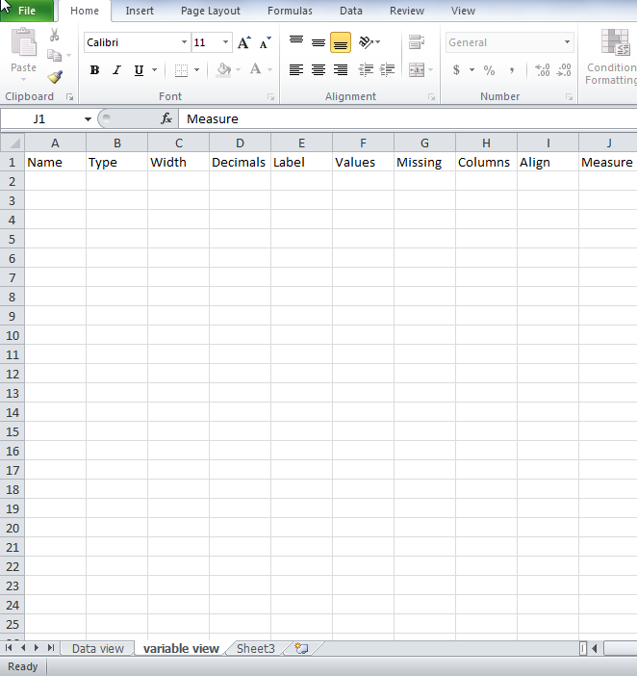

Slide 9
Research in behavioral sciences
One of the main objective of a behavioral scientist is to develop theories and principles which provide insights into human and organizational behavior.
These theories and principles have to be evaluated against actual observations
This is called the validation of theories by empirical research
Research can be classified into two groups—qualitative research and quantitative research

Slide 10
Qualitative research
Qualitative research involves collecting qualitative data by way of in-depth interviews, observations , field notes, open-ended questions etc.
The researcher himself is the primary data collection instruments, and the data could be collected in the form of words, images, patterns etc.

Slide 11
Data analysis involves searching for patterns, themes and holistic features.
Results of such research are likely to be context specific and reporting takes from of a narrative with contextual description and direct quotations from researchers

Slide 12
Qualitative research
Quantitative research involves collecting quantitative data based on precise measurement using structured, reliable and validated data collection instruments or through archival data sources.
The nature of the data is in the form of variables and data analysis involves establishing statistical relationships
Quantitative research could be classified into two groups depending on the data collection methodologies—experimental research, and non experiments research

Slide 13
Experimental research forms the basis of much of the psychological research. The main purpose of experimental research is to establish a cause and effect relationship
There are two main types of experimental designs– between subjects designs, and within-subjects design.in a between-subjects design, we randomly assign different participants to different condition.
On the other hand, in a within-subjects design the same participants are randomly allocated to more than one condition

Slide 14
It is also referred to as repeated measures design.in addition to having a purely between-subjects or within-subjects designs, one can also have a mixed design experiment
The commonly used techniques for analyzing such data includes t-test, ANOVA etc.

Slide 15
Non -experimental research is commonly used in sociology, political science and management disciplines.
Quantitative research is also classified based on the type of data used as primary and secondary data research. primary data is the one which we collect directly from the subject of study. This is done with the help of standard survey instrument
There are many database management firms, which keep a record of different kinds of micro- and macro-environmental data. For example, the United states patent and Trademarks office(USPTO,www.uspto.gov)has detailed information about all the patents filed in the united states
Some other commonly used sources of secondary data include company report, trade journals and magazines, newspaper clippings etc.
Many times, the secondary data is supplemented by data collected from primary methods such as surveys.

Slide 16
TYPES OF VARIABLES
A Variable is a characteristic of an individual or object that can be measured. There are two types of variables
  Qualitative
  Quantitative

Slide 17
1.Qualitative variable
Qualitative variables are those variables which differ in kind rather than degree. These could be measured on nominal or ordinal scales
The nominal scale indicates categorizing into groups or classes. For example, gender, religion, race, color, occupation etc.
The ordinal scale indicates of items. For example, agreement disagreement scale(1– strongly agree to 5—strongly disagree),consumer satisfaction ratings(1—totally satisfied to 5—totally dissatisfied)etc.

Slide 18
2.Quantitative variables
Quantitative variables are those variables which differ in degree rather than kind. These could be measured on interval or ratio scales.
The interval scale indicates rank and distance from an arbitrary zero measured in unit intervals. For example, temperature, examination scores etc.
The ratio scale indicates rank and distance from a natural zero. For example, height, monthly consumption, annual budget etc.
SPSS does not differentiate between interval and ratio data and lists them under the label scale

Slide 19
HYPOTHESIS TESTING
A hypothesis is an assumption or claim abut some characteristic of a population, which we should be able to support or reject on the basis of empirical evidence.
Its bulbs is at least 1000 hours.
Hypothesis testing is a process for choosing between different alternatives.
The alternatives have to be mutually exclusive and exhaustive.
Being mutually exclusive means when one is true the other is false and vice versa.

Slide 20
Average life of the bulb is greater than or equal to1000hours.
Average life of the bulb is less than 1000hours.
Null Hypothesis(H0)– It is the presumption that is accepted as correct unless there is strong evidence against it.
Alternative hypothesis(H1)– It is accepted when H0 is rejected.

Slide 21
Hypothesis testing helps in decision-making in real life business, economics and research-related problems.
Marketing: The marketing department wants to know if a particular marketing campaign had any impact in increasing the level of product awareness.
Production: The production department wants to know if the average output from two factories in the same.
Finance: The finance department wants to know if the average stock price of the company’s stocks has been less than that of the competitor’s stocks.
Human Resources: The HR department wants to know if ther has been any significant impact of the 360-degree feedback system on employees performance.
Quality Control: The quality control department wants to know if the average number of faults is within the prescribed limit.

Slide 22
Economics: Policy-makers are interested in knowing if there has been any significant impact on the performance of small-scale industries due to the opening up of the economy
Research: A scientist wants to know if the average output from genetically modified seeds is more than that from the normal variety of seed.
While testing a hypothesis, if we reject it when it should be accepted, it amounts to Type1 error.
Accepting a hypothesis when it should be rejected amounts to Type2 error.
The only way to reduce both types of errors is to increase the sample size.

Slide 23
Significance level(P- VALUE)
There is always a probabilistic component involved in the accept-reject decision in testing hypothesis.
The criterion that is used for accepting or rejecting a null hypothesis is called significance level or. p-value

