Slide 1
WEB PAGES AND
WEB SITES

Slide 2
WEB PAGES AND WEB SITES
A Web page is an HTML document that is stored on a web server and that has an URL
A Web site is a collection of Web pages belonging to a particular person or organization

Slide 3
SPECIAL KINDS OF
WEB SITES
AND PAGES

Slide 4
PORTALS
A Portal is a Web site that the browser displays first
All portal services are free but some require us to register and choose a password
Some ISP’s configure their home pages to be our start page when we sign up for an internet, so that the ISP’s home page serves as our portal

Slide 5
WEB GUIDES
A Web guide is a Web site with a system of categories and subcategories that organizes links to Web pages

Slide 6
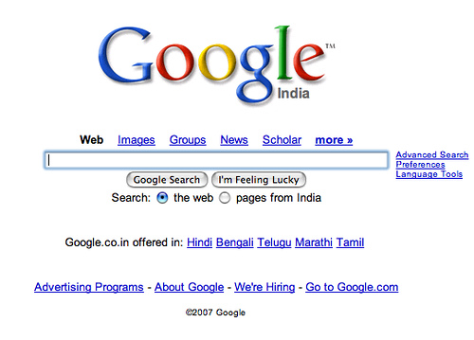
SEARCH ENGINES
A search engine is a website or type of software that searches files across the internet for specific keywords or phrases defined by the user
Google, Yahoo, Bing, Ask and AOL search are some of the top search engines

Slide 7
HOME PAGES
PERSONAL
A personal home page is the front door of a Web site that an individual puts on the Web to introduce oneself
Personal web pages are often used solely for informative or entertainment purposes.

Slide 8
HOME PAGES
BUSINESS AND ORGANIZATION
A business home page is the front door to a business’s Web site
It should be attractive, easy to find and provide enough information to get people quickly to the Web site that they want to visit

Slide 9
THANK YOU....

