Slide 1
Calendar
Presented By
S.ITHAYA EZHIL MANNA
Assistant Professor In Mathematics
St.Joseph’s College,Trichy-2

Slide 2
Different kinds of years

Slide 3
Different kinds of years
The year has been defined generally as the period of
apparent revolution of the sun around the earth and
is therefore called a `Solar Year'.

Slide 4
Different kinds of years
The year has been defined generally as the period of
apparent revolution of the sun around the earth and
is therefore called a `Solar Year'.
The year must be in conformity with the occurrence of the seasons and it must be useful for civil purposes.

Slide 5
Different kinds of years
The year has been defined generally as the period of
apparent revolution of the sun around the earth and
is therefore called a `Solar Year'.
The year must be in conformity with the occurrence of the seasons and it must be useful for civil purposes.
We now define three kinds of years.

Slide 6
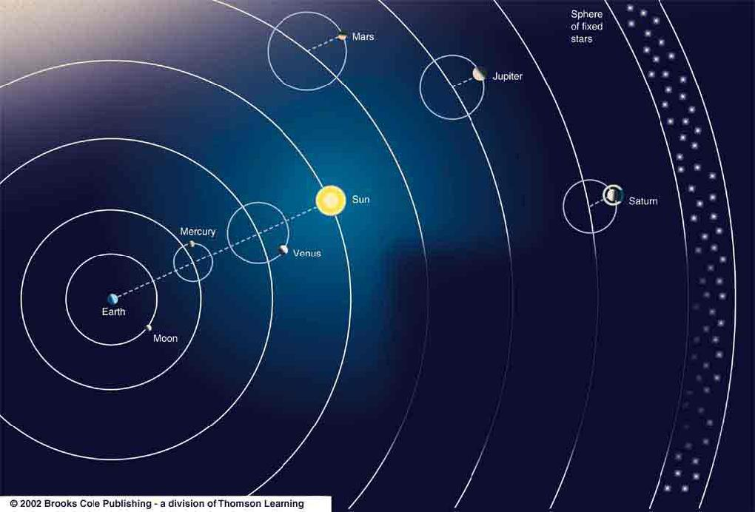
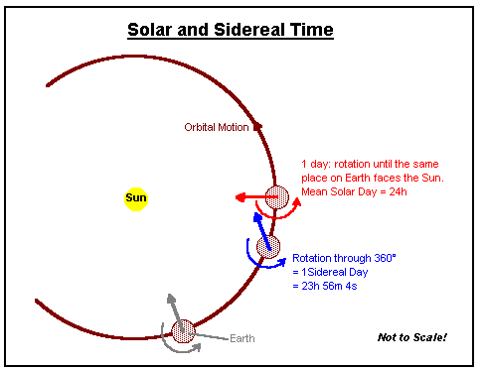
The sidereal year is the period of revolution of the sun in the ecliptic with reference to any point of the ecliptic.
Its durations about 365.2564 mean solar days.

Slide 7
The tropical year is the interval between two successive passages of the sun through the first point of Aries ɣ.

Slide 8
The tropical year is the interval between two successive passages of the sun through the first point of Aries ɣ.
Due to the phenomenon called
precession

Slide 9
The tropical year is the interval between two successive passages of the sun through the first point of Aries ɣ.
Due to the phenomenon called
precession*(Retrograde motion is the
apparent motion of a planet in a
direction opposite to that of other bodies
within its system),

Slide 10
The tropical year is the interval between two successive passages of the sun through the first point of Aries ɣ.
Due to the phenomenon called
precession*(Retrograde motion is the
apparent motion of a planet in a
direction opposite to that of other bodies
within its system), ɣ undergoes a small
retrograde motion of about 50’’.26 per
year along the ecliptic.

Slide 11
The tropical year is the interval between two successive passages of the sun through the first point of Aries ɣ.
Due to the phenomenon called
precession*(Retrograde motion is the
apparent motion of a planet in a
direction opposite to that of other bodies
within its system), ɣ undergoes a small
retrograde motion of about 50’’.26 per
year along the ecliptic.
Therefore the duration of a tropical year
is slightly less than a sidereal year.

Slide 12
The tropical year is the interval between two successive passages of the sun through the first point of Aries ɣ.
Due to the phenomenon called
precession*(Retrograde motion is the
apparent motion of a planet in a
direction opposite to that of other bodies
within its system), ɣ undergoes a small
retrograde motion of about 50’’.26 per
year along the ecliptic.
Therefore the duration of a tropical year
is slightly less than a sidereal year.
It is about 365.2422 mean solar days.

Slide 13
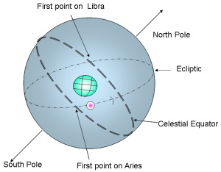
The tropical year is the interval between two successive passages of the sun through the first point of Aries ɣ.
Due to the phenomenon called
precession*(Retrograde motion is the
apparent motion of a planet in a
direction opposite to that of other bodies
within its system), ɣ undergoes a small
retrograde motion of about 50’’.26 per
year along the ecliptic.
Therefore the duration of a tropical year
is slightly less than a sidereal year.
It is about 365.2422 mean solar days.

Slide 14
3. The anomalistic year is the interval between two successive passages of the sun through the perigee of its apparent orbit.

Slide 15
3. The anomalistic year is the interval between two successive passages of the sun through the perigee of its apparent orbit.
As the perigee has a slow forward motion of about 11”.25 per year ,the anomalistic year is slightly longer than a sidereal year.

Slide 16
3. The anomalistic year is the interval between two successive passages of the sun through the perigee of its apparent orbit.
As the perigee has a slow forward motion of about 11”.25 per year ,the anomalistic year is slightly longer than a sidereal year.
Its duration is about 365.2596 mean solar days.

Slide 17
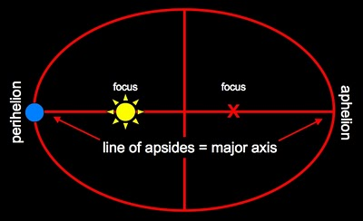
3. The anomalistic year is the interval between two successive passages of the sun through the perigee of its apparent orbit.
As the perigee has a slow forward motion of about 11”.25 per year ,the anomalistic year is slightly longer than a sidereal year.
Its duration is about 365.2596 mean solar days.

Slide 18
Civil year, Julian Calendar

Slide 19
Civil year, Julian Calendar
None of the three years mentioned above could be used conveniently for ordinary civil purposes as they involve fractions of a day.

Slide 20
Civil year, Julian Calendar
None of the three years mentioned above could be used conveniently for ordinary civil purposes as they involve fractions of a day.
To avoid this inconvenience the civil year is introduced.

Slide 21
Civil year, Julian Calendar
None of the three years mentioned above could be used conveniently for ordinary civil purposes as they involve fractions of a day.
To avoid this inconvenience the civil year is introduced.
The basis for the civil year is a tropical year and as such the seasons fall at fixed months of the year.

Slide 22
Civil year, Julian Calendar
None of the three years mentioned above could be used conveniently for ordinary civil purposes as they involve fractions of a day.
To avoid this inconvenience the civil year is introduced.
The basis for the civil year is a tropical year and as such the seasons fall at fixed months of the year.
The civil year consists of 365 mean solar days for three consecutive years followed by a fourth year of 366 days called leap year.

Slide 23
Civil year, Julian Calendar
None of the three years mentioned above could be used conveniently for ordinary civil purposes as they involve fractions of a day.
To avoid this inconvenience the civil year is introduced.
The basis for the civil year is a tropical year and as such the seasons fall at fixed months of the year.
The civil year consists of 365 mean solar days for three consecutive years followed by a fourth year of 366 days called leap year.
This system of Reckoning(calculating or estimating) time is due to the Roman Emperor Julius Caesar.

Slide 24
Civil year, Julian Calendar
He introduced this system in the year B.C.45.

Slide 25
Civil year, Julian Calendar
He introduced this system in the year B.C.45.
The calendar constructed on these principles is called the Julian calendar.

Slide 26
Civil year, Julian Calendar
He introduced this system in the year B.C.45.
The calendar constructed on these principles is called the Julian calendar.
According to the Julian calendar, for a leap year, the number denoting the year is a multiple of 4.

Slide 27
Gregorian Calendar

Slide 28
Gregorian Calendar
According to the Julian calendar four civil years exceed four tropical years by about 44m.56.08s.

Slide 29
Gregorian Calendar
According to the Julian calendar four civil years exceed four tropical years by about 44m.56.08s.
That is 400 civil years exceed 400 tropical years by about 3 days 2 hours 53 minutes 20 seconds.

Slide 30
Gregorian Calendar
According to the Julian calendar four civil years exceed four tropical years by about 44m.56.08s.
That is 400 civil years exceed 400 tropical years by about 3 days 2 hours 53 minutes 20 seconds.
It is essential that this difference must be compensated, otherwise the civil year won’t mark the recurrence of seasons(Spring,Summer,Autumn and Winter) in the long run.

Slide 31
Gregorian Calendar
According to the Julian calendar four civil years exceed four tropical years by about 44m.56.08s.
That is 400 civil years exceed 400 tropical years by about 3 days 2 hours 53 minutes 20 seconds.
It is essential that this difference must be compensated, otherwise the civil year won’t mark the recurrence of seasons(Spring,Summer,Autumn and Winter) in the long run.
Therefore in the year 1582 A.D., Pope Gregory XIII introduced a correction to the Julian Calendar. According to him a year whose number is a multiple of 100 is not a leap year unless the number denoting the century is a multiple of 4.

Slide 32
Gregorian Calendar
According to the Julian calendar four civil years exceed four tropical years by about 44m.56.08s.
That is 400 civil years exceed 400 tropical years by about 3 days 2 hours 53 minutes 20 seconds.
It is essential that this difference must be compensated, otherwise the civil year won’t mark the recurrence of seasons(Spring,Summer,Autumn and Winter) in the long run.
Therefore in the year 1582 A.D., Pope Gregory XIII introduced a correction to the Julian Calendar. According to him a year whose number is a multiple of 100 is not a leap year unless the number denoting the century is a multiple of 4.
The calendar constructed on this principle is called the Gregorian Calendar.

Slide 33
Gregorian Calendar
This calendar is now in force. According to this calendar 1900 A.D, is not a leap year whereas 2000 AD is a leap year.

Slide 34
Gregorian Calendar
This calendar is now in force. According to this calendar 1900 A.D, is not a leap year whereas 2000 AD is a leap year.
Even the Gregorian system of reckoning time is not prefect for according to this, 4000 civil years exceed 4000 tropical years by about 1 day 4 hours and 55 minutes. This requires further correction.

Slide 35
Julian date

Slide 36
Julian date
The Julian date has no connection with Julius Caesar.

Slide 37
Julian date
The Julian date has no connection with Julius Caesar.
In the year 1582 A.D, Joseph Scaliger introduced a new mode of reckoning time for the purpose of astronomical calculations. He called after his father’s name Julius.

Slide 38
Julian date
The Julian date has no connection with Julius Caesar.
In the year 1582 A.D, Joseph Scaliger introduced a new mode of reckoning time for the purpose of astronomical calculations. He called after his father’s name Julius.
The starting point or epoch for the system is the mean noon of Jan.1, 4713 B.C.

Slide 39
Julian date
The Julian date has no connection with Julius Caesar.
In the year 1582 A.D, Joseph Scaliger introduced a new mode of reckoning time for the purpose of astronomical calculations. He called after his father’s name Julius.
The starting point or epoch for the system is the mean noon of Jan.1, 4713 B.C.
The Julian date on any given day is the number of mean solar days that have elapsed since Jan.1, 4713 B.C.

Slide 40
Julian date
The Julian date has no connection with Julius Caesar.
In the year 1582 A.D, Joseph Scaliger introduced a new mode of reckoning time for the purpose of astronomical calculations. He called after his father’s name Julius.
The starting point or epoch for the system is the mean noon of Jan.1, 4713 B.C.
The Julian date on any given day is the number of mean solar days that have elapsed since Jan.1, 4713 B.C.
The Nautical Almanac (An almanac (also spelled almanack and almanach) is an annual publication that includes information such as weather forecasts, farmers' planting dates, tide tables, and tabular information often arranged according to the calendar)gives the Julian date for every day of the year.

Slide 41
Julian date
The day of the week corresponding to a given Julian date can be found by dividing the J.D. by 7.

Slide 42
Julian date
The day of the week corresponding to a given Julian date can be found by dividing the J.D. by 7.
The remainder 0 gives Monday.
1 gives Tuesday.
2 gives Wednesday and so on.

Slide 43
Julian date
The day of the week corresponding to a given Julian date can be found by dividing the J.D. by 7.
The remainder 0 gives Monday.
1 gives Tuesday.
2 gives Wednesday and so on.
The Julian dates are very useful for recording the dates of eclipses.

Slide 44
Julian date
The day of the week corresponding to a given Julian date can be found by dividing the J.D. by 7.
The remainder 0 gives Monday.
1 gives Tuesday.
2 gives Wednesday and so on.
The Julian dates are very useful for recording the dates of eclipses.
If the Julian date of occurrence of an eclipse be x , an eclipse of the same kind occurs on the Julian date x+6585*.

Slide 45
Julian date
The day of the week corresponding to a given Julian date can be found by dividing the J.D. by 7.
The remainder 0 gives Monday.
1 gives Tuesday.
2 gives Wednesday and so on.
The Julian dates are very useful for recording the dates of eclipses.
If the Julian date of occurrence of an eclipse be x , an eclipse of the same kind occurs on the Julian date x+6585*.
Julian dates are also used for observations related to variable stars.

