Slide 1
Science and Technology in China
Far east, China had high level of cultural and technical development
China civilisation occurred by 1000 BC and attained supreme development
China’s Greatest contributions important to the world civilization.
Chinese conducted systematic observations and investigations on astronomy, medicine and other natural sciences.
They developed indigenous technology in iorn-casting, block-printing, paper, gunpowder, magnetic instrument.
Their inventions adopted by the Europeans.

Slide 2
Astronomy
Chinese emperors encouraged to mathematicians to study astronomical truths.
Believed that knowledge of astronomy gave power over man and nature
Royal Astronomers used astronomical measurements and calculations which served as the basic for the preparation of almanacs.
Almanac determined the duration of the month, dates and equal length of day and night in all seasons.
Earlier Astronomer had problem with calculating the length of the solar year.
Based on their observation of cycle of seasons they calculated as 366 days for a year.
Finally they concluded that 365 ¼ days for a year in 4th c. B.C.
Calculated the 12 months based on the position of the polestar.

Slide 3
Chinese astronomer calculated the time by the shadow of a fixed special stone pillar about eight feet height.
Position of the shadow of the stone pillar to find out the arrival of summer.
Absorbed the moments of the stars
Hsien, eminent astronomer considered as the first Chinese Star mapper.
He prepared the star map of the universe.

Slide 4
Armillary Sphere
Important invention to astronomy of China
by Shou- Chang, in 1st Century A.D
Invented during the period of Han Dynasty (206 BC-220 BC)
It was the fundamental tool
This instrument used for the draw imaginary circle which dividing the sky for the measurement and map making.

Slide 5
Alchemy
Alchemy major work of the Chinese
Main aim: discovery of an internal medicine to attain immortality.
Chinese gave main contribution towards in the field of pharmacology.
‘Ts’ and T’ung Ch’I’ – important Archemical work written during the period of Han dynasty.
It was the laboratory manual in the field of alchemy.
‘Pao P’u Tzu’ written in 4th century A.D
Contains the alchemical purposes
Discussed the creation of gold and the preparation of the elixir (single medicine for all the deceases) to live long.

Slide 6
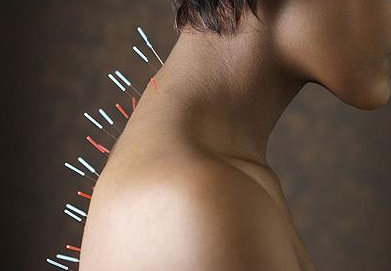
Medicine
Two forms of therapy- introduce by classical Chinese
1. Acupuncture
2. Moxibustin
Acupuncture
It is a method of encouraging the body to promote natural healing and to improve functioning.
This is done by inserting needles and applying heat or electrical stimulation at very precise acupuncture points.
It existed since the Han Dynasty in China over 2000 years ago.
Introduced in Europe in the 17th Century.

Slide 7
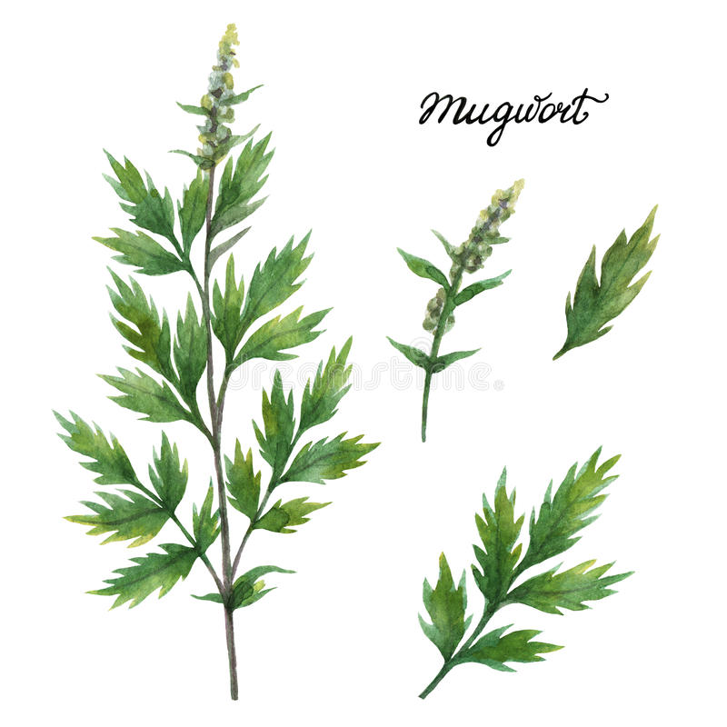
Moxibustion Therapy
Moxibustion is an ancient technique for healing all kinds of illnesses in China by using moxa or mugwort herb.
It found by philosopher Zhuangzi.
It healing and preventing from illness just by smoking specialized mugwort over specific parts of the body.
Moxa sticks wrapped in papers.

Slide 8
There are two types of using Moxa,
1. Direct Moxa (placed directly on the skin)
2. Indirect Moxa (something placed between the burning Moxa and the Skin. (slices of Ginger, Garlic, Salt, Pepper and Mud)
Burning of moxa against the skin to treat pain or illness and Fighting against Cancer, asthma
The plant, Asian Mugwort was called as Golden Grass
Traditional medical system followed in Japan, Korea, Vietnam, Tibet and Mongolia.

Slide 9
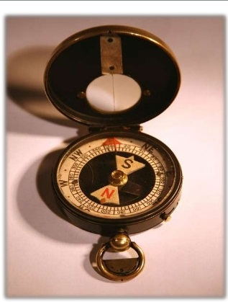
Chinese Technology
Magnetic Compass
Magnetic Compass invented during the period of Han Dynasty (206-220 C.E)
Later adopted by Song Dynasty of China during the 11th century.
Compass is an instrument used while conduct navigation which shows the direction.
It reached European countries through the Arabs by 13th century.
Later it used by Portugal, Holland and England

Slide 10
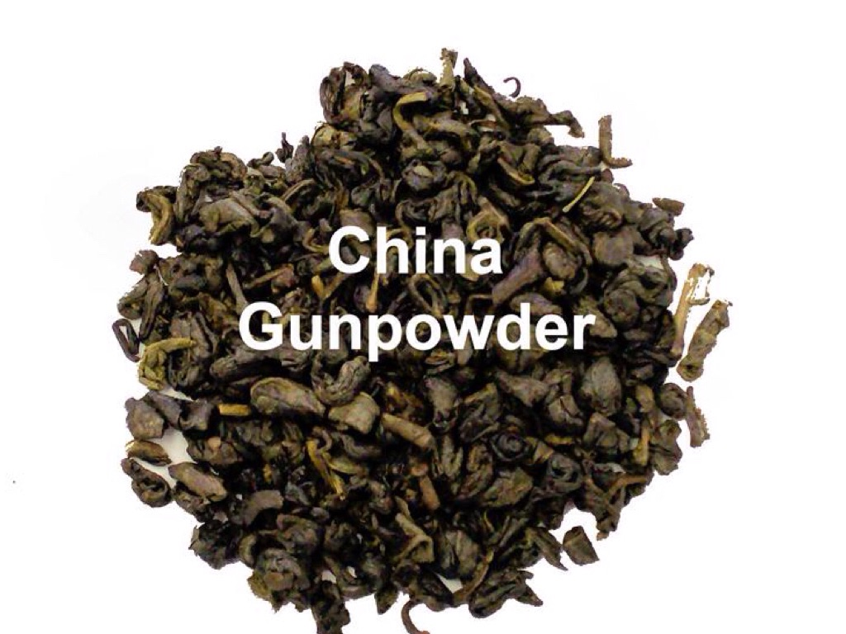
Gun Powder
Invented Gun powder in the 7th century by Chinese
Gun powder formula Potassium nitrate 75% with proper quantity of charcoal 15% and sulphur 10% to make explosives.
Art of making Gun Powder was introduced in Europe during the Mongol’s conquest of Europe in the 14th Century.

Slide 11
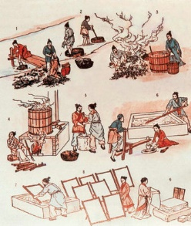
Paper Invention 105 C.E
by Chinese Eunuch Cai Lun.
Vegetable Fibres and tree bark, old rags and hemp waste were all put it together in water and settle to form a uniform layer.
It was the preparation method of a crude form of paper.
Since 2nd century onwards paper used as a substitute for the silk cloth for conveying the messages.
Later this crude form of paper strengthened with gypsum and polished.
This paper making spread to Japan and then to Korea between 280 C.E to 610 A.D.
Later paper was made from bamboo and rice straw.
In 1348 A.D Europeans began to manufacture paper.

Slide 12
Great wall of China
Three dynasties contributed to complete the construction of Great wall of China
Qin Dynasty
Han Dynasty
Ming Dynasty
Shih Huang Ti of Han Dynasty constructed the first stage of the Chinese Wall in 221 B. C.E.
Great Wall mostly built during the Ming Dynasty.
Great wall of china- about 6400km long

Slide 13
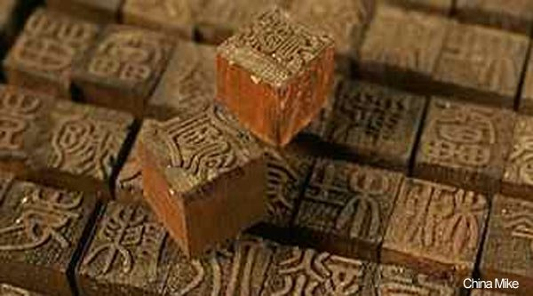
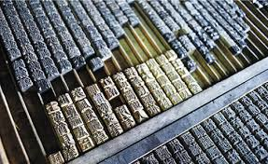
Wooden Blocks
Chinese Printing Technology
invention of printing – 8th century C.E.
Earliest method of Chinese printing used by wooden blocks.
Chinese invented a way of using cut woodblocks to print text on paper. between 704 and 751 C.E
During the period of Tang Dynasty, the invention of printing on paper occurred.
Chinese printed copies of works of Confucius, poetry, Buddhist teaching.
by the 11th century Chinese first invented movable type printing.
Moveable printing type

