Slide 1
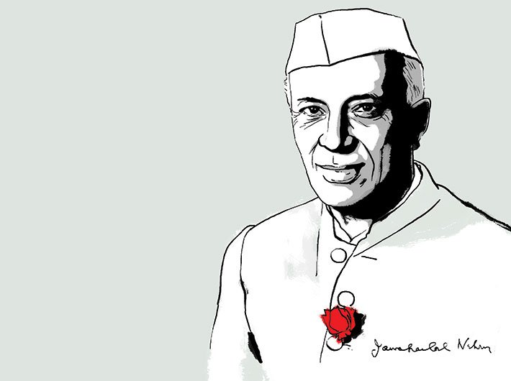
Understanding Jawaharlal Nehru(1889–1964) and his policies

Slide 2
Jawaharlal Nehru, was a leader of India’s nationalist movement and became India’s first prime minister after its independence.
In 1919, he joined the Indian National Congress and joined Indian Nationalist Movements.
He was to serve a total of nine sentences, adding up to more than nine years in jail.
Became first Prime Minister of Independent India.
Nehru's four pillars of domestic policies were democracy, socialism, unity, and secularism

Slide 3
Domestic Policy
He imparted modern values and thought, stressed secularism, insisted upon the basic unity of India.
In the face of ethnic and religious diversity, he carried India into the modern age of scientific innovation and technological progress.
He prompted social concern for the marginalized and poor and respect for democratic values.
Nehru reform the antiquated Hindu civil code.
Hindu widows could enjoy equality with men in matters of inheritance and property.
Nehru changed Hindu law to criminalize caste discrimination.
Established many Indian institutions of higher learning, including the All India Institute of Medical Sciences, the Indian Institutes of Technology, and the National Institutes of Technology,
Guaranteed free and compulsory primary education to all of India's children.

Slide 4
Economic Reforms of Nehru
Firm believer in state control over the economic sectors.
His socialist ideals revealed themselves in the way he introduced laws for land redistribution, in order to curtail the economic disparity in India among the landed and the land-less classes.
His Economic policy considered to be Socialist in nature.
Key economic reforms was the introduction of the Five Years Plan in 1951.
It was introduce to determine the mode of government expenditure and grants in important development sectors like agriculture, industries and education.

Slide 5
Nehru's Industrial Policies:
Nehru was intent to harness and fully exploit the natural resources of India for the benefit of his countrymen.
The main sector he identified was hydroelectricity.
He constructed a number of dams to achieve that end.
The dams would not only harness energy, but would also support irrigation to a great degree.
Nehru considered dams to be the very symbol of India's collective growth, as they were the platforms where industrial engineering and agriculture met on a common platform.

Slide 6
Nehru's Foreign Policy
Jawaharlal Nehru was supporter of the anti-imperialist policy.
He extended his support for the independence of small and colonized nations of the world.
One of the prominent architects of the Non-Aligment Movement (NAM)
NAM was formed during the Cold War, largely on the initiative of then-Yugoslav President Josip Broz Tito
The basic concept for the group originated in 1955 during discussions that took place at the Asia-Africa Bandung Conference held in Indonesia.
NAM has sought to "create an independent path in world politics that would not result in member States becoming pawns in the struggles between the major powers."
Man behind the design of India’ s Foreign Policy

Slide 7
Panchsheel , or the Five Principles of Peaceful Co-existence, were first formally enunciated in the Agreement on Trade and Intercourse between the Tibet region of China and India signed on April 29,1954, Agreement based on the following principles: -
Mutual respect for each other’s territorial integrity and sovereignty,
Mutual non-aggression
Mutual non-interference,
Equality and mutual benefit, and
Peaceful co-existence.

Slide 8
Sino-Indian War of 1962
Roots of the Sino-Indian conflict in 1962
The Indian Government had granted asylum to Dalai Lama after his banishment following the Tibet uprising in 1959 and it irked China.
Boundary disputes over the MacMohan Line in Arunachal Pradesh and Aksai Chin area in Ladakh, on the 3,225-kilometre-long disputed border issue.
Nehru and his Chinese counterpart, Premiere Zhou Enlai were unable to reach a political accord.
They captured Rezang la in Chushul and Tawang in Arunachal Pradesh- started on October 20- ended November 20, 1962

