Slide 1
MERCANTILE THEORY
Mercantilism: is an economic policy…Wealth is power, key to wealth is export more than import
European countries competed for world power and needed colonies to provide necessary raw materials.
Colonies’ role: provide raw materials (so mother country does not have to import from other nations) and markets for exports
  Favorable balance of trade for England

Slide 2
MERCANTILE THEORY
European nations relied on strong central governments to enforce mercantile doctrines
Americans helped British maintain naval supremacy by providing wood for ships, ships’ stores, sailors, trade (enumerated commodities- goods that can only be traded to Britain)
Americans provide profitable market for English manufactured goods
Americans discouraged from buying these goods from other countries

Slide 3
MERCANTILE THEORY
Most famous of laws to enforce mercantilism were the Navigation Laws (1650)
  Restricted trade to English vessels (no Dutch)
Additional laws: Goods bound for colonies had to go to England first for duties
Colonists also not allowed to manufacture certain products to not compete with British

Slide 4
The Navigation Acts 1650
Was it reasonable for England to pass laws such as these to control Colonial trade?
It was difficult for Great Britain to enforce these laws because of the distance.
Colonists broke the law and smuggled and traded with other countries.
No country could trade with the colonies unless the goods were shipped in either colonial or English ships.
All vessels had to be operated by crews that were at least three-quarters English or colonial
The colonies could export certain products only to England
Almost all goods traded between the colonies and Europe first had to pass through an English port.

Slide 5
MERCANTILE THEORY
Advantages of mercantilism
VA/MD tobacco farmers guaranteed monopoly on English market.
Rights of Englishmen, but some self-government, no taxes to support army/navy to protect them
Until 1763, Navigation Laws were
not a burden because laxly enforced (salutary neglect)
Merchants disregarded or evaded restrictions, some got rich by smuggling (e.g. John Hancock)
Average American better off economically than average English

Slide 6
MERCANTILE THEORY
Disadvantages of mercantilism
Mercantilism stifled economic initiative due to lack of freedom
South favored due to Tobacco, sugar and rice
Parliament set up a Board of Trade with Admiralty Courts. Took away the right of trial by jury and were considered guilty until proven innocent.
Most important, mercantilism was insulting: colonies felt they were being milked like cows, kept in economic adolescence
British failed to see an emerging nation

Slide 7
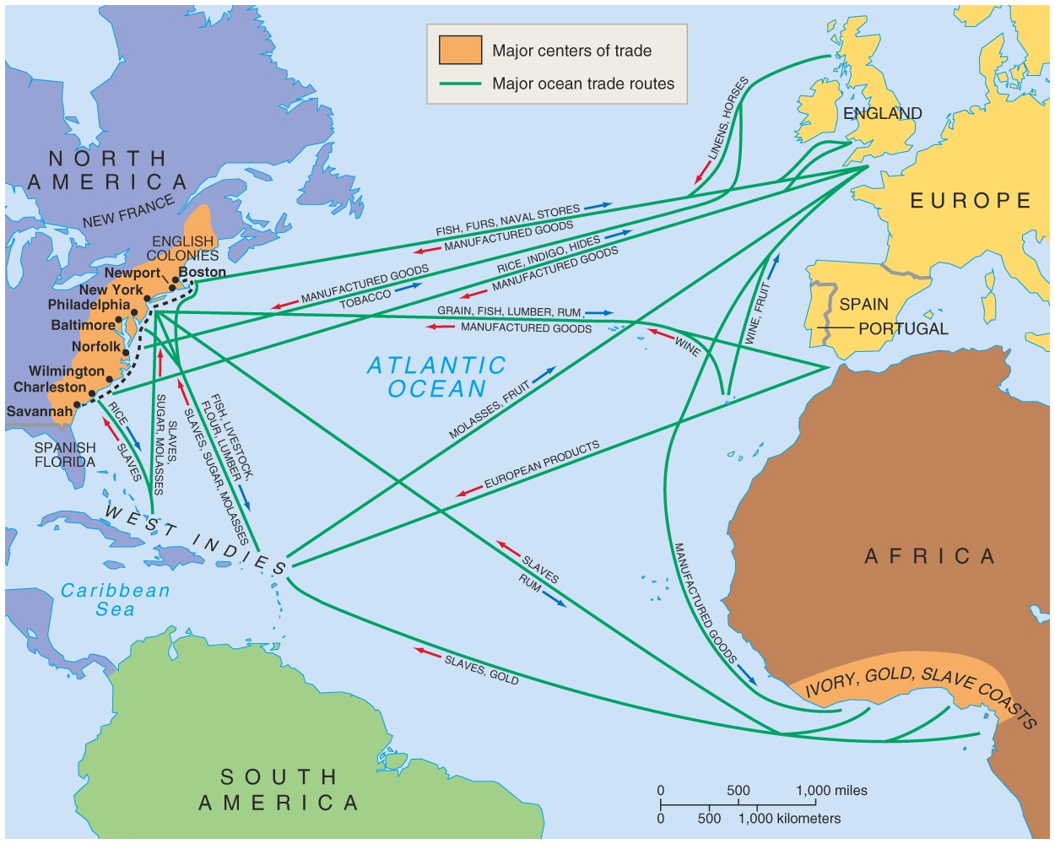
Trade
Enumerated Commodities
Lumber
Tobacco
Rice
Indigo
Furs
Sugar
To England

Slide 8
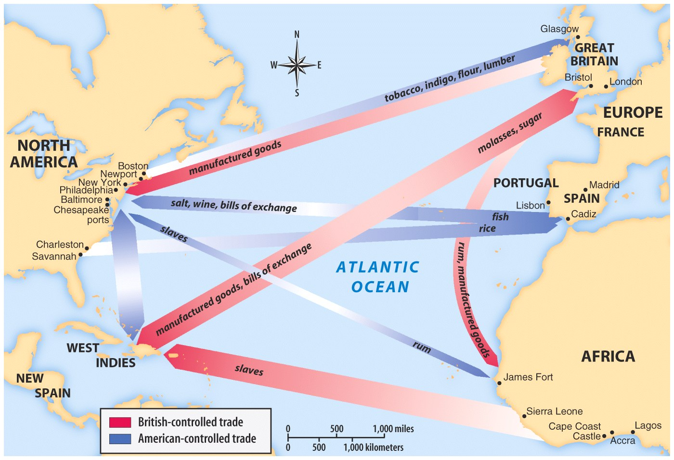
Manufactured Goods
Furniture
Clothing
Colonials had
not factories.
From England to Colonies

Slide 9
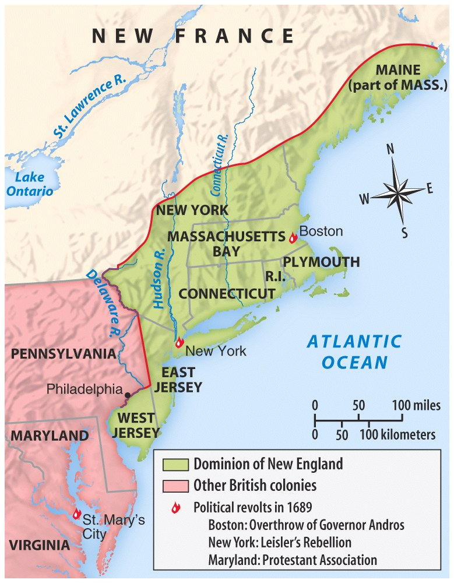
DOMINION OF NEW ENGLAND
Forced by King James II
NE Colonies, NJ & NY
Goals
Restrict Colonial trade
Defend Colonies
Stop Colonial smuggling
Sir Edmund Andros
Gain control over Colonies
Eliminated town meetings, the press and schools
Taxed without the consent of the governed
Collapsed after Glorious Revolution

Slide 10
Free Enterprise
Four components of Free Enterprise & Economic Freedom:
• Private Property rights are respected.
• Voluntary Exchange – individuals come to an agreement on a price for goods. Ex. You have
a dozen eggs. I have 10 dollars. I decide it is worth it to spend two dollars on eggs. You
decide you would prefer to have the two dollars than the dozen eggs.
• Profit Motive – You are motivated by profit to produce goods that people will buy. Ex. If you
produce goods that people don’t want you will not be able to sell your goods. If the goods are
inferior, people will stop buying your goods. Therefore, you must produce a quality product if
you want people to continue to buy your goods.
• Supply and Demand – there are a limited number of goods available. As the price goes up
fewer people are willing to purchase your goods. Demand goes down. As the price of goods
go down more people will want to purchase your goods. Demand goes up.
The lower the supply of goods there are available the higher prices will go. The higher the
supply of goods are available the lower prices will go.
Specialization – becoming an expert in one economic activity. Example: You become an expert at
making furniture. You make furniture and sell your products in order to buy products from others who
have specialized.
In a Free Enterprise economy, government makes relatively few decisions or regulations on what,
how, how much, and for whom is produced. The more production is regulated, the less “free” the
market.

