Slide 1
Indian Constitution
Methods to be adopted for preparation

Slide 2
Methods
LRWS Method
Map method
Mind Map
Flow chart method
ICT Method
Discussion/Analytical Method
Field Study

Slide 3
LRWS Method
    Listening
    Reading
    Writing
    Speaking

Slide 4
Map method

Slide 5
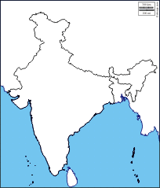
India (outline)

Slide 6
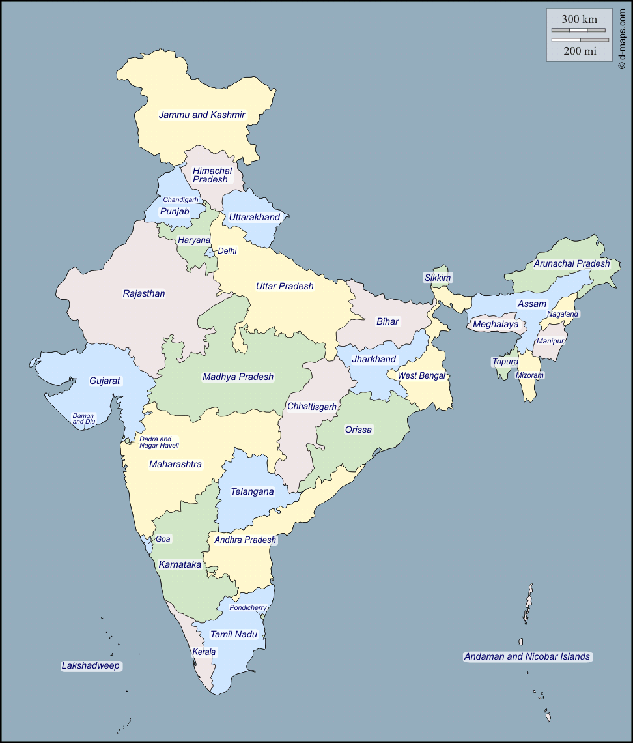

Slide 7
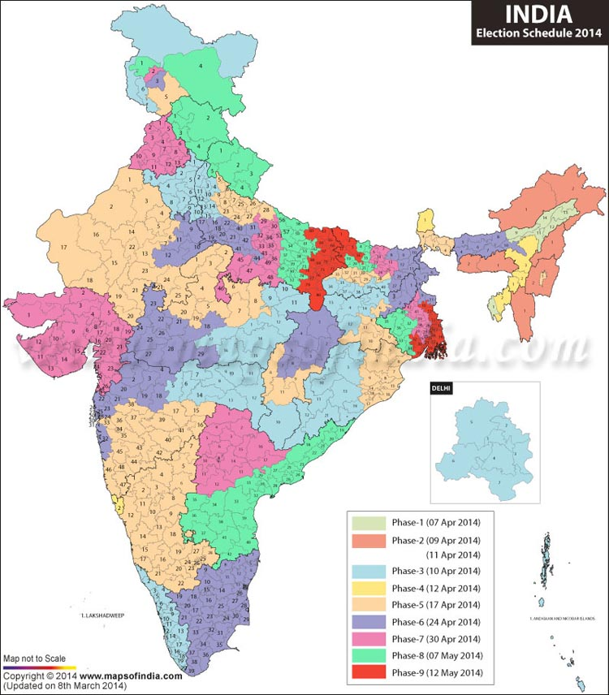

Slide 8
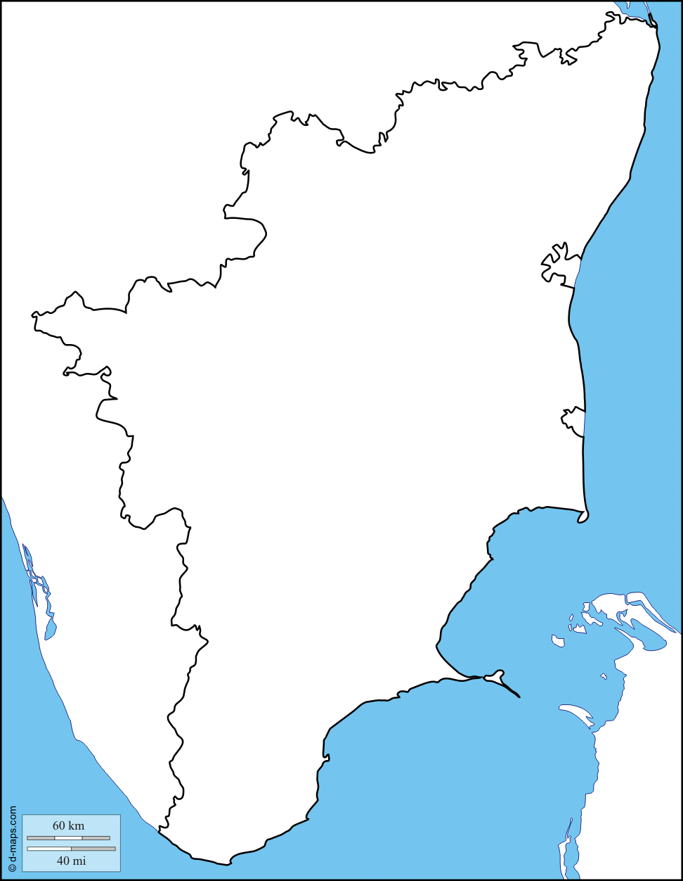
Tamil Nadu

Slide 9
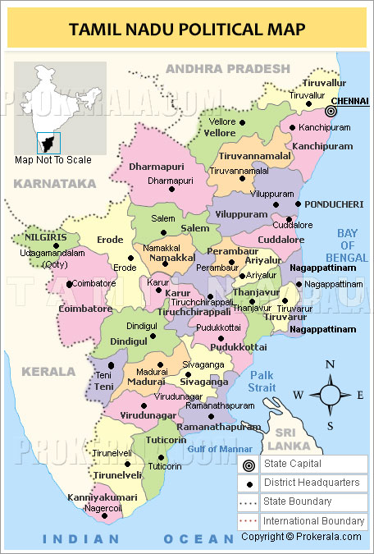

Slide 10
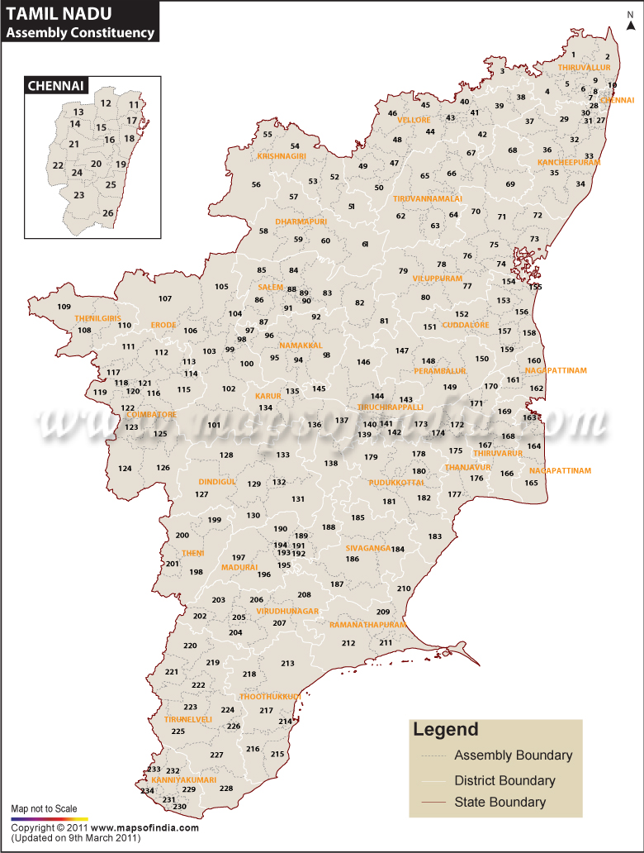

Slide 11
Mind Map

Slide 12
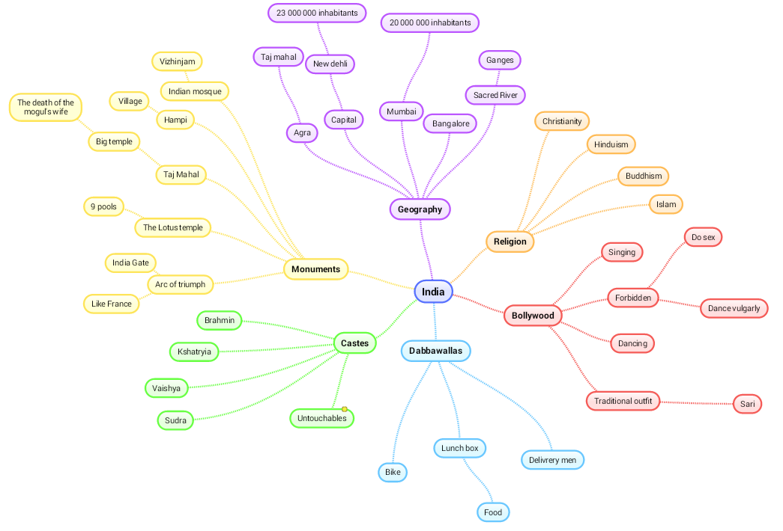

Slide 13
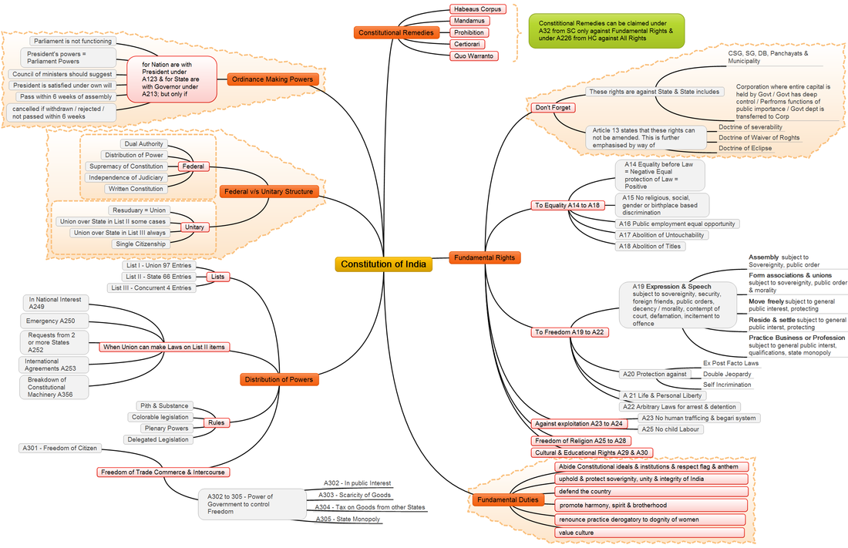

Slide 14
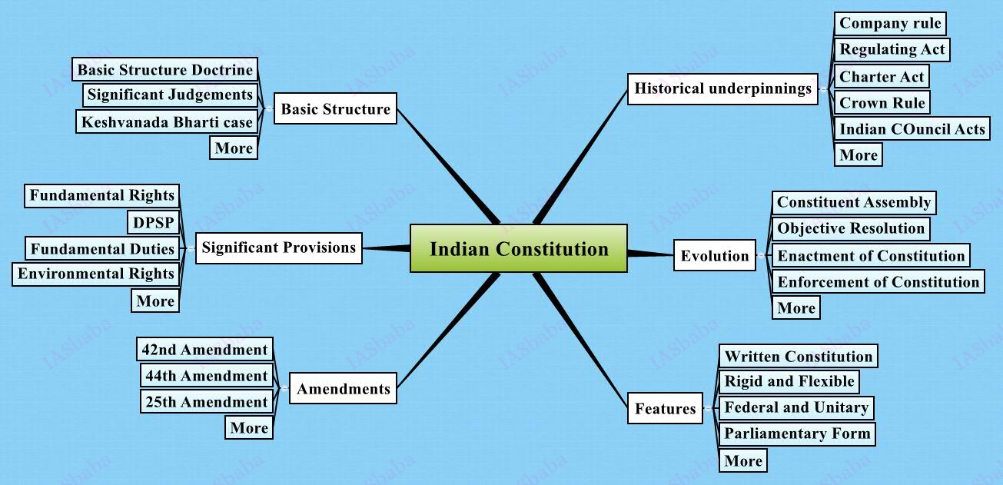

Slide 15
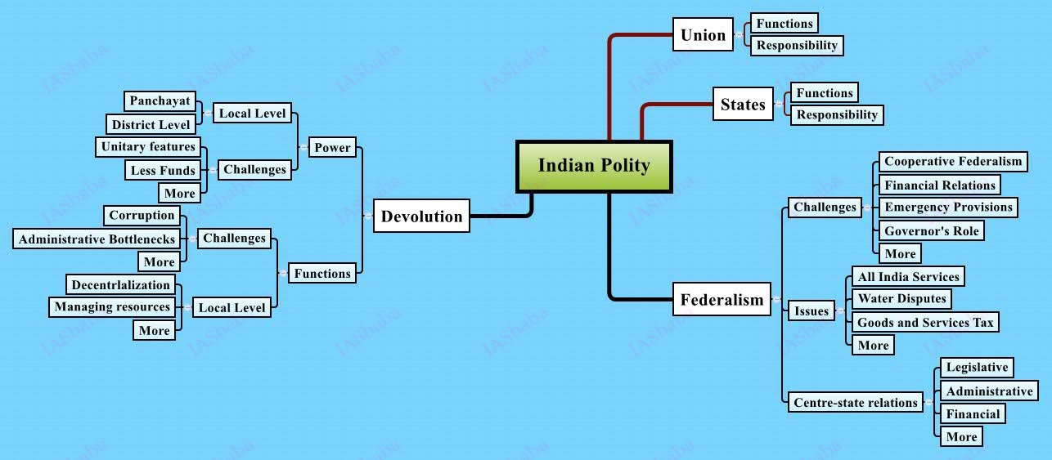

Slide 16
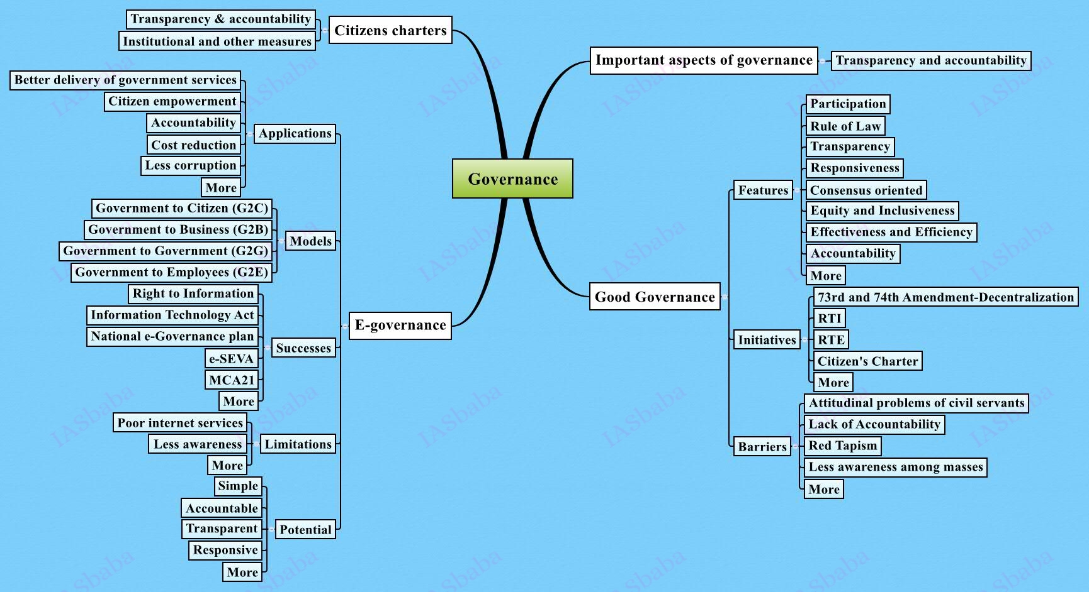

Slide 17
Flow chart method

Slide 18
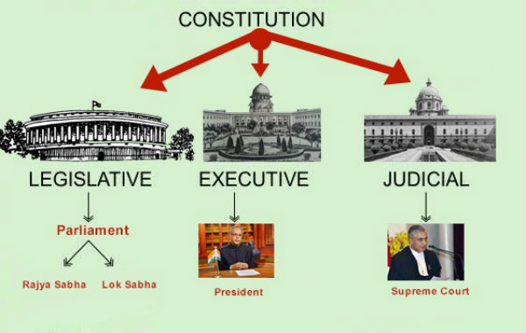

Slide 19
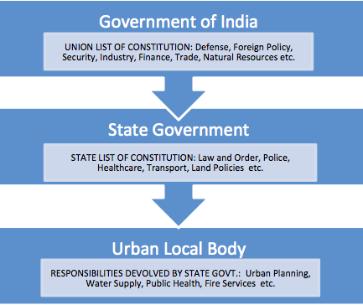

Slide 20
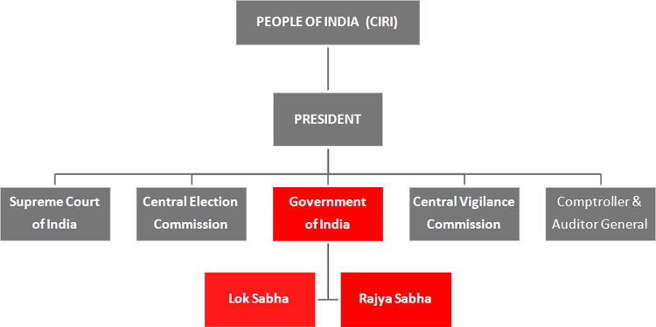

Slide 21
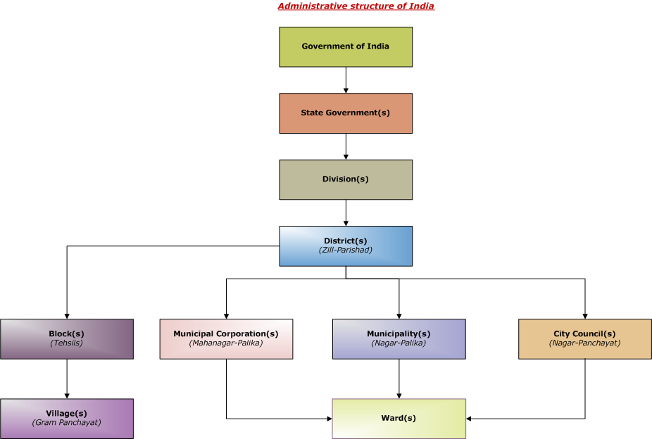

Slide 22
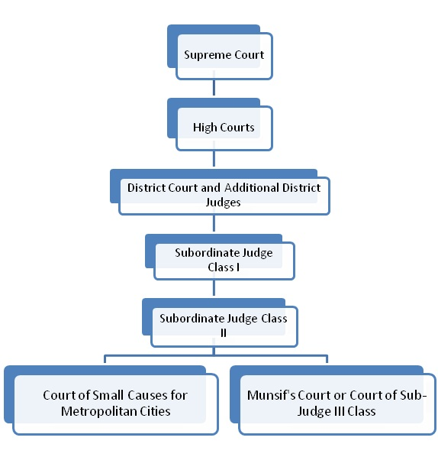

Slide 23
ICT Method
Pictures
Audio
Video

Slide 24


Slide 25
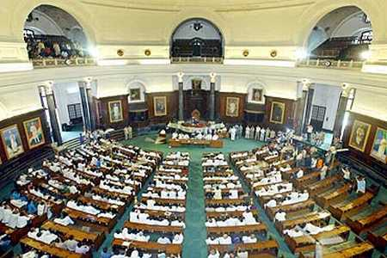
Lok Sabha

Slide 26
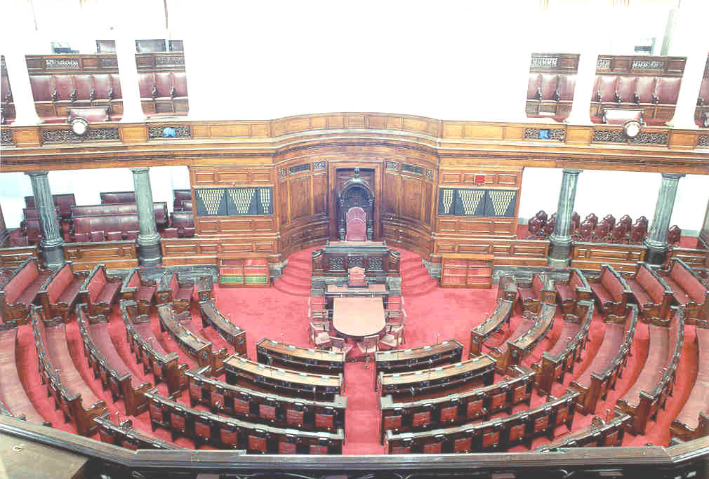
Rajya Sabha

Slide 27
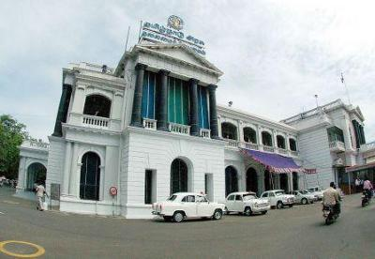

Slide 28
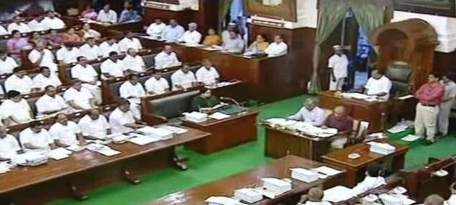

Slide 29
Audio

Slide 30
Video

Slide 31
Analytical Method

Slide 32
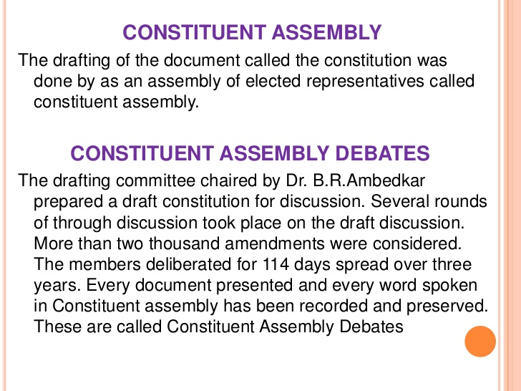

Slide 33


Slide 34
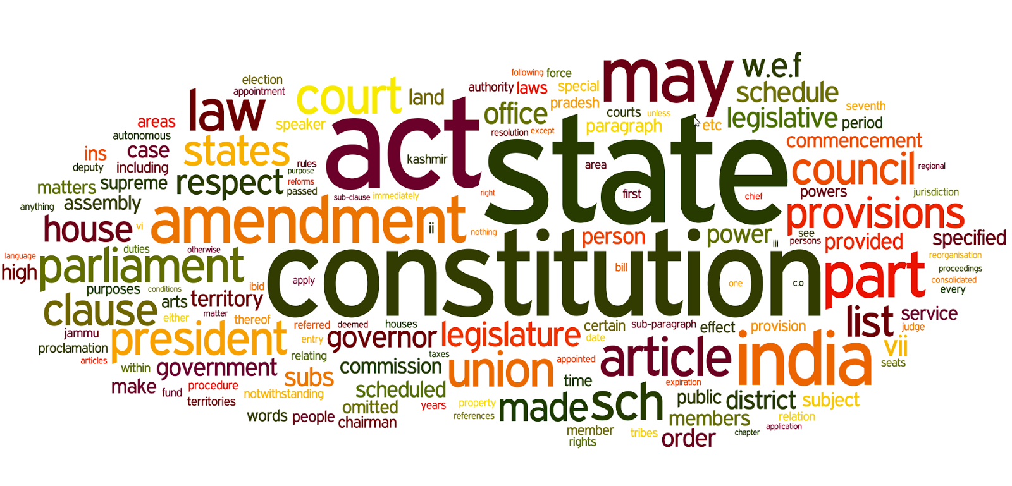

Slide 35
Field Study

