Slide 1
History of Human Rights
An inscription of the Code of Hammurabi

Slide 2
The reforms of Urukagina of Lagash, the earliest known legal code (2350 BC)
was no reformer at all.
to curb the encroachment of a secular authority at the expense of temple prerogatives
The oldest legal codex extant today is the Neo-Sumerian Code of Ur-Nammu (ca. 2050 BC)
Mesopotamia, including the Code of Hammurabi (ca. 1780 BC).

Slide 3
the most famous examples of this type of document.
It shows rules, and punishments
including women's rights, men's rights, children's rights and slave rights.

Slide 4
The Cyrus Cylinder of Cyrus the Great, founder of the Achaemenid Persian Empire

Slide 5
Achaemenid Persian Empire of ancient Iran established unprecedented principles of human rights in the 6th century BC under Cyrus the Great.
After his conquest of Babylon in 539 BC, the king issued the Cyrus cylinder, discovered in 1879 and seen by some today as the first human rights document.
Books of Chronicles, Nehemiah, and Ezra, which state that Cyrus allowed (at least some of) the Jews to return to their homeland from their Babylonian Captivity.

Slide 6
the Cylinder as a "charter of human rights“
The cylinder now lies in the British Museum.

Slide 7
Citizenship beginning in ancient Greece, where all citizens had the right to speak and vote in the political assembly.
The Twelve Tables Law established the principle "Privilegia ne irroganto", which literally means "privileges shall not be imposed".
A declaration for religious tolerance on an egalitarian basis can be found in the Edicts of Ashoka,

Slide 8
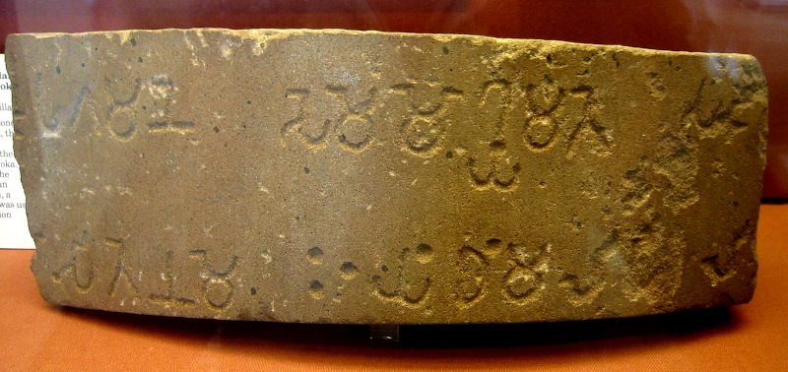
Edict of Ashoka
6th Pillar Edicts
of Ashoka- described
Moral Behaviour

Slide 9
The slaughter or capture of prisoners of war was also condemned by Ashoka.
the Sanskrit Laws of Manu of the 1st century BC

Slide 10
Muhammad preached against what he saw as the social evils of his day.
Islamic social reforms in areas such as social security, family structure, slavery, and the rights of women and ethnic minorities, female infanticide, exploitation of the poor, murder, false contracts, and theft.
Mosaic laws and customs of the time into his divine revelations.

Slide 11
Constitution of Medina, also known as the Charter of Medina, was drafted by Muhammad in 622.
Middle Ages
Magna Carta is an English charter originally issued in 1215 which influenced the development of the common law and many later constitutional documents, such as the United States Constitution and the Bill of Rights.

Slide 12
Magna Carta was originally written because of disagreements amongst Pope Innocent III, King John and the English barons about the rights of the King.
habeas corpus,
No Freeman shall be taken or imprisoned, or be disseised of his Freehold, or Liberties, or free Customs, or be outlawed, or exiled, or any other wise destroyed; nor will We not pass upon him, nor condemn him, but by lawful judgment of his Peers, or by the Law of the Land. We will sell to no man, we will not deny or defer to any man either Justice or Right.
”
— Clause XXIX of the Magna Carta (clauses 36, 38, 39, and 40 of the 1215 )

Slide 13
Magna Carta (British Library Cotton MS Augustus II-1215 AD)

Slide 14
Modern human rights movement
Age of Discovery, early modern period and Age of Enlightenment.
15th and 16th centuries by Spain, during the Age of Discovery, resulted in vigorous debate about human rights in Colonial Spanish America.
The sermon, known as the Christmas Sermon, gave way to further debates from 1550-51

Slide 15
U.S. Declaration of Independence ratified by the Continental Congress on July 4, 1776

Slide 16
Several 17th- and 18th-cent European philosophers, like John Locke, developed the concept of natural rights, the notion that people are naturally free and equal.
Though Locke believed natural rights were derived from divinity since humans were creations of God, his ideas were important in the development of the modern notion of rights.
in 1689, the English Bill of Rights was created which asserted some basic human rights, most famously freedom from cruel and unusual punishment

Slide 17
Novels-Julie, or the New Heloise by Jean-Jacques Rousseau and Pamela; or Virtue Rewarded by Samuel Richardson, laid a foundation for popular acceptance of human rights.
Two major revolutions occurred during the 18th century in the United States (1776) and in France (1789). The Virginia Declaration of Rights of 1776 sets up a number of fundamental rights and freedoms. The later United States Declaration of Independence

Slide 18
states "that all men are created equal, that they are endowed by their Creator with certain unalienable rights, that among these are life, liberty and the pursuit of happiness".
Similarly, the French Declaration of the Rights of Man and Citizen defines a set of individual and collective rights of the people. These are, in the document, held to be universal—not only to French citizens but to all men without exception.

Slide 19
19th century to World War I
Philosophers such as Thomas Paine, John Stuart Mill and Hegel expanded on the theme of universality during the 18th and 19th centuries.
In 1831 William Lloyd Garrison wrote in a newspaper called The Liberator that he was trying to enlist his readers in "the great cause of human rights

Slide 20
Declaration of the Rights of Man and of the Citizen approved by the National Assembly of France, August 26, 1789

Slide 21
Rights in War and the Geneva Conventions
Original Geneva Convention in 1864
Progression of Geneva Conventions from 1864 to 1949
Henry Dunant, the founder of GC
the International Committee of the Red Cross
laws of war.
4 GC were organised

Slide 22
Original Geneva Convention in 1864

Slide 23
Between World War I and World War II
The League of Nations was established in 1919 at the negotiations over the Treaty of Versailles following the end of World War I.
The League's goals included disarmament, preventing war through collective security, settling disputes between countries through negotiation, diplomacy and improving global welfare

Slide 24
"It is not a treaty...[In the future, it] may well become the international Magna Carta."[49] Eleanor Roosevelt with the Spanish text of the Universal Declaration in 1949

Slide 25
Universal Declaration of Human Rights
UDHR
declaration adopted by the United Nations General Assembly in 1948.
...recognition of the inherent dignity and of the equal and inalienable rights of all members of the human family is the foundation of freedom, justice and peace in the world
— Preamble to the Universal Declaration of Human Rights, 1948

Slide 26
The inclusion of both civil and political rights and economic, social and cultural rights.
Eleanor Roosevelt as Chair, who began to discuss an International Bill of Rights in 1947.
Later histories
Human right was included in point VII of Helsinki Accords, which was signed in 1975 by thirty-five states

Slide 27
During his inaugural speech in 1977, the 39th President of United States Jimmy Carter made human rights a pillar of United States foreign policy.
Human rights advocacy organization Amnesty International later won Nobel Peace Prize also in 1977.
won Nobel Peace Prize in 2002
human rights, and to promote economic and social development

