Slide 1
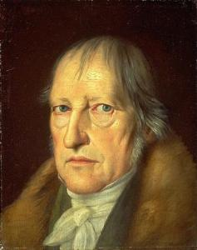
Georg Wilhelm Friedrich Hegel

Slide 2
Introduction
→ Georg Wilhelm Friedrich Hegel (1770–1831), who left his deepest mark upon the philosophy of history, is commonly regarded as the representative philosopher of German idealism in the post-Kantian era
→ He attributes the unfolding of concepts of reality in terms of the pattern of dialectical reasoning (thesis — antithesis — synthesis) that Hegel believed to be the only method of progress in human thought,

Slide 3
His Work
1.Hegel's Science of Logic, tr. by A. V. Miller (Humanity, 1998)
2. Georg Wilhelm Friedrich Hegel, Phenomenology of Spirit, tr. by A. V. Miller and J. N. Findlay (Oxford, 1979)
3. Georg Wilhelm Friedrich Hegel, Philosophy of History, tr. by J. Sibree (Dover, 1956)
4. Georg Wilhelm Friedrich Hegel, Elements of the Philosophy of Right, tr. by A. Wood and H. Nisbet (Cambridge, 1991)

Slide 4
His Contribution to Historical Research
→ Hegel’s ideas also reached the social sciences by a different channel: via the philosophy of History
→ Hegel the conception of history as the self-creation of man and the idea (first expounded by Hegel in the Phenomenology) that the prime motive force of the historical process is human labor, or the practical activity of men in society.
→ The Hegelian concept of dialectical change can be, and has been, reformulated as a description of processes whereby social organisms create their own environment and are in turn influenced by it.
→ Hegel to account for natural processes, the idea of a “dialectical” interrelationship between man and his environment is clearly of general application, and it may be that the long-run Hegel’s philosophy for the social sciences will be found to lie in this kind of approach

