Slide 1
Flora in India
Get enchanted by the rich diversity of India flora on your Eco tour to India.
Indian flora is one of the most pristine in the whole world
Due to the wide range of climatic conditions, India holds rich variety of flora that no other country can boost of.
India covers more than 45,000 species of flora, out of which there are several species that are not found anywhere else.
Since ancient times, use of plants as a source of medicines has been the inherent part of life in India.

Slide 2
There are more than 3000 officially documented plants in India that holds great medicinal potential.
India comprises of seven percent of world's flora.
Indiais divided into main eight floristic regions namely –
  Western Himalayas,
  Eastern Himalayas, Assam,
  Indus plain, Ganga plain,
  the Deccan, the Malabar and the Andamans.

Slide 3
Trees
India is a home to large variety of trees that grows fast and are mostly evergreen.
Trees in India holds the great religious and cultural importance.
Tree worship is still the element of modern Indian traditions.
There are many trees which are considered as sacred in India.

Slide 4
Trees have always been associated with wisdom and immorality in India.
Hindu literature describes a celestial tree as having its roots in the heaven and its branches in the underworld that unites and connects beings of every kind.
Banyan is the National Tree of India. India's medicinal are no less diverse.
Peepal, banyan (Bodhi tree), banana, and Tulsi are some of the plants that holds special cultural and religious significance in India.
Indian Rosewood, Kikar, Aleo Vera, Ashwagandha, Cork, Brahmi, Sal, Khair and Garden Asparagus are some of the popular trees grown in India.

Slide 5
Flowers in India:
India has some of the unique flower plants and is a magnet for many visitors both locally and from overseas.
No fewer than eighty percent of the Indian flower plants are endemic i.e.Occurring here and nowhere else.
Flowers in India are used on large scale in weddings, making garlands and the purpose of decorations.

Slide 6
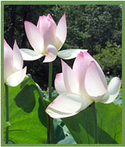

the spectacular Flowering plants found in India is Lotus
scented smell and beautiful petals of Rose

Slide 7
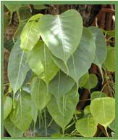

Peepal is living natural monument in India
Banyan is the National Tree of India

Slide 8
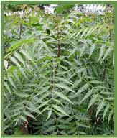

Neem tree is popularly known as the Miracle Tree
Aloe Vera is the popular herb

Slide 9
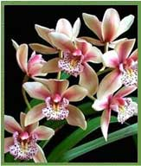
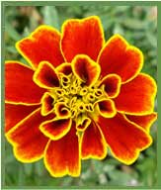
Orchids are one of the prominent plant species that cover whole of north-east India.
The Marigold Flower holds the great religious significance.

