Slide 1
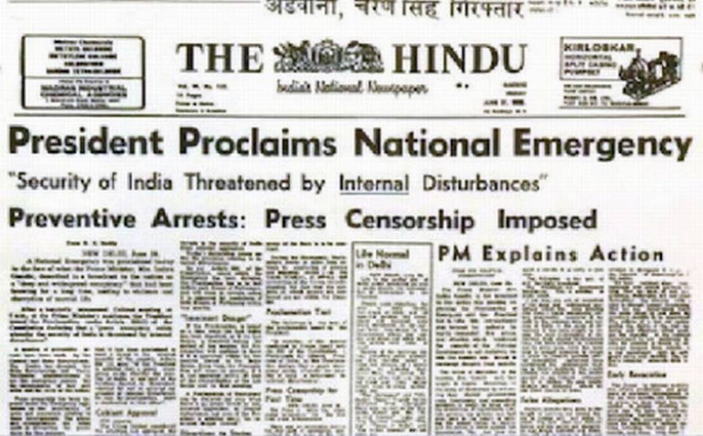
Emergency in India

Slide 2
The part 18 of Indian constitution deals with the emergency provisions
National / War Emergency: Article 352
Constitutional Emergency in States: Article 356
Financial Emergency: Article 360
First time constitutional emergency was declared in Punjab in 1952
From June 25, 1975 to March 21, 1977 were 21 months of uncertainty -imposition of internal Emergency -Prime Minister Indira Gandhi.
The Emergency was officially issued by the then President Fakhruddin Ali Ahmed.
With the suspension of the Fundamental rights, politicians who opposed Ms. Gandhi were arrested.

Slide 3
The Emergency seems to have inculcated a consciousness amongst people, who now think cautiously before breaking any law. Intentionally or unintentionally.
week after the declaration of the Emergency, Mrs Gandhi announced a 20-point economic programme
Seeks remedies for the country's short-term problems, mainly the rise in prices and slump in production.
long-term problems of agricultural production and effective distribution of essential commodities.

Slide 4
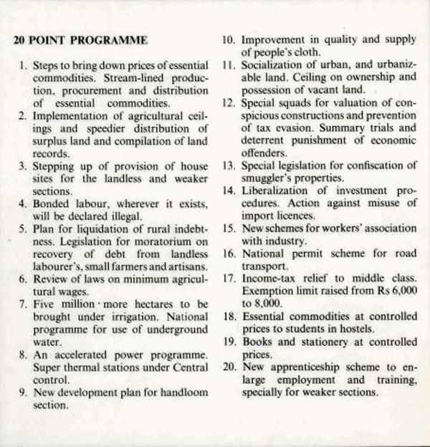

Slide 5
There has been worldwide concern about the curbs put on the press since the Emergency.
opposition who were involved in all kinds of agitations who were arrested.
The opposition was brutally oppressed.
Ramnath Goenka, the only newspaper owner who stood up to Indira Gandhi
July 1, 1975: Civil Liberties suspended and the government introduced a mandatory birth control programme.
August 4, 1975: A least 50,000 or more people had be jailed in India since the declaration of Emergency.

Slide 6
Timeline of key events during the emergency
- June 25, 1975: The then President of India Fakhruddin Ali Ahmed, upon advice by Indira Gandhi, declared a state of emergency under Article 352 of the Constitution.
July 1, 1975: Civil Liberties suspended and the government introduced a mandatory birth control programme. During the emergency, Indira Gandhi’s 20-Point programme promised to liquidate the existing debts of landless labourers, small farmers and rural artisans. The programme planned to extend alternate credit to them, abolish bonded labor and implement the existing agricultural land ceiling laws.
July 4, 1975: The Government of India banned four major religious, political and revolutionary parties and 22 associated parties with them. These parties included the Anand Marg, Rashtriya Swayamsevak Sangh, the Naxalites and the Jamaa-e-Islami-e-Hind.
July 22, 1975: The 38th Amendment barred judicial review of the emergency.
August, 1975: An amendment to the Representation of the People Act was drafted to clear Indira Gandhi from the Allahabad high court ruling of June 12th 1975.
August 4, 1975: A least 50,000 or more people had be jailed in India since the declaration of Emergency.

Slide 7
August 15, 1975: Bangladesh President Mujibar Rahaman was assassinated by Bangladeshi military leaders and this incident gave rise to new external problems in India.
September 15, 1975: Delhi High Court ruled that charges must be entered when arrested under the Internal Security Act.
September 26, 1975: The 39th Constitution Amendment stated that the election of the prime minister could not be challenged by the Supreme Court but only by a body constituted by Parliament
January 9, 1976 : The government suspends seven freedoms guaranteed by Article 19 of the Constitution of India.
February 4, 1976: Lok Sabha's life extended by one year.
November 2, 1976: Lok Sabha passes 42nd Constitution Amendment Bill making India a socialist, secular, republic and laying down the fundamental duties of citizens.
January 18, 1977 : The President dissolves Lok Sabha. General elections announced.
March 21, 1977 : Emergency withdrawn.
March 1977: Janata Party gains absolute majority in sixth Lok Sabha elections. For the first time since India gained independence in 1947, a party other than the Congress was going to govern at the Centre.
- March 24, 1977: Morarji Desai becomes the Prime Minister of India.

