Slide 1
BARRIERS TO EFFECTIVE COMMUNICATION
No matter how good the communication system - unfortunately barriers can and do often occur
Caused by a number of factors – due to physical barriers, system design faults or additional barriers

Slide 2

Physical barriers
Often due to the nature of the environment
The natural barrier which exists, if staff are located in different buildings or on different sites

Slide 3
Poor or out dated equipment
Introduce new technology, may also cause problems.
Staff shortages

Slide 4
Whilst distractions - background noise, poor lighting or an environment which is too hot or cold - affect people's morale and concentration

Slide 5
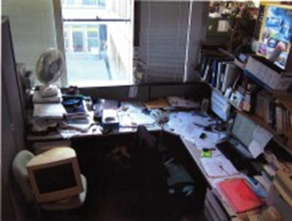
System design
Unclear structure
Inappropriate information systems
Lack of supervision or training
Lack of clarity in roles and responsibilities

Slide 6
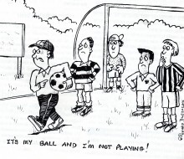
Attitudinal barriers

Slide 7
a result of problems with staff in an organisation.
These may be brought about, poor management,
lack of consultation with employees,
personality conflicts which can result in people delaying or refusing to communicate

Slide 8
the personal attitudes of individual employees which may be due to
lack of motivation or dissatisfaction at work,
insufficient training
just resistance to change due to entrenched attitudes and ideas.

Slide 9

Psychological factors

Slide 10

Personal problems like worries about their health or marriage, then this will probably affect

Slide 11

People's state of mind
We all tend to feel happier and more receptive to information when the sun shines.

Slide 12

Different languages and cultures
A national barrier particularly in an organisations involved in overseas business.

Slide 13
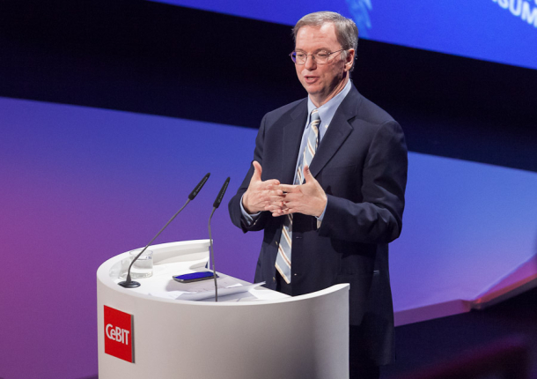
Individual linguistic ability
The use of difficult or inappropriate words in communication
Poorly explained or misunderstood messages can also result in confusion

Slide 14

Physiological barriers
May result from individuals' personal discomfort, caused,
Ill health, poor eye sight or hearing difficulties.

Slide 15
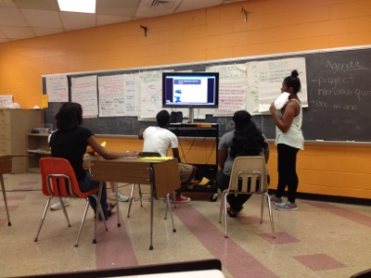
Presentation of information

