Slide 1
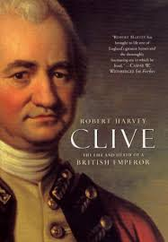
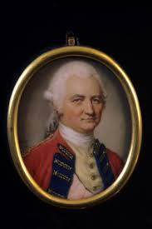
Robert Clive
As a General
Joined-service of-EIC-as Writer Clerk-1743- reached Madras-1744
Hero of Arcot- He suggested to Governor of Madras that he should be given some troops to capture Arcot-
Chanda Sahib army was defeated by Clive and also Defeated Chanda Sahib forces at Trichinoploy-
Went to England after the Victory of Second carnatic War-
Clive again sent to Indaia as a Governor of Fort St. David-1756-

Slide 2
Clive in Battle of Plessy(1757)
Conquest of Bengal- Siraj Ud-Daula- Nawab of Bengal –Defeated –with the help of Admiral Watson- and rebel commander Mir Jaffer was made as Nawab-
Trough Battle of Plessy(1757)-Mir Jaffer was made near Puppet in the hands of Company-Rich provinces Bengal and Bihar came to the control of English-
Battle of Plassey in 1757 made company the masters in Bengal and Bihar-

Slide 3
First Governorship of Bengal-(1757-1760) – Third Cranatic War – When General Lally recalled Bussy- Clive took advantage sent his troop to capture Northern Circars 1759-won the battle too-
Second Governership(1760-1765)-
Battle of Buxar(1764)- Treaty of Allahabad(1765)-settlement with Shuja-ud –dwala of Oudh and Mugul Emperor Shah Alam II- Important outcomes-Mughual give
Diwani Right to company in the regions of Bengal- Bihar-Oudh was made us buffer state between Company and Mughal

Slide 4
As a Statesman
Civil Reforms
Abolished-private trade of Company servants- Double Bhatta (field allowance was abolished)-
Dual Government- Company acquired Diwani right of Bengal, Bihar and Orissa- as a result of Treaty of Allahabad(1765)-Revenue collection was kept in the hands of Company- Administration was left in the hands of Nawabs.

