Slide 1
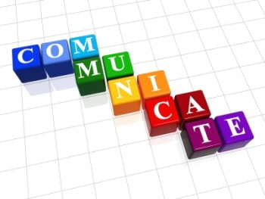
COMMUNICTAION

Slide 2

Exchange of thoughts, messages, or information, as by speech, visuals, signals, writing, or behavior.
Derived from the Latin word "communis", meaning to share.

Slide 3
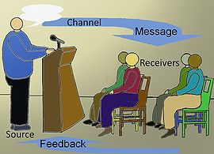
Requires a sender, a message and a recipient, although the receiver need not be present or aware of the sender's intent to communicate at the time of communication

Slide 4
Occur across vast distances in time and space.
Requires that the communicating parties share an area of communicative commonality
The communication process is complete once the receiver has understood the message of the sender

Slide 5
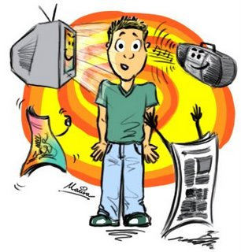
Communication – not a mass media experience rather relational experience between two people

Slide 6
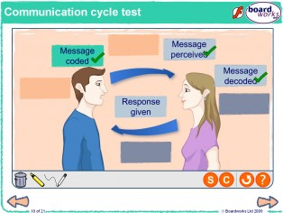
Speaker must care enough for the listener to learn to speak in the listener’s context and idiom while the listener must respect the speaker enough to have an open mind and a desire to be in a relationship with the speaker

Slide 7
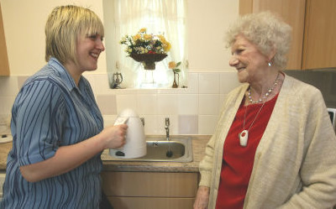
Theories and Skills in Communication
Communication is an Art
To be perfected it needs to be practiced
The nuances of this art must be rehearsed with painstaking effort to achieve mastery

Slide 8

Communication is a Science
Its Theories and concepts explain the way communication works in people and causes an understanding in them
These theories help the communicator choose effective tools in facilitating understanding in the listener

Slide 9
What is effectiveness in
Communication?
Speaking fluently in flawless language
Holding the attention of the listeners – beginning till the end
Presenting excellent content with all the latest information – in systematic way

Slide 10
Well-documented and adequately illustrated talk
Talk peppered with humor
Speech so well delivered that everyone could understand

