Slide 1
CLIMATE
There are variations in weather conditions during different seasons
These changes occur due to the changes in the elements of weather (temperature, pressure, wind direction & velocity, humidity and precipitation, etc.,

Slide 2
“WEATHER is the momentary state of the atmosphere while CLIMATE refers to the average of the weather conditions over a longer period of time. Weather changes quickly, may be within a day or week but Climate changes impereceptively and may be noted after 50 years or even more”

Slide 3
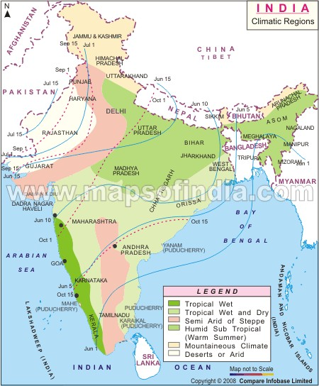

Slide 4
Monsoon is traditionally defined as a seasonal reversing wind accompanied by seasonal changes in precipitation, but is now used to describe seasonal changes in atmospheric circulation and precipitation associated with the asymmetric heating of land and sea. Usually, the term monsoon is used to refer to the rainy phase of a seasonally-changing pattern, although technically there is also a dry phase.

Slide 5
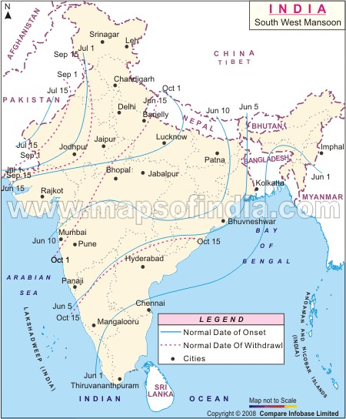

Slide 6
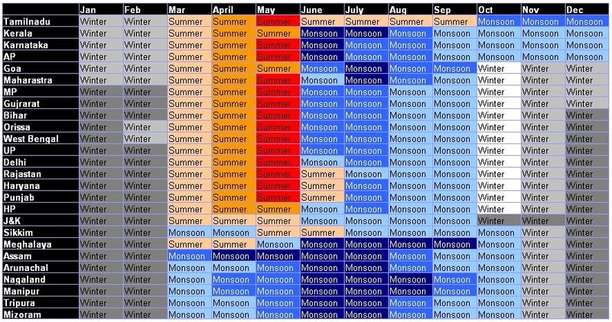

Slide 7
Unity & Diversity in the Monsson Climate
The monsoon regime emphasises the unity of India with the rest of SE Asian region
  The climate of Kerala and TN in the south are so different from that of UP and Bihar in the North
Some regional variations in preparation….
  While snowfall occures in the Himalayas, it only rains over the rest of the country
  Variations are noticeable not only in the type of precipitation but also in its amount

Slide 8
  Cherrapunji & Mawsyhram in Khasi Hills of Megalaya receives rainfall of 1800 cm in a year
  Jaisalmer in Rajasthan rarely gets more than 9 cm of rainfall in the same period
  Tura sityated in the Garo Hills of Meghalaya may receive an amount of rainfall in a single day is equal to 10 years of rainfall at Jaisalmer

Slide 9
  Ganga delta and coastal plains of Orissa are hit by strong rain bearing storms almost every third or 5th day in July and August
  While the Coramantal coast a thousand km to the South goes generally dry during these months
  Most parts of the country get rainfall during June – September
  But on coastal areas of TN rains in the beginning of the winter season

Slide 10
In summer the mercury occasionally touches 55°C in the western Rajasthan
It drops down to as low as minus 45°C in winter around Leh.
Cheru in Rajasthan may record a temperature of 50°C or more on a June day
While the mercury hardly touches 19°C in Tawang (A P) on same day
On a December night temperature in Drass (J&K) may drop down to minus 45°C

Slide 11
While Tiruvanantapuram and Chennai on the same night records 20°C or 22°C
On a December night temperature in Drass (J&K) may drop down to minus 45°C
While Tiruvanantapuram and Chennai on the same night records 20°C or 22°C
These examples confirm that there are seasonal variations in temperature from place to place and from region to region in India.

