Slide 1
Architecture during Delhi Sultanate
Art and architecture of the Delhi Sultanate period was different from the Indian style
Indo Islamic style of architecture developed as mingling of the Indian and Turkish styles
DOMES AND ARCHES OF Turkish styles
well known buildings of this period
Quwat- ul – Islam mosque,
Alai Darwaza,
Tomb of GhiasudduinTughlaq,
Ferozshahkotla,
Tuglaqgabad fort

Slide 2
Quwat- ul – Islam mosque

Slide 3
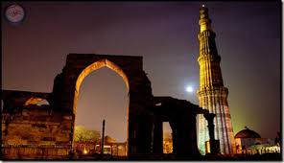
Qutub Minar

Slide 4
Qutub Minar was specially made by Qutb-ud-din Aibak, the first Sultan of Delhi, and was finished by his heir – Iltutmish
It is about 73 metres high and built of marble and red sandstone.
It is a five storey building. The stairs of the complex has about 375 steps
Qutub Minar was renovated by Firoz Shah, during his reign when it was damaged
It was named in honour of QutubuddinBakhtiar Kaki, a saint from Transoxiana who came to live in India and was greatly venerated by Iltutmish.

Slide 5
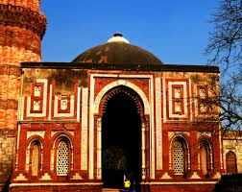
Alai Darwaza,

Slide 6
The Alai Darwaza is the main gate from the southern side of the Quwwat-ul-Islam Mosque in the Qutub Minar complex .
Built by Allaudin Khilji the Sultan of Delhi in 1311 AD
Alai Darwaza has a domed entrance which is constructed using red sandstone and is adorned with white marble
Alai Darwaza is one of the first buildings in India to be built using an Islamic architectural style

Slide 7
Tomb of GhiasudduinTughlaq

Slide 8
Built during the years 1320-25, the tomb of Ghiyas ud din Tughlaq,
first ruler of the Tughlaq dynasty, stands like a small fortress directly opposite the Tughlaqabad fort
The tomb was built by the Sultan himself, and is a brilliant example of the early Indo – Islamic style.
The structure sits within a fortified pentagonal enclosure, with the heavily battered walls and corner turrets characteristic of Tughlaq era buildings.

Slide 9
Ferozshahkotla

Slide 10
Feroz Shah Kotla was a fortress built by Sultan Feroz Shah Tughlaq to house his version of Delhi city called Ferozabad.
A pristine polished sandstone pillar from the 3rd century B.C. rises from the palace's crumbling remains, one of many pillars of Ashoka left by the Mauryan emperor;
to Delhi under orders of Firoz Shah Tughlaq of Delhi Sultanate, and re-erected in its present location in 1356.

Slide 11
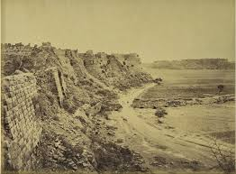
Tuglaqgabad fort

Slide 12
This third city of Delhi was constructed by GHIYASU’D-DIN TUGHLAQ in AD 1321-1325.
The fort is renowned for the prescriptions due to which it remains abandoned from ages

Slide 13
These depict the style of Indo -Muslim architecture.
The forts were simple but strong. They built arches above the doorways and windows instead of beams, which were used by Indians before the coming of the Muslims.

