Slide 1
INTERNATIONAL HUMAN RESOURCES MANAGEMENT
APPROACHES – STAFFING POLICY

Slide 2
Introduction
Hr manager at international level must not only select people with skills but also employees who can mix with the organisation’s culture.
Recruitment and selection practices in an international firm depend on its staffing policy , host government’s constraints on hiring policies and the firms ability to attract candidates.
Any organisation need to hire employees, whose style, beliefs and value system are consistent with those of the firm.

Slide 3
Types of Employees
Parent Country National or Home Country National– Permanent resident of the country where the firm is headquartered.
Host Country National – Permanent resident of the country where the operations of the company are located.
Third Country National – Permanent Resident of a country other than the parent country and the host country.

Slide 4
Types- Contn…
Expatriate – A parent country national sent on a long –term assignment to the host country operations.
Inpatriate – A host country national or a third country national assigned to the parent country where the company is headquartered.
Repatriate – An expatriate coming back to the home country at the end of a foreign assignment.

Slide 5
Four Approaches to IHRM
ETHNOCENTRIC
POLYCENTRIC
GEOCENTRIC
REGIOCENTRIC

Slide 6
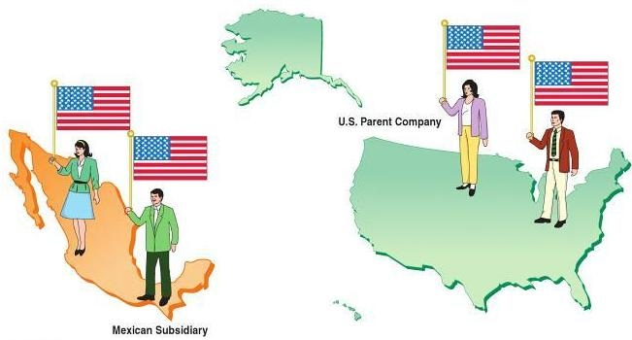
ETHNOCENTRIC
The ethnocentric approach places natives of the home country of a business in key positions at home and abroad. In this example, the U.S. parent company places natives from the United States in key positions in both the United States and Mexico.

Slide 7

ENTHNOCENTRIC ORGANISATIONS
Motto : ‘ this work in my country therefore, it must work in other countries also’
Home Country Oriented Organization
All key positions are filled with the HCNs.
Common for MNCs in the early stages of Internalization.
HCN,s are developed to work anywhere

Slide 8
Disadvantages Contn…
Quite expensive to employ expatriates in foreign subsidiaries
For many expatriates a key international position means new status, authority and an increase in standard of living. These changes may affect expatriates sensitivity to needs and expectations of their host country subordinates.
Language, cultural differences exist.

Slide 9

Reasons
Lack of qualified host country managers or Perception that they may not be available.
Desire to maintain a unified corporate culture and tight control.
Desire to transfer quickly the firm’s core competencies to foreign subsidiaries.
To ensure that coordination and communication are maintain adequately in headquarters.

Slide 10

Example:
When a Korean Company (Samsung, LG, Hyundai) invests in Chennai, India is the Host Country and Korea is the Home Country (Guest). If the Korean Company is ethnocentric it will appoint the Home or Parent Country nationals at head positions.
Firms such as P&G, Phillips, Samsung originally followed the ethnocentric approach.

Slide 11
Disadvantages
May lead to reduced productivity and high turnover due to limited promotion opportunities for host country nationals.
The parent company nationals may take a lot of time in understanding the host country culture leading to faulty decisions.
Since the compensation paid to parent company nationals is greater, host country nationals may feel discriminated and frustrated

Slide 12
Contn…
This approach is reflected in
Staffing policy
Performance appraisal
New product development
Evaluation of all the above designed and administered by Parent Country nationals.

Slide 13
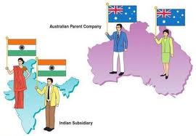
POLYCENTRIC
In this example, the Australian parent company uses natives of India to manage operations at the Indian subsidiary. Natives of Australia manage the home office.
Top Indian IT companies like TATA, HCL technologies India's fourth largest software export, Infosys and Wipro stepped in United States to set up their subsidiaries and recruited American nationals from colleges and experienced professionals who had the local knowledge and domain expertise

Slide 14
POLYCENTRIC ORGANISATIONS
The motto is ‘When in Rome do as the Romans do’
It means when you are elsewhere live as they live elsewhere.
The Polycentric Staffing requires host country nationals to be hired to manage subsidiaries, while parent-country nationals occupy key positions at corporate headquarters.

Slide 15
Introduction
The Polycentric Message is ‘Local People know what is best for them. Let’s give them some money and leave them alone as long as they make us a profit’.
Government Pressure and Foreign Laws often necessitate polycentric approach.
Many multinationals adopt this approach because they face the heterogeneous environments.
Product Preferences may be the deciding factors and strategies are to be developed on a market by market basis.

Slide 16
Advantages
Less Expensive
Local managers can handle easily local dynamics.
No Language and cultural Barriers.
Local politics and administration can be managed easily.
Though high salary need be given to Host Country Nationals, it is still less than paying PCNs
Turnover Reduced

Slide 17
DisAdvantages
Bridging the Gap between HCN subsidiary. Managers and the PCNs at Headquarters face problems with regard to
Language barriers
conflicting national loyalties
differences emanating from personal values, attitudes to business etc.
Parent Company Nationals do not get exposure and experiences to foreign jobs.
This may restrict their career growth .

Slide 18
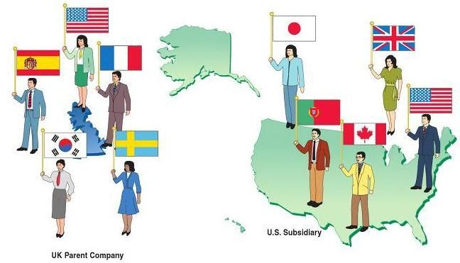
GEOCENTRIC
The geocentric approach uses Ihe best available managers for a business without regard for their country of origin. In this example, the UK parent company uses natives of many countries at company headquarters and at the U.S. subsidiary.

Slide 19
GEOCENTRIC ORGANISATIONS
Motto’Right Person For the Right Job’
This Staffing Philosophy seeks the best people for key jobs throughout the organisation, regardless of the nationality.
The MNC takes a Global Approach to its operation.
It follows worldwide integrated business.

Slide 20
Advantages
It enables a multinational firm to develop an international executive team which assists in developing a global perspective.
It develops an internal pool of labour for deployment throughout the global organisation.
It helps in building a stronger and more consistent culture among the entire global management team.
It has a continuous interaction and networking among the team members.

Slide 21
DISAdvantages
Greater Paperwork is involved in hiring foreign nationals.
Hassles of obtaining work permit for dependents of the employee.
Training,relocation and compensation costs of foreign nationals are higher.
The employment policy of a foreign country may be a constraint.
Bridging the Gap between with regard to language barriers, conflicts on national loyalties, personal values, culture is difficult and time consuming.

Slide 22
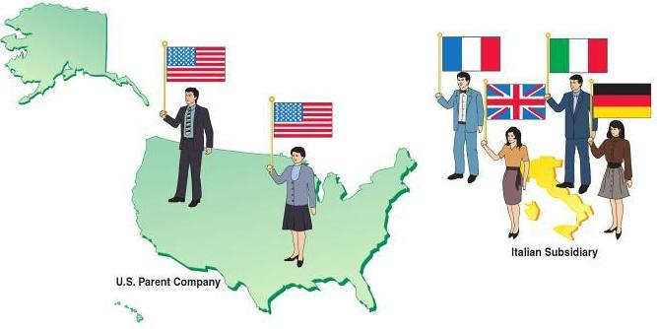
REGIOCENTRIC
The regiocentric approach places managers from various countries within geographic regions of a business. In this example, the U.S. parent company uses natives of the United States at company headquarters. Natives of European countries are used to manage the Italian subsidiary.

Slide 23
REGIOCENTRIC ORGANISATIONS
Regionally oriented organizations.
A corporation implements a regional strategy when synergistic benefits can be obtained by sharing functions across regions.
The operations of the global firm are divided into a few geographical regions.
The international staff is transferred within the same region they work.
Eg. Europe, America, Asia-Pacific etc.

Slide 24
Introduction
Regional Headquarter organizes collaborative efforts among local subsidiaries, responsible for the regional plan, local research and development, local executive selection and training, product innovation, cash management, brand policy, capital expenditure and public relations.
The Headquarter managers take care of world strategy, country analysis basic research and development, foreign exchange, transfer pricing, technology transfer, inter company loans etc.

Slide 25
Advantages
It allows interaction between executives transferred to regional headquarters from subsidiaries in the region and PCNs, posted to regional headquarters.
It facilitates shift from a purely ethnocentric approach to geocentric approach.
It reflects some sensitivity to local conditions, since local subsidiaries are staffed almost totally by HCNs.

Slide 26
DISAdvantages
There may be ‘Federalism’ at regional rather than on country basis
Career prospects at regional level are hampered

Slide 27
THANK YOU
ANNIE JANE
13PHR131
REFERENCES:
- Human Resource Management – C.B.Gupta
- Articlebase from Internet:
Approaches To International Human Resource Management – Dr.Shanmukha Rao Padala & Dr.N.V.S. Suryanarayana.
- www.whatishumanresource.com/international-recruitment

