Slide 1
Modernism

Slide 2
Modernism…..
An international artistic movement
Architecture, arts and crafts, film and literature
Began in the latter part of the 19th century
Came to an end(?) in the middle of the twentieth century

Slide 3
Modernism…
Falls between Realism and Postmodernism
Encompasses a range of artistic movements

Slide 4
Modernization…
Transformation of culture and society
brought about by embracing a combination of
new ways of thinking and new technology

Slide 5
Modernism…..
Modernism - a reaction to modernization, a means by which a particular society can
absorb the shocks that rapid and radical
change can cause

Slide 6
Modernity (and Postmodernity) refer to historical and sociological configurations
Modernism (and Postmodernism) are cultural and epistemological concepts
Modernism is the cultural experience of modernity

Slide 7
Modernism…..
Aesthetic complement of Modernity(Change in the social sphere)
Its drive for change is rooted in the disruptions to social life brought about by Modernization(change in technology)

Slide 8
Modernity - a historical period
Post-traditional order marked by
Change
Innovation
Dynamism

Slide 9
Modernity consists of…..
Industrialism(transformation of nature: development of the created environment)
Surveillance (control of inf & social supervision)
Capitalism (capital accumulation)
Military power (industrialization of war)

Slide 10
Modernity – marked by…..
The poverty and squalor of industrial cities
Two destructive world wars
Death camps
The threat of global annihilation

Slide 11
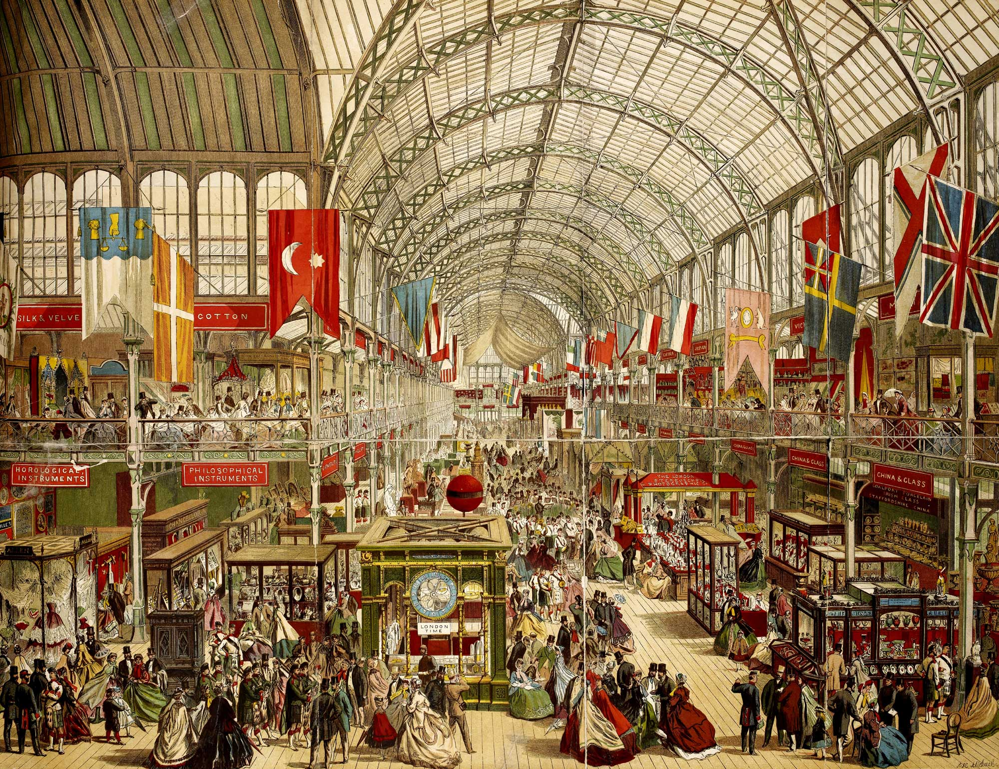
The great exhibition hall, London 1851

Slide 12
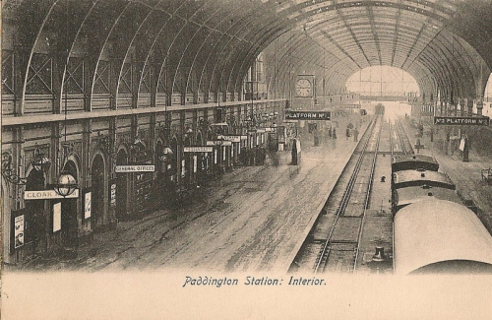

Slide 13
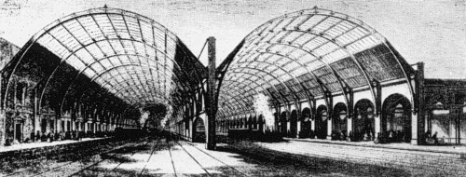

Slide 14
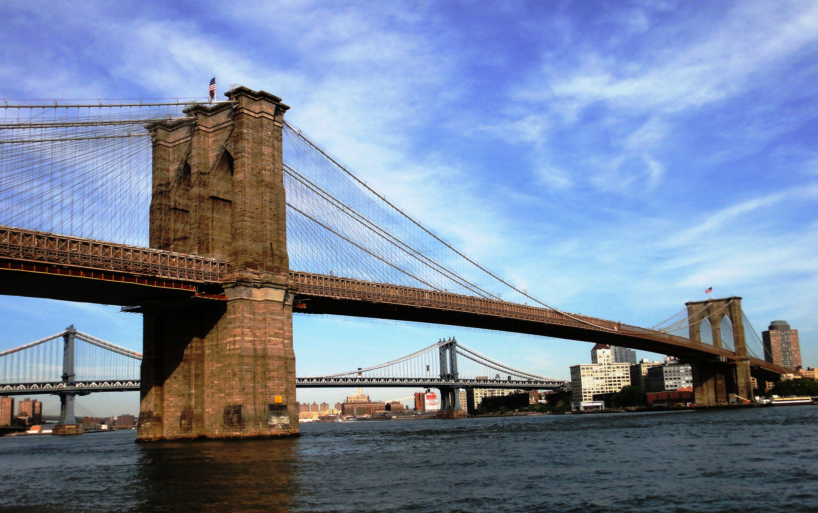

Slide 15
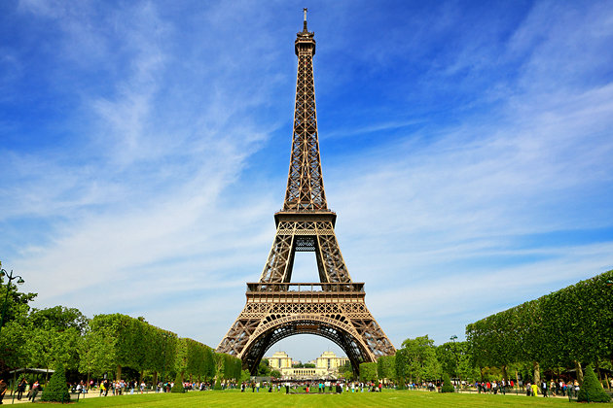

Slide 16
Questioning??????
History and civilization were inherently progressive
Progress was always good
(society – antithetical to progress)

Slide 17
Thinkers who qned the optimism
Arthur Schopenhauer (1788-1860)(The World as Will and Idea)German philosopher
(influenced Nietzsche)
Charles Darwin (1809-1882) Evolution by natural selection(undermined religious certainty)

Slide 18
Karl Marx(1818-1883) Das Capital(1867)
Sigmund Freud (1856-1939): Studies on Hysteria(1895)- Primacy of the Unconscious mind in mental life

Slide 19
Friedrich Nietzsche(1844-1900)
Henri Bergson(1859-1941)- difference between scientific clock time and the direct subjective human experience of time)

Slide 20
Beginning…..
Historian William Everdell: Modernism began in the 1870s
Visual Art Critic Clement Greenberg: middle of the 19th century in France
Baudelaire (Literature), Edouard Manet(1832-1883)(Painting), Flaubert(prose fiction)

Slide 21
Everdell:
Seurat’s Divisionism
A Sunday Afternoon on the Island of La Grande Jatte

Slide 22
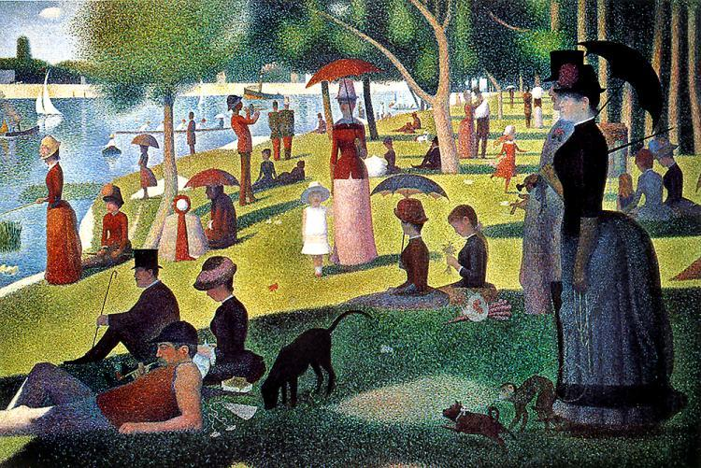

Slide 23
Modern – Latin ‘modo’ – means ‘current’ or ‘of the moment’
Sudden, unexpected breaks with traditional ways of viewing and interacting with the world

Slide 24
Reaction against Victorian culture and aesthetic
Stability and quietude of Victorian Era – thing of the past

Slide 25
Characteristics…..
Experimentation
Individualism
Central preoccupation: Inner Self and Consciousness

Slide 26
The Modernist does not care for Nature, Being or the overarching structures of History
He/She does not see progress and growth, but decay and a growing alienation of the individual

Slide 27
Beginning of the distinction between “high”art and “low” art
Educational reforms of the Victorian Age
Greater demand for literature

Slide 28
Press – supplied the demand
Sophisticated literati scorned the new popular literature
‘Real’ artists found themselves in a state of alienation from the mainstream society

Slide 29
All truths became relative, and in a state of flux
No guiding spirit rules the events of the world
Absolute destruction was kept in check by only the tiniest of margins

Slide 30
A Range of artistic movements
Abstractionism
Avant-gardism
Constructivism
Cubism
Dadaism
Futurism
Situationism

Slide 31
Symbolism
Expressionism
Imagism
Surrealism
Vorticism

Slide 32
Imagism…..
Exponent: Ezra Pound
T. E. Hulme: wanted poetry to concentrate entirely upon “the thing itself”
Minimalist language, Directness

Slide 33
Dreaminess, Pastoral poetry abandoned
New, cold, mechanized poetics
Short, unrhymed, sparse in adjectives and adverbs(avoided ornamental, verbose style of Victorian poetry)

Slide 34
Defining characteristic…..
Arthur Rimbaud: Il faut etre absolument moderne! (One must be absolutely modern!)
Ezra Pound: Make it new!

Slide 35
Asking the artists to jettison tradition
And experiment with the possibilities inherent in every medium
Regardless of the apparent senselessness or ugliness of the outcome

Slide 36
Gertrude stein…..
Duty of the work of art to strive for ugliness
Only in that way it could be truly new
Beauty- a lingering trace of past traditions

Slide 37
T. S. eliot…..
Intellectual, allusive, ironic mode of poetry
Looked backwards for inspiration, but not nostalgic or romantic about the past
Poetic voice sounds very colloquial, but secondary meanings found underneath

Slide 38
The USA…..
Lost Generation
Gertrude Stein, Hemingway, Scott Fitzgerald
Turning the mind’s eye inward, attempting to record the workings of the consciousness

Slide 39
Novel…..
Unreliable narrator supplanted the omniscient, trustworthy narrator
Stream of Consciousness
Surveyed the inner space of the human mind

Slide 40
Experimentation…..
Genre and Form
Eg. The Waste Land

Slide 41
Self-consciousness and irony concerning literary and social conventions
Realistic fiction
Freud’s ideas – Consciousness and Sexual repression

Slide 42
Classical and mythic forms refashioned or made new
Allusiveness – symbolic references
Self-conscious intertexuality

Slide 43
Isolation
Eccentricity
Pessimism
Reaction against formal limits of Realism and optimism of the Victorian Era

Slide 44
Suggests Change, uncertainty and Risk
Giddens: Modernism – risk culture
All knowledge – open to revision

Slide 45
Literary archetype…..
Faust – to make himself
Dilemma of modern development
Interplay of creation and destruction

Slide 46
Self – identity……
A project
Identity is not fixed, but created and built on

Slide 47
An urban aesthetic…..
Baudelaire’s flaneur (stroller)
Walking the anonymous spaces of the modern city
Experiencing the complexity, disturbances and confusions of the streets with their shops, displays, images and variety of persons

Slide 48
New insights from Psychology and Sociology
Anthropological Study of Comparative Religion
Shifting Power Structures

Slide 49
Women entering workforce
New city consciousness
Radio, Cinema – Information technology

Slide 50
No absolute truth, only relative, provisional truths
Reaction against the dominance of rational, logical, patriarchal discourse and its monopoly of power

Slide 51
No linear plots, multiple plots, unresolved endings
Multiple points of view – rejection of a single, omniscient point of view
Primitivism – belief, thought or behaviour of a primitive or instinctive nature

Slide 52
Exponents…..
Painting: Henri Matisse, Pablo Picasso
Literature: James Joyce, Gertrude Stein
Dance: Isadora Duncan
Music: Igor Stravinsky
Architecture: Frank Lloyd Wright

