Slide 1
Ecocriticism
DR. Cheryl Davis
Assistant Professor of English
St. Joseph’s College(Autonomous)
Tiruchirappalli - 620002

Slide 2
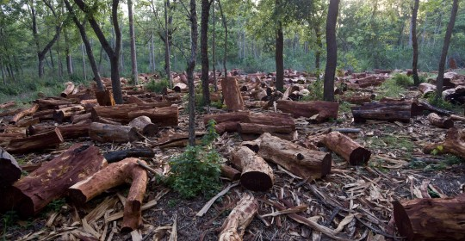
Cutting of Trees

Slide 3
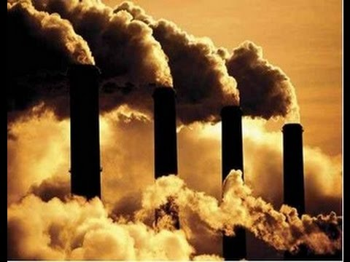
Chemicals from Factories

Slide 4
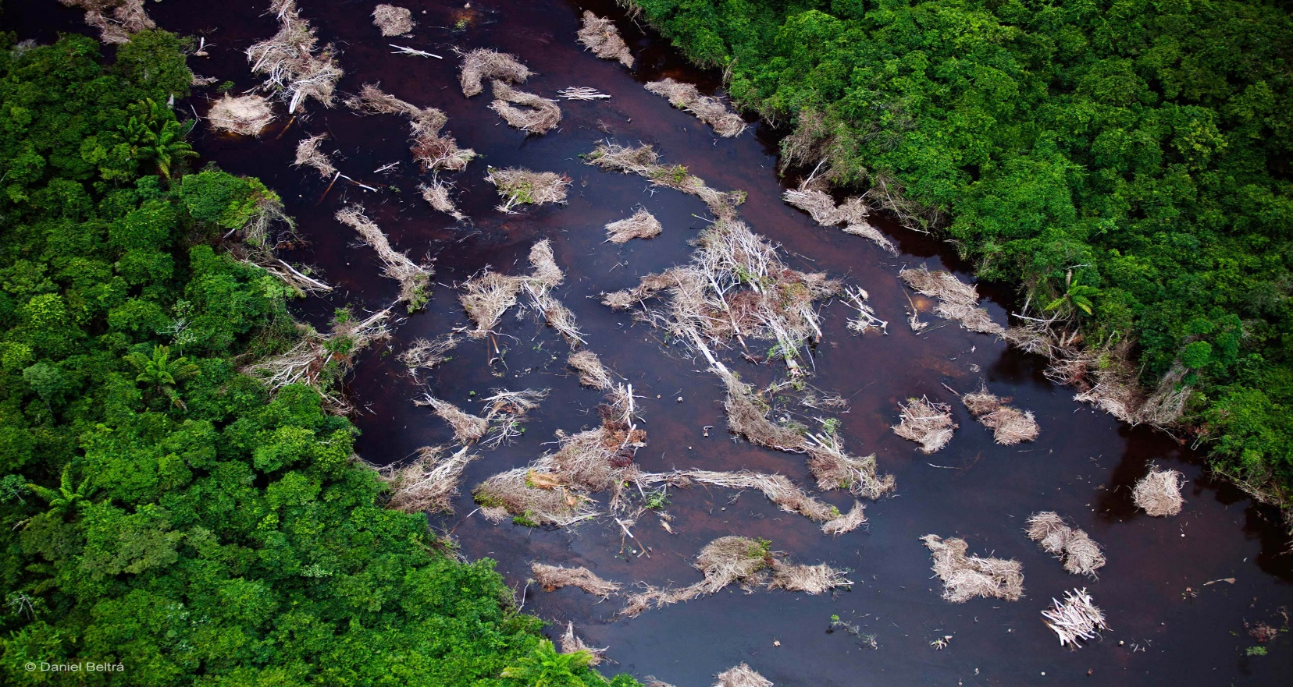
Polluting the Rivers

Slide 5
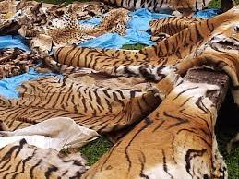
Killing of Animals

Slide 6
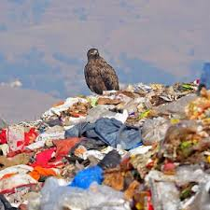
Use of Plastics

Slide 7
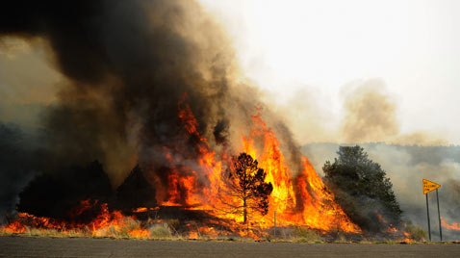
Forest Fire

Slide 8
Definition
Ecocriticism is the study of literature and environment
It examine the various ways how literature treats the subject of nature.
The movement started in the 1990’s. It Started in America and later spread to England.
William Rueckert – Literature and Ecology: An Experiment in Ecocriticism states – Nature is concerned with complex interactions and with the large sets of interrelationships.

Slide 9
Definition continued
Michael P Branch traces the word “ecocriticism” back to William Rueckert’s 1978 essay Literature and Ecology: An Experiement in Ecocriticism.
According to Rueckert, Ecocriticism means “the application of ecology and ecological concept to the study of literature”
Ecocriticism takes an earth-centered approach to literary studies
Everything is connected to everything else.

Slide 10
Ecocritics
Cheryll Glotfelty – Associate Professor of Literature and the environment at the University of Nevada, Reno revived the term ecocriticism as “ the study of nature writing” – The Ecocritical Reader
It is also called as “Green Cultural Studies”
It is concerned with populations, communities, ecosystems and biosphere.

Slide 11
American and British Literature
ASLE – Association of the study of Literature and Environment.
ISLE – Journal – Interdisciplinary studies in Literature and Environment

Slide 12
Origin - Ecology
Ecology taken from the Greek “oikos”, meaning house.
The term coined by Ernest Haeckel, German biologist in 1866
Eco in short of Ecology which is concerned with the relationships between living organisms in their natural environment as well as their relationship with that environment.
How man’s relationship with his physical environment are reflected in Literature.
A combination of natural science and a humanistic discipline.

Slide 13
Important Ecocritics
Cheryll Glotfelty
Simon C. Estok
Harold Fromm
William Howarth
William Rueckert
Suellen Campbell
Michael P. Branch
Glen A. Love.

Slide 14
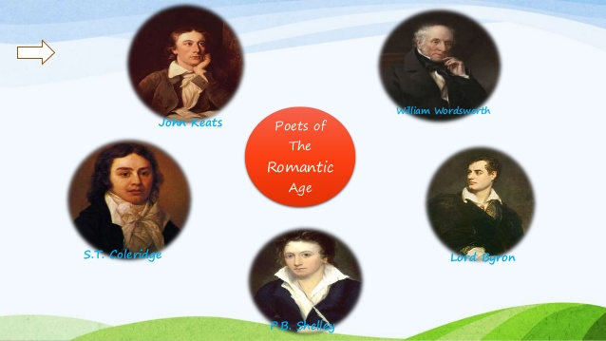
Romantic Poets

Slide 15
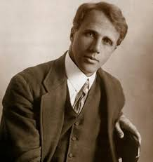
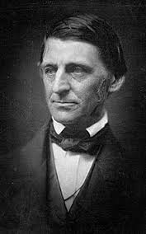
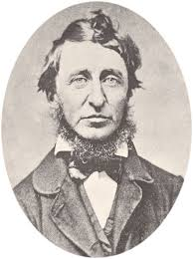
Robert Frost, Ralph Waldo Emerson and Henry David Thoreau

Slide 16
Themes
Man always exists within some natural environment.
The survival of the earth
Man’s identity with the physical and cultural environment.
Man threatened in the ecologically degraded world

Slide 17
Themes Continued-
Overexploitation of natural resources
Man’s disregard of air, water and soil that sustains him.
The survival of both man and the earth.
Humanists fight for the world in which they live in.
The combination of the physical and the spiritual – God – man – nature.

Slide 18
Anthropocentric – Human Centered and Biocentric – Life Centered
God created man to protect nature
Man at the centre and nature at the periphery
Today nature is at the centre and vice versa
Everyone has to change their anthropocentric attitudes into biocentric attitudes which is centred around any life on earth.
Man should change his own way of life and thinking.

Slide 19
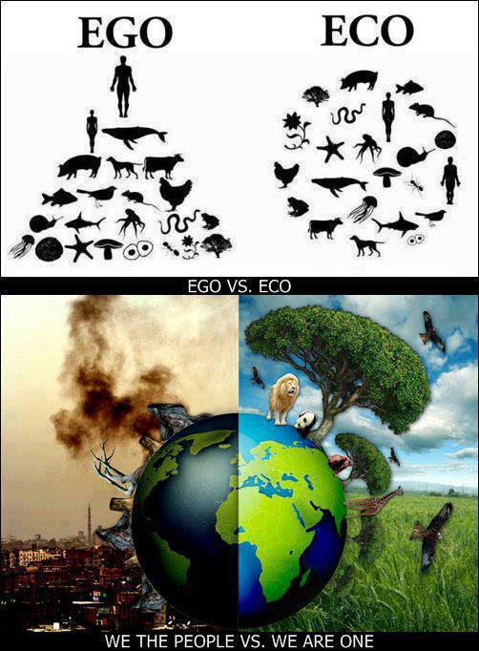
Ego - Eco

Slide 20
Area of Study - Research
The relationship between man and nature
Man and the physical environment
Landscape and mindscape
Exploitation or destruction of nature
Ecofeminism
Eco theology

Slide 21
Area of Study – Continued
Pollution and Apocalypse
Dwelling and the Earth
Pastor and Wilderness
Animals and Plants (Flora and Fauna)

Slide 22
Ecology in Literature
Hemingway’s Old Man and the Sea
J.M Synge’s Rider’s to the Sea
Sivasankarai Pillai’s Chemeen.
Pearl S. Buck’s The Good Earth.
John Steinbeck’s The Grapes of Wrath

Slide 23
Ecology in Literature
W.W.E Ross: The Snake Trying
Gieve Patel: On Killing a Tree
Imtiaz Dharkar: Blessing

Slide 24
Conclusion
Mahatma Gandhi – “there is enough for every man’s need on this earth but not enough for every man’s greed” – there is a call for a world wide concern to protect the environment in which we live and it is left in the hands of every human being to protect it.
Thank You

