Slide 1
Joseph’s Academy of Soft Skills (JASS)
by
Dr.R.Ganesasubramanian
Department of Economics
St.Joseph’s College(Autonomous)
Tiruchirappalli-02
Resume Writing

Slide 2
Course contents
Discussion
Learn to Identify Values, skills, qualification
Preparing a Resume
Resume Formats
Introduction/Meaning
I
II
III
IV
V

Slide 3
Soft skills defined …
Skills, abilities and traits that pertain to personality, attitude and behavior-Moss and Tilly, 1996
“Hard skills are what you do, and soft skills are how you do it,”
Soft skills are a combination of people skills, social skills, communication skills, character traits, attitudes, career attributes, social intelligence and emotional intelligence quotients among others that enable people to navigate their environment, work well with others, perform well, and achieve their goals with complementing hard skills.
The Collins English Dictionary defines the term "soft skills" as "desirable qualities for certain forms of employment that do not depend on acquired knowledge:
they include common sense, the ability to deal with people, and a positive flexible attitude."

Slide 4
Soft skills: The two domains
Intrapersonal
(Motivational)
Interpersonal
(Interactive)

Slide 5
Top Ten Soft Skills
Communication
oral speaking capability, written, presenting, listening.
Courtesy
manners, politeness, business etiquette(politeness), gracious, says please and thank you, respectful.

Slide 6
Flexibility
adaptability, willing to change, lifelong learner, accepts new things, adjusts, teachable.
Integrity
honest, ethical, high morals, has personal values, does what’s right.
Interpersonal skills
nice, personable, sense of humour, friendly, empathetic, has self-control, patient, sociability, warmth, social skills.

Slide 7
Positive attitude
optimistic, enthusiastic, encouraging, happy, confident.
Professionalism
business-like, well-dressed, appearance, self-confidence.
Responsibility
accountable, reliable, gets the job done, resourceful, self-disciplined, wants to do well, conscientious, common sense.

Slide 8
Teamwork
cooperative, gets along with others, agreeable, supportive, helpful, collaborative.
Work ethic
hard working, willing to work, loyal, initiative, self-motivated, on time, good attendance.

Slide 9
Soft Skills in Action
Communication
conveying thoughts in a way to express ideas and influence change.
Leadership
an expression of authority that inspires others to act by gaining trust and credibility.

Slide 10
Adaptability and flexibility
the ability to allow for and accept change.
Personal Accountability
owning up to one's actions and behaviour's.
Time Management
finding the best balance of activities and available time to accomplish goals.

Slide 11
Importance of soft skill
To handle interpersonal relations
To take appropriate decisions
To communicate effectively
To have good impression and impact to gain professional development

Slide 12
Introduction
Resume writing
What is Resume?
Why do we need?
What is Difference between Resume, CV, Bio data?
Resume is career marketing device.
It represents person as a viable and attractive candidate for or a set of jobs.
Not the History of the Candidate
The resume is the tool with the specific purpose
Resume is to support the person during the interview

Slide 13
Meaning
Resume-
French root word suggest “Summary” or “Synopsis” of one’s career.
It summarises a person’s skills, experience, education and achievements.
It has to be 10 to 20 seconds.
No negative mark should be included.
Prioritize information about you
Good resume will guide the interviewer

Slide 14
Structure of a Resume
Job Objective
Personal Profile
Educational Credentials
Professional Experience
Technical Qualification
Core Competencies
Achievements
Co-curricular & Extra curricular Accomplishments
Contact Information
References

Slide 15
Top 10 quality which employers expect
Communication skills (verbal& written)
Honesty/Integrity
Teamwork skills
Interpersonal skills
Motivation/Initiative/Leadership
Strong work ethics
Analytical skills
Flexibility/adaptability
Computer skills
Self confidence

Slide 16
Preparing a Resume
Effective resume like a trailer of a movie
Make ascertains on your abilities, skills, qualities and achievements it gives positive consideration about the candidate.
Backup the ascertains with evidence
Focus on the writing skills
Know what the employer seeks
Place emphasis on quality (grooming habits, trust worthiness and communication skills)

Slide 17
For Effective Resume
Writing
Clear and concise
Ensure correctness
Organization
Start with contact information
Summary of sections
Presentation
Effective layout

Slide 18
Writing
Write resume with a target in mind and be appropriate.
Customization of resume can increased chances of short listing.
Analyse the job ads and job descriptions and compose the resume to address the requirements.

Slide 19
Moderate size resume.
Right font size and avoid multiple fonts.
Chronological order with the latest experience/ job/ qualifications.
Ensure correct employment dates and designations (no fake claim).
Choose the correct tense and use it consistently.
Be accurate and honest.

Slide 20
Highlight your strengths
To prove that you are a better choice than competitor, mention your
Specific achievements / Targets achieved
Point-out the technology / skills used in different projects
Value additions in previous jobs

Slide 21
Organisation
Start with contact information
Name (bold, not underlined)
Address
Telephone number
Email address

Slide 22
Sections
Objective
Education
Experience
Achievements and awards
Skills
Professional affiliations
Publications or projects

Slide 23
Objective
It should be tailored to the prospective employer’s needs.
Emphasize how you will use your skills, not what you want to gain.
Establish yourself how you are perfect candidate for that position.
Avoid fluffy phrases.

Slide 24
Achievements and Awards
Scholarships
Grants
Prizes
Nominations
Professional societies
Significant accomplishments
Committees and leadership roles

Slide 25
Skill Section
Software programs and proficiency (Word, Power-Point, Excel, FrontPage, AutoCAD and professional software…).
Programming languages (include Visual Basic, HTML, PHP…).
Abilities (based on experience).
Languages and language ability (strict confidence).

Slide 26
Presentation
A clean, professional format with a little style.
Extra white space makes it easy to read – set margins.
A focused, targeted resume is best:
Avoid the temptation to go more than 2 pages
Delete obvious information in order to highlight your unique qualities
Font
for text: a serif font like Times
for headings: Arial or Helvetica
Font size should be 11 or 12.

Slide 27
Resume Formats

Slide 28
Resume formats
Types
Chronological –Traditional type experience section is focus. Objective or summary, to attract the focus of the reader.
Functional – major skills and accomplishments from the very beginning from all the past jobs
Combined – both characteristics of Chronological and Functional.

Slide 29
Chronological Resume
lists a candidate's job experiences in chronological order.
Professional experience section starts from the most recent experience and moving chronologically towards previous experiences.
Reverse chronological resume works to build credibility through experience gained, while illustrating career growth over time and filling all gaps in a career trajectory.
Reverse chronological resume format are used by those who are not professional resume writers.
A chronological resume is not recommended to job seekers with gaps in their career summaries.

Slide 30
Functional Resumes
focus on skills that are specific to the type of position being sought.
highlighting particular skills or experiences and directly emphasizes specific professional capabilities and utilizes experience summaries.
works well for those making a career change, having a varied work history or with little work experience.
also preferred for applications to jobs that require very specific skills or clearly defined personality traits.

Slide 31
Combined Resume (Chronological and Functional)
It has a equilibrium of functional and chronological approaches.
typically leads with a functional list of job skills, followed by a chronological list of employers.
tendency to repeat itself, therefore, less widely used than the other two.

Slide 32
Don'ts
Do not shoot same resume to all jobs.
Don’t state your expectations out of the job rather tell what you can contribute.
Do not disclose the salary- keep them to be discussed in interview.
Use simple and plain language. Avoid professional jargon.

Slide 33
Reminders
Proofread with regard to for grammar and punctuation.
Check the spelling
Get feedback from someone in-the-know/experts.

Slide 34
Model Resumes

Slide 35
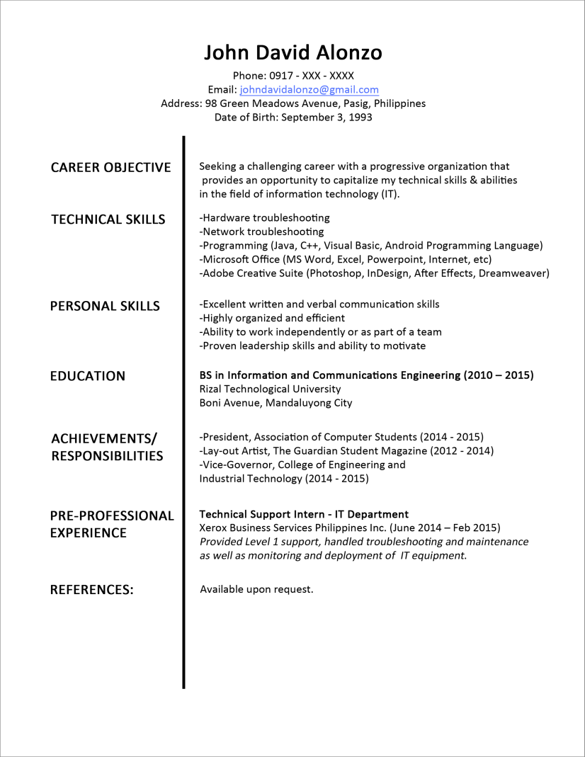

Slide 36
