Slide 1

Scheduling

Slide 2
Intro
Interleave the execution of processes to maximize CPU utilization while providing reasonable response time
The scheduler determines:
    Who will run
    When it will run
    For how long

Slide 3
Scheduling algorithms: Terms
Response time: minimize, for interactive users
Turnaround time: average time for a job to complete
Waiting time: minimize the average over processes
Throughput: number of completed jobs per time unit

Slide 4
Scheduling algorithms: Terms
Throughput – number of processes completed per unit time
Turnaround time – interval of time from process submission to completion
Waiting time – sum of time intervals the process spends in the ready queue
Response time – the time between submitting a command and the generation of the first output
CPU utilization – the percentage of time in which the CPU is not idle

Slide 5
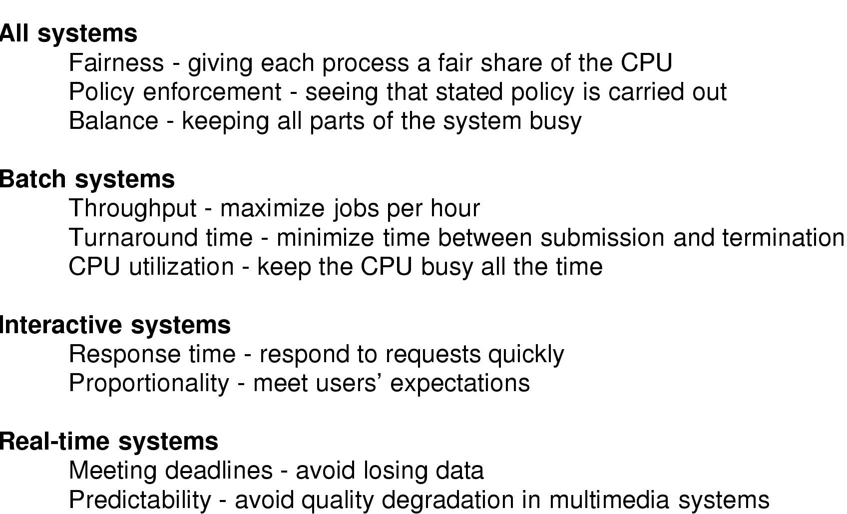
Criteria by system type

Slide 6
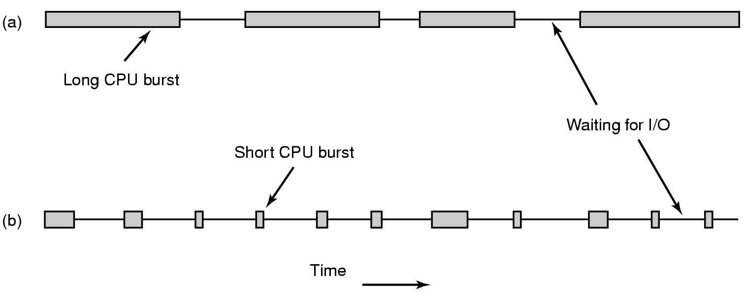
Scheduling – Types of behavior
Bursts of CPU usage alternate with periods of I/O wait
  CPU-bound processes
  I/O bound processes

Slide 7
CPU Utilization vs. Turnaround time
We have 5 interactive jobs i1…i5 and one batch job b
Interactive jobs: 10% CPU; 20% disk I/O; 70% terminal I/O; total time for each job 10 sec.
Batch job: 90% CPU; 10% disk I/O; total time 50 sec.
Cannot run all in parallel !!
i1..i5 in parallel - disk I/O is 100% utilized
b and one i in parallel - CPU is 100% utilized

Slide 8
CPU utilization vs. Turnaround time
Two possible schedules:
1. First i1…i5, then b
UT = (10x0.5 + 50x0.9)/60 = 83%
TA = (10x5 + 60x1)/6 = 18.33sec.
2. b and each of the i’s (in turn) in parallel:
UT = (50x(0.9+0.1))/50 = 100%
TA = (10+20+30+40+50+50)/6 = 33sec.

Slide 9
When are Scheduling Decisions made ?
1. Process switches from Running to Waiting (e.g. I/O)
2. New process created (e.g. fork)
3. Process switches from Running to Ready (clock.. )
4. Process switches from Waiting to Ready (e.g. IO completion)
5. Process terminates
Types of Scheduling:
Preemptive scheduling: process preepmtion may be initiated by scheduler
When for non-preemptive scheduling?
only 1 And 5.

Slide 10
First-come-first-served (FCFS) scheduling
Processes get the CPU in the order they request it and run until they release it
Ready processes form a FIFO queue

Slide 11
FCFS may cause long waiting times
Process
Burst time (milli)
P1
24
P2
3
P3
3
If they arrive in the order P1, P2, P3, we get:
P1
P2
P3
0
24
27
30
Average waiting time:
(0+24+27) / 3 = 17

Slide 12
FCFS may cause long waiting times (cont’d)
Process
Burst time (milli)
P1
24
P2
3
P3
3
If they arrive in the order P1, P2, P3, average waiting time 17
What if they arrive in the order P2, P3, P1?
P2
P3
P1
0
3
6
30
Average waiting time:
(0+3+6) / 3 = 3

Slide 13
(Non preemptive) Shortest Job First (SJF) scheduling
The CPU is assigned to the process that has the smallest next CPU burst
In some cases, this quantity is known or can be approximated
Process
Burst time (milli)
A
5
B
2
C
4
FCFS schedule
D
1
A
B
D
C
Average waiting time: 8.75
0
5
7
11
12
SJF schedule
D
B
C
A
Average waiting time: 5.75
0
1
3
7
12

Slide 14
Non-preemptive SJF: example
(varying arrival times)
Process
Arrival time
Burst time
P1
0
7
P2
2
4
P3
4
1
P4
5
5
Non-preemptive SJF schedule
P1
P3
P2
P4
0
2
4
5
7
8
12
16
P2
P3
P4
Average waiting time:
(0+6+3+7) / 4 = 4

Slide 15
Preemptive SJF (Shortest Remaining Time First)
Process
Arrival time
Burst time
P1
0
7
P2
2
4
P3
4
1
P4
5
5
Preemptive SJF schedule
P1
P2
P3
P2
P4
P1
0
2
4
5
7
11
16
P1(5)
P2(2)
P4(4)
Average waiting time:
(9+1+0+2) / 4 = 3

Slide 16
example
Service Time | Arrival Time | Process
3 | 0 | 1
6 | 2 | 2
4 | 4 | 3
5 | 6 | 4
2 | 8 | 5

Slide 17
First-Come-First-Served (FCFS)
0
5
10
15
20
Each process joins the Ready queue
When the current process finishes executing, the oldest process in the Ready queue is selected
Average waiting time is 4.6; Average Turnaround is 8.6
1
2
3
4
5

Slide 18
Shortest Remaining Time First - SRTF
0
5
10
15
20
Preemptive version of the ‘Shortest Job First’ policy
Must estimate processing time
Average waiting time is 3.2; Average Turnaround is 7.2
1
2
3
4
5

Slide 19
Round Robin - the oldest method
Each process gets a small unit of CPU time (time-quantum), usually 10-100 milliseconds
For n ready processes and time-quantum q, no process waits more than (n - 1)q
Approaches FCFS when q grows
Time-quantum ~ switching time (or smaller)
    relatively large waste of CPU time
Time-quantum >> switching time
    long response (waiting) times, FCFS

Slide 20
Compatible Time Sharing System (CTSS)
Assign time quanta of different lengths to different priority classes
Highest priority class: 1 quantum, 2nd class: 2 quanta, 3rd class: 4 quanta, etc.
Move processes that used their quanta to a lower class
Net result - longer runs for CPU-bound processes; higher priority for I/O-bound processes
for a CPU burst of 100 time quanta - 7 switches instead of 100 (in RR)

Slide 21
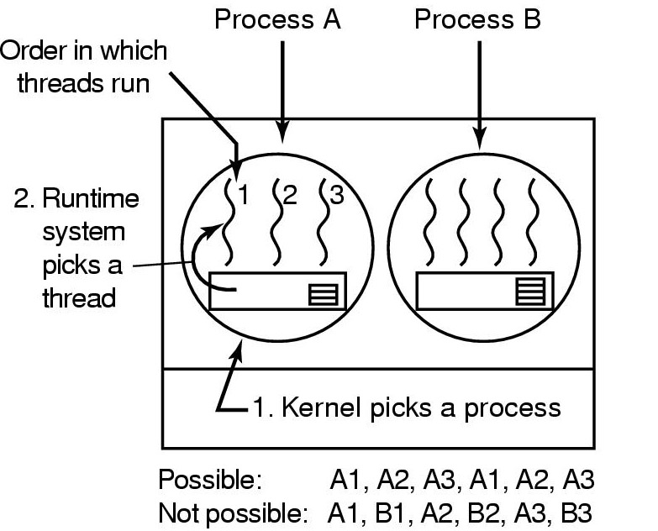
User-level Thread Scheduling
Scheduling within a quantum
Different scheduling algorithms for threads/processes possible
No way to preempt user threads
Thread context switch much faster
Application-specific scheduling possible

Slide 22
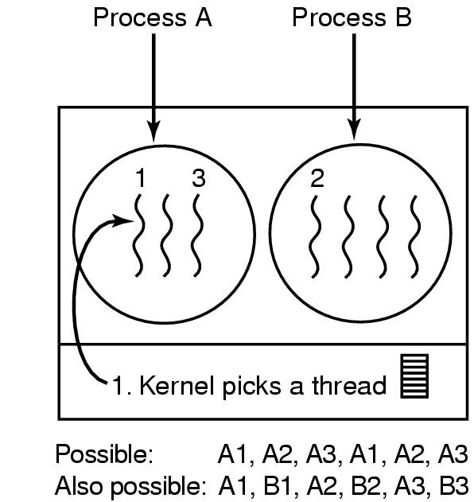
Kernel-level Thread Scheduling
Scheduling within a quantum
Scheduler may prefer switches within same process
Context switch more expensive
A blocking thread does not block all process threads

Slide 23
Three classes of threads
Real-time FIFO
  Have highest priority, can only be preempted by a higher-priority real-time FIFO thread
Real-time round robin
  Assigned time quantum
Timesharing
  Priorities 100-139
Priority determines the number of clock ticks (jiffys) assigned to a round-robin or timesharing thread

