Slide 1
Computer Networks and Security
II MCA

Slide 2
Network Security-Issues
Confidentiality/Secrecy
– Data is only understandable to the communicating parties
Authentication
– Can you prove who you are?
Integrity
– Did you get the message I sent?
Non-repudiability
– Yes you did!
Notes:
There are several issues concerned with network security.
Confidentiality:
All data could be eavesdropped. Confidentiality requires that only the communicating parties should be able to understand the transmitted messages.
Authentication:
Deals with the problem of who you are? Both the sender and receiver need to confirm that the other party is indeed who they claim to be
Integrity:
Requires that the content of the communication is not altered in transmission

Slide 3
Network Security - Why is it difficult?
Complexity.
Resource sharing.
Unknown Perimeter.
Many points of attack.
Anonymity.
Unknown Paths.

Slide 4
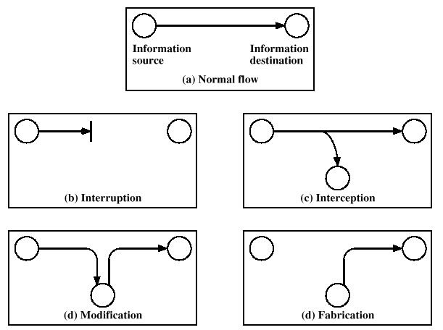
Types of Attacks in Computer Systems
Notes:
There are four types of attaks in computer systems: interruption, interception, modification, and fabrication.

Slide 5
Basic Security Techniques
Hashing
Symmetric Key Cryptography
Diffie-Hellman Key Exchange
Public Key Cryptography

Slide 6
Hashing
Analogous to fingerprints
  A way to identify people
  Don’t change with time
  Easily taken
  Small
  Cannot generate the persons
One Way Function
  Given x it is “easy” to compute y = f (x)
  Given y it is “hard” to compute x = f ⁻¹(y).
Notes:
Let’s start hashing with an analogy using fingerprints.
Fingerprints are a way to identify and keep track of people. They don’t change with time.
Give a person, it is very easy to take a fingerprint and the fingerprint is smaller than the person it identifies. In addition, we cannot generate a person by only looking at a fingerprint. This makes fingerprint a one way function

Slide 7
Hashing Principles
Can be applied to data of any length
Output is fixed length
One way function
  Relatively easy to compute h(x), given x.
  Infeasible to get x, given h(x).
Collision resistance
  Weak collision resistance: given x, it is hard to find y ≠ x such that H(y) = H(x).
  Strong collision resistance: it is hard to find any pair x and y(y ≠ x) such that H(y) = H(x).
The strength mostly depends on the size of the hash result
Notes:
Hashing algorithms take a message of any length and return a small fixed size digest.
If you hash the same message you will always get exactly the same digest result. If any part of the message changes, you get a completely different digest
The strength of a hashing algorithm mostly depends on the size of the hash result.
Fundamental Limitation of Hashing - hashing alone can't prove the integrity of a message.

Slide 8
Hashing
Algorithms
  MD5(16 Byte hash result)
  SHA1(20 Byte hash result)
Note
  Hashing alone can’t prove integrity
  Hashing result is also called:
    Hash, digest, fingerprint, analysis, message digest
Notes:
There are different Hashing algorithms, but they all do the same thing in almost the same way, and the 2 most popular methods are SHA1 and MD5. Chinese researchers found collisions for MD5 this year. So, many systems that use it will probably switch to more secure algorithms
Basic hashing algorithms have a fundamental limitation: hashing alone can't prove the integrity of a message. If we want to send a message and prove to the recipient that the message is intact and unmodified, we might send a hash we calculated, and let then recipient calculate their own hash result and see if the results match. The problem is that if the bad guys can intercept and corrupt the message then they can also intercept and replace the hash. If we have a way of safely sending the hash data to the recipient (sort of putting the hash result in a sealed envelope with our signature and a wax stamp on the outside) to protect the hash result, why not put the entire message inside this protective envelope. The answer is that hashing alone can't help us protect our information, but later we'll learn to combine hashing with other techniques and then we will be able to protect our information. The improvement on hashing that does allow us to prove the integrity of a message is called a HMAC, and we'll examine HMACs later.

Slide 9
Symmetric Key Cryptography Principles
Use a single secret key
The cipher text has almost the same size as the original message
Built on a shared secret or some random unpredictable data
The strength mostly depends on the key length
Encrypt large files fast and efficiently
Go by many names(session key, single key, bulk encryption)
Notes:
Session Key Encryption goes by many names including Symmetric Key, Bulk Encryption and Single Key encryption
Session Key - because you often build a key to encrypt a single message or session, and then throw the key away Single Key - because you use the same key to encrypt and decrypt Symmetric Key - because a copy of the same key does both the encryption and decryption job Bulk Encryption - because this encryption method can work on large amounts of data or big messages

Slide 10
Chopping
Chop the message into blocks
Perform math operations on each block
Message
Block # 1 as character
Drew's typical data. Could be numbers, letters, image, sound, video. It doesn't matter, it's all data and it all gets stored as bytes of information
Drew's t
Notes:
Many symmetric key algorithms chops the message into blocks. Each block has 8 bytes. Encryption methods just perform math operations on these blocks of data to encrypt and decrypt.
Initialization Vectors inserts some random data at the beginning of a new message. Without Initialization vectors if you sent the same message using the same session key you get the same cipher text. Initialization Vectors make each repeated message unique.
Cipher Block Chaining (CBC) combines each block to be encrypted with the encryption of the previous block. With CBC Chaining, a message with lots of pattern will produce a cipher text without pattern. Using CBC Chaining a message with lots of pattern will produce a cipher text without pattern..

Slide 11
Initialization Vectors
Goal: making each repeated message unique
Approach: inserting some random data at the beginning of a new message
Message
Add the IV and the message
Hey ATM machine, please give me $100
abcd1234Hey ATM machine, please give me $100
Notes:
Many symmetric key algorithms chops the message into blocks. Each block has 8 bytes. Encryption methods just perform math operations on these blocks of data to encrypt and decrypt.
Initialization Vectors inserts some random data at the beginning of a new message. Without Initialization vectors if you sent the same message using the same session key you get the same cipher text. Initialization Vectors make each repeated message unique.
Cipher Block Chaining (CBC) combines each block to be encrypted with the encryption of the previous block. With CBC Chaining, a message with lots of pattern will produce a cipher text without pattern. Using CBC Chaining a message with lots of pattern will produce a cipher text without pattern..

Slide 12
Chaining Mode
Chaining Mode controls how the encryption combines the results of encrypting many blocks in a single message
A message with patterns
Encryption without chaining
aaaaaaaa
aaaaaaaa
AD942241384D4237
AD942241384D4237
Notes:
Many symmetric key algorithms chops the message into blocks. Each block has 8 bytes. Encryption methods just perform math operations on these blocks of data to encrypt and decrypt.
Initialization Vectors inserts some random data at the beginning of a new message. Without Initialization vectors if you sent the same message using the same session key you get the same cipher text. Initialization Vectors make each repeated message unique.
Cipher Block Chaining (CBC) combines each block to be encrypted with the encryption of the previous block. With CBC Chaining, a message with lots of pattern will produce a cipher text without pattern. Using CBC Chaining a message with lots of pattern will produce a cipher text without pattern..

Slide 13
Cipher Block Chaining(CBC)
combines each block to be encrypted with the encryption of the previous block to hide pattern
Encrypt block 1
aaaaaaaa - Block1 as ASCII characters
61-61-61-61-61-61-61-61 - Block1 in Hex notation
56-61-04-D7-1A-EC-8C-10 - Cipher text result for Block1
Encrypt block 2
aaaaaaaa - Block2 as ASCII characters
61-61-61-61-61-61-61-61 - Block2 in Hex notation
56-61-04-D7-1A-EC-8C-10 - Block1 1 Encrypted
B7-C2-65-38-7B-4D-ED-71 - Block2 + (block1 encrypted ) Hex
80-C2-00-8E-00-C0-00-00 - Encrypted (Block2 + encrypted block1)
Notes:
Many symmetric key algorithms chops the message into blocks. Each block has 8 bytes. Encryption methods just perform math operations on these blocks of data to encrypt and decrypt.
Initialization Vectors inserts some random data at the beginning of a new message. Without Initialization vectors if you sent the same message using the same session key you get the same cipher text. Initialization Vectors make each repeated message unique.
Cipher Block Chaining (CBC) combines each block to be encrypted with the encryption of the previous block. With CBC Chaining, a message with lots of pattern will produce a cipher text without pattern. Using CBC Chaining a message with lots of pattern will produce a cipher text without pattern..

Slide 14
Symmetric Key Encryption/Decryption Processes
Encryption Process
  Pad the message to the nearest multiple of 8 bytes.
  Add an initialization vector to the front of message
  Use chaining to combine the results of the previous block
  Encrypt each block of data sequentially
Decryption Process
  Decrypt each block sequentially
  Use chaining to undo the results of the previous block chaining from the current block
  Remove any initialization vector data at the front of the message
  Remove any padded bytes at the end
Notes:
The actual encryption and decryption processes
The decryption process works in reverse order.

Slide 15
Symmetric Key Algorithms
DES, 3DES
Rijndael (AES Winner)
IDEA
Twofish
Blowfish
RC4, RC5, RC6
Serpent
MARS
Feal
Notes:
There are many symmetric key algorithms. They do almost the same thing.
DES is no longer considered secure for highly sensitive applications

Slide 16
Diffie-Hellman Key Exchange Algorithm
Choose public numbers: P (large prime number), G (<= P)
A generates random R1 and sends B:
S1 = G^{R1} mod P
B generates random R2 and sends A:
S2 = G^{R2} mod P
A calculates secret key:
K = (S2 ) ^{R1} mod P = G^{R2R1} mod P
B calculates secret key:
K = (S1 ) ^{R2} mod P = G^{R2R1} mod P

Slide 17
Diffie-Hellman Usage
Used in
  SSL, SSH, IPSec, Cisco encrypting routers, Sun secure RPC and etc...
Several groups
  Group1 Diffie-Hellman exchanges uses moderately large prime numbers
  Group2 Diffie-Hellman exchanges uses very large prime numbers

Slide 18
Public Key Encryption
Two keys:
  public encryption key e
  private decryption key d
encryption easy when e is known
decryption hard when d is not known
decryption easy when d is known
The most famous algorithm: RSA

Slide 19
RSA overview - setup
Alice wants people to be able to send her encrypted messages.
She chooses two (large) prime numbers, p and q and computes n=pq and z=(p-1)(q-1)
She chooses a number e such that e is relatively prime to z
She finds a number d such that ed-1 is exactly divisible by z
She publicizes the pair (n,e) as her public key. She keeps (n,d) secret and destroys p, q, and z

Slide 20
RSA overview - encryption
Bob wants to send a message x to Alice.
He looks up her public key (n, e) in a directory.
The encrypted message is
Bob sends y to Alice.

Slide 21
RSA overview - decryption
To decrypt the message
After Alice receives the message from Bob, Alice computes
Claim: D(y) = x
Symmetric key cryptography is at least 100 times faster than RSA

Slide 22
Tiny RSA example.
Let p = 7, q = 11. Then n = 77 and
z = 60
Choose e = 13. Find d = 13⁻¹ mod 60 = 37.
Let message = 2.
E(2) = 2¹³ mod 77 = 30.
D(30) = 30³⁷ mod 77=2

Slide 23
Combinations of Basic Techniques
HMAC – Hashing Message Authentication Code
Digital Signature and Signed Hashes
Digital Envelope
Notes:
The most important concept of the entire network security is that no single security technique solves real world problems alone. Each of the basic tools can only solve some small part of the problem, each basic technique has a set of limitations and restrictions.

Slide 24
MAC
Mechanisms that provide integrity check based on a secret key
MAC algorithm could be made out of a symmetric cipher
Can be thought as a checksum
Assume message M, shared key K
  MAC(M) = e(M||K)
Notes:
Before going through HMAC, first let’s see what is MAC?
A MAC algorithm can be generated using multiple different techniques; howerver, sender and receiver generally need to have a shared secret key, K. A MAC algorithm could be made out of a common symmetric cipher such as DES2 or AES3. A sender wanting to send a secure message can send M encrypted, e(M), with a symmetric cipher and then resend M||K (M concatenated with K) encrypted, e(M||K). The receiver first decrypts M, d(e(M)), to generate M'. He then encrypts M'||K, e(M'||K) and compares with the e(M||K) originally sent. If the two match, the data has not been manipulated.

Slide 25
MAC
Process
  A sends M & M1=MAC(M)=e(M||K)
  B receives both parts
  B makes his own MAC,
      M2 = e(M||K)
  If M2 != M1, data has been corrupted
  If M2 == M1, data is valid
MAC may not be used for non-repudiation
Notes:
A general step-by-step process of how a generic MAC functions works can be described in the following steps:
1.Sender sends Message & MAC(Message), M1
2.Receiver receives both parts
3.Receiver makes his own MAC(Message),M2
4.If M2 != M1, data has been corrupted
5.If M2 == M1, data is valid

Slide 26
HMAC
Combines a hashing function with a secret shared key
  HMAC = HASH(M||K)
HMAC can be used with any iterative cryptographic hash function, e.g., MD5, SHA-1, in combination with a secret shared key.
Computationally faster and compacter than MAC
Used in IPSec

Slide 27
Digital Signatures
Desirable properties of handwritten signatures:
  Signed document is authentic.
  Signature is unforgeable.
  Signature is not reusable.
  Signed document is unalterable.
  Signature cannot be repudiated.
  (Above not strictly true but mostly so)
Same properties and more can be achieved by digital signatures.
Digital Signatures use public key cryptography.

Slide 28
RSA based signature
Message
Alice signs
Signed message
Bob verifies
Message
Hello, I
love you
Encrypt
With
Private
key
Hjkhrk
Hj837*
*ji8hj]
Decrypt
With
Public
key
Hello, I
love you
Alice signs message by encrypting with private key.
Bob decrypts message with Alice’s public key.
If meaningful message then it must have been encrypted with Alice’s private key!

Slide 29
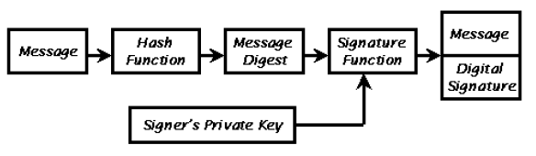
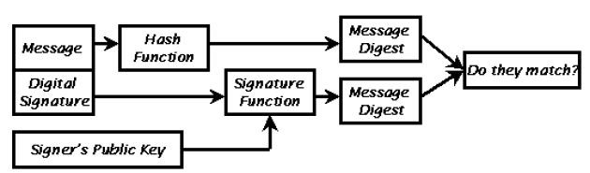
Signing With Message Digests
Figure 1: The process used to create a Digital Signature
Figure 2: The process used to verify a Digital Signature

Slide 30
Digital Envelopes
With digital signatures, the data is transmitted in the clear
A digital envelope uses a one-time, symmetric key (nonce) for bulk data encryption

Slide 31
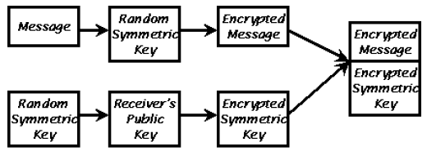
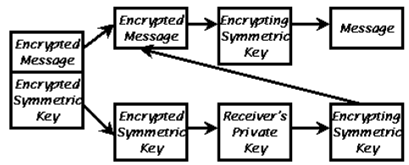
Digital Envelopes
Figure 3: The process used to create a Digital Envelope
Figure 4: The process used to verify a Digital Envelope

Slide 32
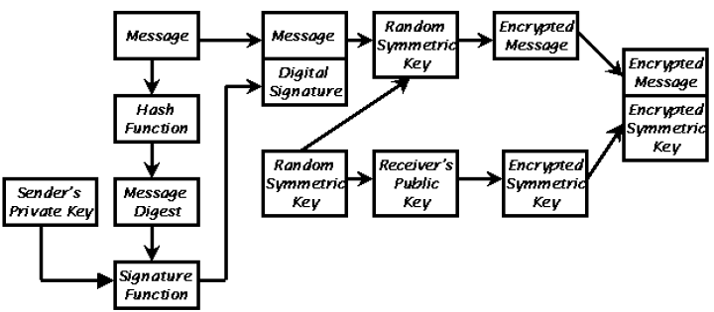
Create a Digital Envelope Carrying Digitally Signed Data
Notes:
Simple digital envelopes ensure the privacy of data but do not unsure the authenticity, nonrepudiation
or the integrity of the data. This can be easily achieved by digitally signing the data
before wrapping it with a digital envelope.

Slide 33
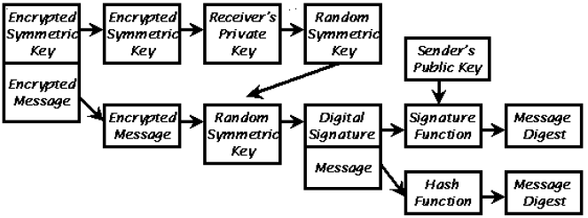
Verify a Digital Envelope Carrying Digitally Signed Data

Slide 34
Security and Network Layers
But where shall we put security?
Security can be applied at any of the network layers except layer 1 (Physical layer).
  Even this is sometimes possible, e.g. spread spectrum techniques for limited privacy.
What are the pros and cons of applying security at each of these layers?

Slide 35
Security and Network Layers
Data Link (Network Interface) layer:
  covers all traffic on that link, independent of protocols above
  protection only for one ‘hop’.
Network (Internet) layer:
  covers all traffic, end-to-end.
  transparent to applications.
  little application control.
    application has no visibility of Internet layer.
  unnatural, since network layer is stateless and unreliable.
    order of data in secure channel may be crucial.
    difficult to maintain if IP datagrams are dropped, re-ordered,…

Slide 36
Security and Network Layers
Transport layer:
  end-to-end, covers all traffic using the protected transport protocol.
  applications can control when it’s used.
    application has greater visibility of transport layer.
  transport layer may be naturally stateful (TCP).
  applications must be modified (unless proxied).
Application layer:
  security can be tuned to payload requirements.
    different applications may have radically different needs.
    eg VoIP applications versus sensitive data transfer.
  no leveraging effect – every application must handle it’s own security.

