Slide 1
Flip-Flops

Slide 2
Logic Circuits
Gates are referred to as logic circuits and perform arithmetic and other functions.
Logic circuits are classified into two groups:
Combinational logic circuits
Logic gates make decisions
Basic building
blocks include:
Sequential logic circuits
Flip Flops have memory
Basic building blocks
include FLIP-FLOPS:

Slide 3
Combinational Circuits
Combinational circuit is a circuit in which the different gates are combined in the circuit, for example encoder, decoder, multiplexer and demultiplexer.
Some of the characteristics of combinational circuits are following −
The output of combinational circuit at any instant of time, depends only on the levels present at input terminals.
The combinational circuit do not use any memory. The previous state of input does not have any effect on the present state of the circuit.
A combinational circuit can have an n number of inputs and m number of outputs.

Slide 4
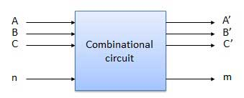
Combinational Circuits
Block diagram

Slide 5
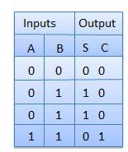
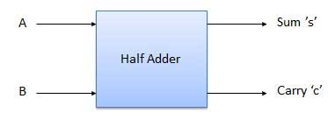
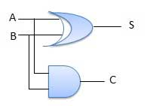
Combinational Circuits
Half Adder
Half adder is a combinational logic circuit with two inputs and two outputs.
The half adder circuit is designed to add two single bit binary number A and B. It is the basic building block for addition of two single bit numbers. This circuit has two outputs carry and sum.
Block diagram Truth Table Circuit Diagram

Slide 6
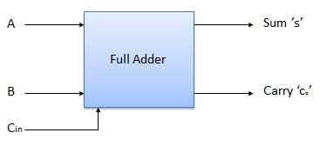
Combinational Circuits
Full Adder
Full adder is developed to overcome the drawback of Half Adder circuit. It can add two one-bit numbers A and B, and carry c.
The full adder is a three input and two output combinational circuit.
Block diagram

Slide 7
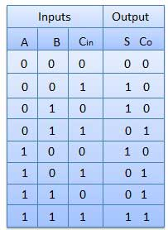
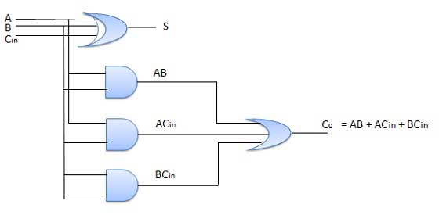
Combinational Circuits
Truth Table Circuit Diagram

Slide 8
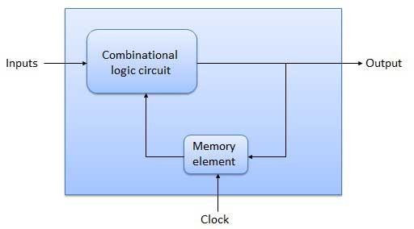
Sequential Logic Circuits
The combinational circuit does not use any memory.
Hence the previous state of input does not have any effect on the present state of the circuit.
But sequential circuit has memory so output can vary based on input. This type of circuits uses previous input, output, clock and a memory element
Block diagram

Slide 9
Sequential Logic Circuits
There are two types of sequential circuits:
synchronous: outputs change only at specific time
asynchronous: outputs change at any time
Multivibrator: a class of sequential circuits. They can be:
bistable (2 stable states)
monostable or one-shot (1 stable state)
astable (no stable state)
Bistable logic devices: latches and flip-flops.
Latches and flip-flops are the basic memory elements for storing information.
A Single latch or FF can store only one bit information which is referred to as state of the latch or FF.

Slide 10
Latch Vs Flip-Flop
Latches and flip-flops differ in the method used for changing their state.
Latches and flip-flops are the basic elements for storing information. One latch or flip-flop can store one bit of information.
The main difference between latches and flip-flops is that for latches, their outputs are constantly affected by their inputs as long as the enable signal is asserted.
In other words, when they are enabled, their content changes immediately when their inputs change.

Slide 11
Latch Vs Flip-Flop
Flip-flops, on the other hand, have their content change only either at the rising or falling edge of the enable signal.
This enable signal is usually the controlling clock signal.
After the rising or falling edge of the clock, the flip-flop content remains constant even if the input changes.
A FF changes state only at a active edge of its enable signal raises from 0 to 1 (rising edge) or from 1 to 0 (falling edge).

Slide 12
Memory Elements
Memory element: a device which can remember value indefinitely, or change value on command from its inputs.
Memory element
Q
command
stored value

Slide 13
Memory Elements
Memory element with clock: Flip-flops are memory elements that change state on clock signals.
Clock is usually a square wave.
Memory element
Q
command
stored value
clock
Positive pulses
Positive edges
Negative edges

Slide 14
Memory Elements
Two types of triggering/activation:
pulse-triggered
edge-triggered
Pulse-triggered
Latches ( It is a type of bistable logic device or multi-vibrator)
ON = 1, OFF = 0
Edge-triggered
flip-flops
positive edge-triggered (ON = from 0 to 1; OFF = other time)
negative edge-triggered (ON = from 1 to 0; OFF = other time)

Slide 15
Flip-Flops
A flip-flop is a bistable electronic circuit that has two stable states – Output is either 0 or +5 Vdc [Volts direct current].
FF also has memory to store the output.
Memory device capable of storing one bit.
Memory means circuit remains in one state after condition that caused the state is removed.
Two outputs designated Q and Q-complimentary to Q.
When referring to the state of a flip flop, referring to the state of the Q output.

Slide 16
Flip-Flops
Easiest way to construct a flip-flop is to connect two inverters.
The line connecting the output of inverter B (INV B) back to the input of inverter A (INV A) is referred to as the feedback line.
V₁
V₂
V₃
INV A
INV B
V₁ = 0 Vdc
INV A
V₂ = +5 Vdc
INV B
V₃ = 0 Vdc
V₁ = +5 Vdc
INV A
V₂ = 0 Vdc
INV B
V₃ = +5 Vdc

Slide 17
Types of Flip-Flops
The flip flop is a bi-stable multi-vibrator;
It has two stable states: 0 (or) +5 Vdc.
Types:
RS flip-flop
GATED RS flip-flop
D flip-flop
JK flip-flop
JK Master-Slave flip-flop

Slide 18
Flip-Flops
Symbol
SET
To SET a flip flop means to make Q =1
To RESET a flip flop means to make Q = 0
RESET

Slide 19
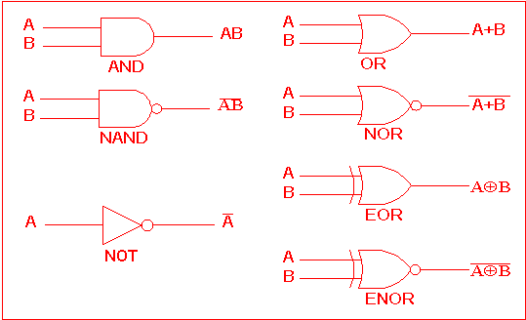
Representation of Logic Gates

Slide 20
RS Flip-Flops
Complementary outputs: Q and Q'.
When Q is HIGH, the latch is in SET state.
When Q is LOW, the latch is in RESET state.
When any input of a NOR gate is HIGH, it forces its output to an Low.
For active-HIGH input S-R latch (also known as NOR gate latch),
Case 1: both inputs LOW a no change
Case 2: S=HIGH (and R=LOW) a SET state Case 3: R=HIGH (and S=LOW) a RESET state
Case 4: both inputs HIGH a Q and Q' both
LOW (invalid)!

Slide 21
R
A
Q
1
0
B
Q'
S
0
1
Case 1: R = 0 and S = 0;
Since a 0 at the input of a NOR gate has no effect on its output (A NOR gate), FF remains in its present state i.e. Q remains unchanged.

Slide 22
R
A
Q
0
1
B
Q'
S
1
0
Case 2: R = 0 and S = 1;
It forces the output of NOR gate B low.
Both input to NOR gate A are now low and the NOR gate output must be high.
Thus, 1 at the S input is said to SET the FF and it switches to the stable state where Q = 1.

Slide 23
1
0
R
A
Q
0
B
Q'
S
1
Case 3: R = 1 and S = 0;
This condition forces the output of NOR gate A low and since both inputs to NOR gate B are now low and the output must be high.
Thus 1 at the R input is said to RESET the FF and it switches to the stable state where Q = 0, Q’ = 1.

Slide 24
1
0
R
A
Q
B
Q'
S
1
0
Case 4: R = 1 and S = 1;
It forces the output of both NOR gates to the low state i.e. both Q and Q’ = 0 at the same time.
This condition violates the basic conditions of a FF that requires Q to be the complement of Q’.

Slide 25
RS Flip-Flop
Active high – state changes occur at the clock’s rising edge( on higher voltage)
Active low – state changes occur at the clock’s falling edge( on lower voltage)
For active-LOW input S'-R' latch (also known as NAND gate latch)
R'=LOW (and S'=HIGH) a RESET state
S'=LOW (and R'=HIGH) a SET state
both inputs HIGH a no change
both inputs LOW a Q and Q' both HIGH (invalid)!
Drawback of S-R latch: invalid condition exists when (S=R=1; S=R=0) and must be avoided.

Slide 26
R-S FLIP-FLOP
Active-Low
S'
Q
Q'
R'
S’ | R’ | Q
1 | 1 | No Change
0 | 1 | 1 [SET]
1 | 0 | 0 [RESET]
0 | 0 | ? (Forbidden)

Slide 27
Gated Flip-Flops
It is a state which is neither 0 nor 1

Slide 28
Gated Flip-Flops

Slide 29
Clocked RS Flip-Flops
Set
FF
Set
FF
S
Q
S
Q
Clock
CLK
Reset
Q
Reset
Q
R
R
ASYNCHRONOUS
SYNCHRONOUS
Outputs of logic circuit can change state anytime when one or more input changes
It can change their outputs values at fixed point of time. Clock signal determines exact time at which any output can change state

Slide 30
Clocked RS Flip-Flops
The addition of two NAND gates at the R and S inputs and the CLOCK (C) to control whether a flip-flop can be enabled or disabled.
If the C input is low, the NAND gate outputs must both be low and no changes in the flip-flop output Q and latch is said to be disabled.
When the C input is high, the information at the R and S inputs will be transmitted directly to the outputs and latch is said to be enabled.

Slide 31
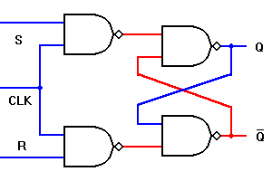
Clocked RS Flip-Flops
S-R latch with Clock input (C) and 2 NAND gates → clocked S-R latch.
Similar to SR Flip-flop but with extra control input C, which enables or disables the operation of S and R inputs.
C=1→ Enabled
C=0→ Disabled, circuit persists in preceding state

Slide 32
Instability
RS flip-flops can become unstable if both R and S are set to 0
All sequential elements are fundamentally unstable under certain conditions
Invalid transitions
Transitions too close together
Transitions at the wrong time

Slide 33
D Flip Flop
The RS flip-flop has two data inputs, R and S.
To Store a high bit, need a high S
To Store a low bit, need a high R.
In order to store the bit 0 or 1, R-S flip flop requires two signals. This is a major disadvantage of an R-S FF for many applications.
The Forbidden condition of both R and S high may occur unintentionally.
To overcome these difficulties, the D (Data) flip-flop, a circuit that needs only a single data input.

Slide 34
D Flip Flop
D flip-flop: single input D (data)
D=HIGH a SET state
D=LOW a RESET state
If the circuit contains four D latches called a quad bi-stable latch.

Slide 35
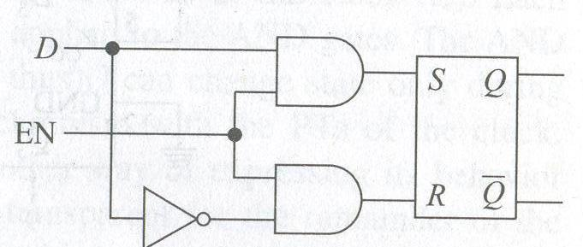
Clocked D Flip Flop
D Flip Flop can be combined with S-R Flip Flop to obtain a master slave configuration.
The D flip-flop acts as master and S-R flip-flop acts as slave.
To convert S-R flip-flop into a D flip-flop: add an inverter.
↑ = clock transition LOW to HIGH

Slide 36
Clocked D Flip Flop
The action of the circuit is as follows:
When EN is low, both AND gates are disabled.
Hence, D can change the value without affecting the value of Q.
When EN is high, both AND gates are enabled. In this case, Q is forced to equal the value of D.
When EN again goes low, Q retains or stores the last value of D.

Slide 37
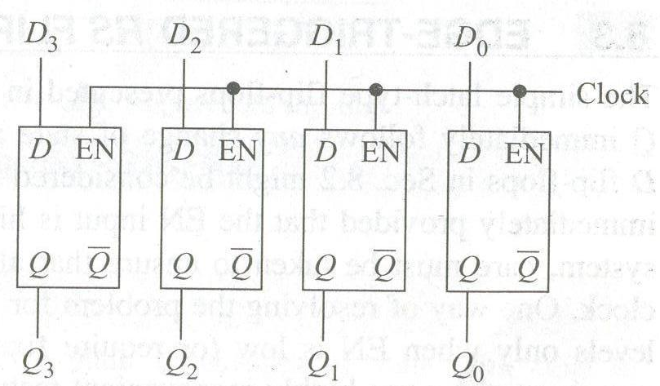
Storing 4-bit word
Four D latches are driven by the same clock signal.
When the clock goes high, input data is loaded into the FF and appears at the output.
Then when the clock goes low, the output retains the data.
For example: Data input is,
D₃D₂D₁D₀ = 0111

Slide 38
Storing 4-bit word
When the clock goes high, this word is loaded into the D latches, resulting in an output of
Q₃Q₂Q₁Q₀ = 0111

Slide 39
Edge-Triggered RS Flip Flops
The simple latch type FFs are completely transparent, where the output Q immediately follows any change of state at the input (R, S, or D).
The gated or clocked RS and D flop-flops might be considered as semi-transparent, where the output Q will change state immediately provided that the EN input is high.
If those FFs are used in synchronous system, need to ensure that all FF inputs change state in synchronism with the clock.

Slide 40
Edge-Triggered RS Flip Flops
Solution to this problem is to allow changes in R, S and D input levels only when EN is low or at any time when EN is high.
This leads to highly inconvenient restrictions and impossible to realize.
Thus, edge-triggered FF was developed to overcome these severe restrictions.

Slide 41
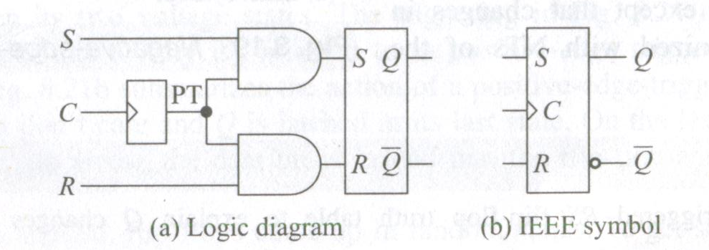
Positive Edge-Triggered RS Flip Flops
The clock (Clr) is applied to a positive pulse-forming circuit.
The clock transition from low to high is called Positive Transitions (PT) are developed and then applied to a gated RS flip-flop.
The result is a positive-edge triggered RS flip-flop.
The small triangle inside the symbol (dynamic input indicator) indicates that Q can change state only with PTs of the clock (C).

Slide 42
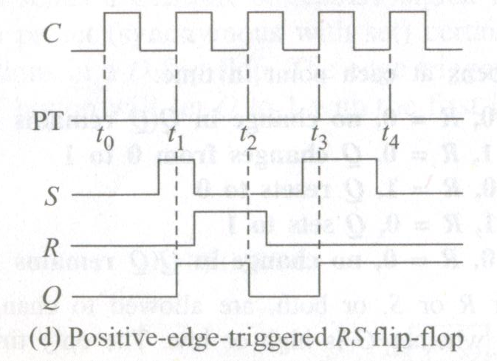
Positive Edge-Triggered RS Flip Flops
Each PT of the clock produces a very narrow PT that is applied to the AND gates.
The AND gates are active only while the PT is high (perhaps 25 ns), and thus Q can change state only during this short period.
In this way, Q changes state in synchronism with the PTs of the clock.

Slide 43
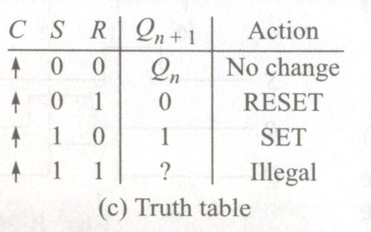
Positive Edge-Triggered RS Flip Flops
Positive edge-triggered RS FF is easy to use in any synchronous system.
This FF is transparent only during PTs.
It is not transparent for the remainder of the time.
In other words, S and R inputs affect Q only while the positive pulse is high, and they need to be static only during this very short time.
During PTs of the clock, the state of the Q changes according to the R and S levels.

Slide 44
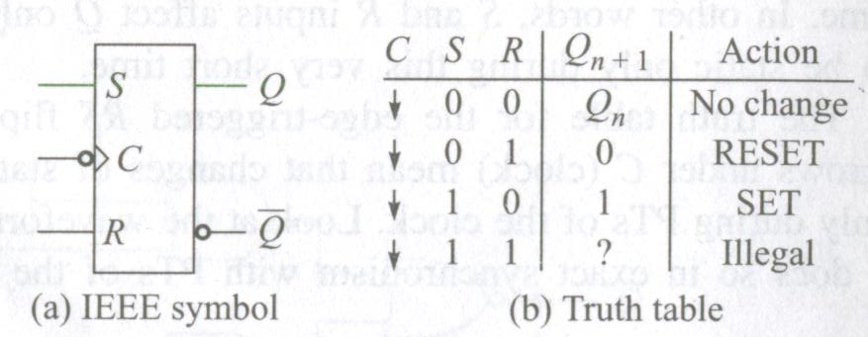
Negative Edge-Triggered RS Flip Flops
Fig.(a) is the symbol for a negative edge-triggered RS flip-flop.
Fig.(b) is a TT and shows that Q changes state according to the R and S inputs, but only during NTs of the clock.
On the IEEE symbol, the small bubble on the clock input (C) means active-low.

Slide 45
Negative Edge-Triggered RS Flip Flops
This bubble, along with the dynamic input indicator, means negative-edge trigging.
This FF behaves exactly like the positive edge-triggered RS FF, except that changes in output Q are synchronized with NTs of the clock (C).

Slide 46
Negative Edge-Triggered RS Flip Flops
Explain how Q changes of state with time using the negative edge-triggered RS FF truth table.

Slide 47
Negative Edge-Triggered RS Flip Flops
Explain how Q changes of state with time using the negative edge-triggered RS FF truth table.

Slide 48
Edge-Triggered D Flip Flop
Although the D latch is used for temporary storage in electronic instruments, the positive-edge-triggered D flip flop is useful in digital computers and systems.
This kind of FF samples the data bit at a unique point in time.
A positive edge-triggered D flip-flop formed with an S-R flip-flop.

Slide 49
Edge-Triggered D Flip Flop
The clock samples D at rising edge of the clock and the output Q is set or reset according to the state of the input D.
This state of the output remains for the whole clock period.
The following figure shows a positive pulse-forming circuit at the input of a D latch.
A positive edge-triggered D flip-flop formed with an S-R flip-flop.

Slide 50
Edge-Triggered D Flip Flop
The narrow positive pulse (PT) enables the AND gates for an instant.
The effect is to activate the AND gates during the PT of C, which is equivalent to sampling the value of D for an instant.
D
S Q
R Q’
PT
CLK
↑ = clock transition LOW to HIGH

Slide 51
Edge-Triggered D Flip Flop
At this unique point in time, D and its complement hit the flip-flop inputs, forcing Q to set or reset (unless Q already equals D).
This operation is called edge triggering because the flip-flop responds only when the clock is in transition between its two voltage states.
The following triggering occurs on the positive going edge of the clock and which is referred to as positive edge triggering.
D
S Q
R Q’
CLK
PT
↑ = clock transition LOW to HIGH

Slide 52
Edge-Triggered D Flip Flop
Truth table summarizes the action of a positive-edge triggered D flip-flop.
When the clock is low, D is a don’t care and Q is latched in its last state.
D
S Q
R Q’
PT
CLK

Slide 53
Edge-Triggered D Flip Flop
On the leading edge of the clock (PT), designated by the up arrow, the data bit is loaded into the flip-flop and Q takes on the value of D.
When power is first applied, FF come up in random states.
To get some computers started, an operator has to push a RESET button.
This sends a CLEAR or RESET signal to all flip-flops.
D
S Q
R Q’
CLK
PT

Slide 54
Positive-edge-triggered D Flip-Flop
When CLK=0 the master latch is open and the content of D is transferred to QM
When CLK=1 the master is closed and its output is transferred to the slave
Master and slave latches are never enabled at the same time

Slide 55
Edge-Triggered D Flip Flop
S
C
Q
Q'
S
C
Q
Q'
Positive-Edge-Triggered
Negative-Edge-Triggered
S
C
Q
Q'
CLR
Positive-Edge-Triggered with active low clear

Slide 56
J-K Flip Flop
The J-K flip-flop is the most adaptable and flexible among other basic flip-flops.
The operation of the JK FF is very similar to SR flip-flop.
The J input is just like S input in the SR flip-flop and when it goes high, it sets the flip flop.
Similarly, the K input is like R input in the SR flip-flop, where it resets the flip flop when it goes high.

Slide 57
J-K Flip Flop
The only difference is when both inputs, J and K, are asserted, for the SR flip-flop, the next state is undefined; whereas, for the JK flip-flop, the next state is the inverse of the current state.
In other words, the JK flip-flop toggles its state when both inputs are declared.

Slide 58
J-K Flip Flop
One of the most useful and versatile flip flop is the JK flip flop the unique features of a JK flip flop are:
If the J and K input are both at 1 and the clock pulse is applied, then the output will change state, regardless of its previous condition.
If both J and K inputs are at 0 and the clock pulse is applied there will be no change in the output. There is no indeterminate condition, in the operation of JK flip flop i.e. it has no ambiguous state.

Slide 59
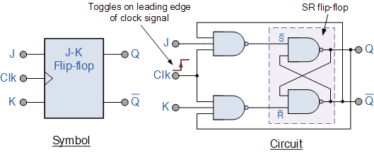
J-K Flip Flop
The JK flip flop is basically a gated SR Flip-Flop with the addition of a clock input circuitry that prevents the illegal or invalid output condition that can occur when both inputs S and R are equal to logic level “1”. Due to this additional clocked input, a JK flip-flop has four possible input combinations, “logic 1”, “logic 0”, “no change” and “toggle”. The symbol for a JK flip flop is similar to that of an SR Bistable Latch as seen in the previous tutorial except for the addition of a clock input.

Slide 60
J-K Flip Flop
Although this circuit is an improvement on the clocked SR flip-flop it still suffers from timing problems called “race” if the output Q changes state before the timing pulse of the clock input has time to go “OFF”.
To avoid this the timing pulse period ( T ) must be kept as short as possible (high frequency).
As this is sometimes not possible with modern TTL IC’s the much improved Master-Slave JK Flip-flop was developed.

Slide 61
JK Master-Slave Flip Flop
The Master-Slave Flip-Flop is basically two gated SR flip-flops connected together in a series configuration with the slave having an inverted clock pulse.
The outputs from Q and Q from the “Slave” flip-flop are fed back to the inputs of the “Master” with the outputs of the “Master” flip flop being connected to the two inputs of the “Slave” flip flop.
This feedback configuration from the slave’s output to the master’s input gives the characteristic toggle of the JK flip flop as shown below.

Slide 62
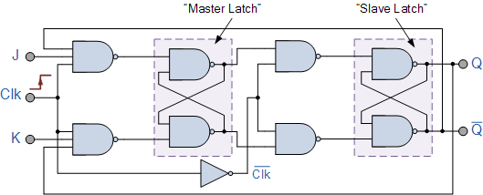
JK Master-Slave Flip Flop

Slide 63
JK Master-Slave Flip Flop
The input signals J and K are connected to the gated “master” SR flip flop which “locks” the input condition while the clock (Clk) input is “HIGH” at logic level “1”.
As the clock input of the “slave” flip flop is the inverse (complement) of the “master” clock input, the “slave” SR flip flop does not toggle.
The outputs from the “master” flip flop are only “seen” by the gated “slave” flip flop when the clock input goes “LOW” to logic level “0”.

Slide 64
JK Master-Slave Flip Flop
The input signals J and K are connected to the gated “master” SR flip flop which “locks” the input condition while the clock (Clk) input is “HIGH” at logic level “1”.
As the clock input of the “slave” flip flop is the inverse (complement) of the “master” clock input, the “slave” SR flip flop does not toggle.
The outputs from the “master” flip flop are only “seen” by the gated “slave” flip flop when the clock input goes “LOW” to logic level “0”.

Slide 65
JK Master-Slave Flip Flop
When the clock is “LOW”, the outputs from the “master” flip flop are latched and any additional changes to its inputs are ignored.
The gated “slave” flip flop now responds to the state of its inputs passed over by the “master” section.
Then on the “Low-to-High” transition of the clock pulse the inputs of the “master” flip flop are fed through to the gated inputs of the “slave” flip flop and on the “High-to-Low” transition the same inputs are reflected on the output of the “slave” making this type of flip flop edge or pulse-triggered.

Slide 66
JK Master-Slave Flip Flop
Then, the circuit accepts input data when the clock signal is “HIGH”, and passes the data to the output on the falling-edge of the clock signal.
In other words, the Master-Slave JK Flip flop is a “Synchronous” device as it only passes data with the timing of the clock signal.

