Slide 1
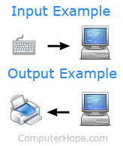
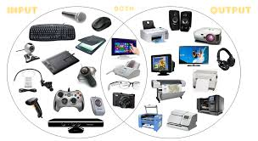
Input and Output devices in a Computer

Slide 2
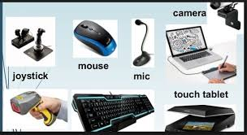
Input Devices
An input device is a hardware or peripheral device used to send data to a computer. An input device allows users to communicate and feed instructions and data to computers for processing, display, storage and/or transmission.

Slide 3
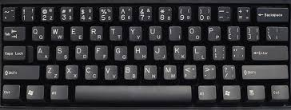
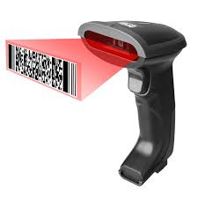
Two main types of Input devices
Human Data-entry Devices
It allow people to communicate with the computer. ex- Keyboard
Source-data automation Devices
It operate with minimal human intervention. ex – Barcode scanner, fax machines

Slide 4
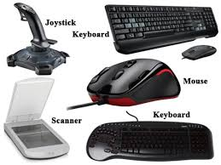
Advantages of Input Devices
Speed up the data collection
Reduction of errors
Combine the data as a transaction

Slide 5
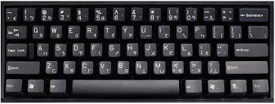
keyboard
Keyboard is the most common and very popular input device which helps to input data to the computer.
It translates numbers, letters, symbols and control keys into signals that can be interpreted by the PC.
It consists of 104 keys.

Slide 6
Typing Keys - These keys include the letter keys (A-Z) and digit keys (09)
Numeric Keypad - It consists of a set of 17 keys, used to enter the numeric data or cursor movement
Function Keys - The 12 function keys are present on the keyboard which are arranged in a row at the top of the keyboard.
Control keys - These keys provide cursor and screen control. It includes four directional arrow keys. Control keys also include Home, End, Insert, Delete, Page Up, Page Down, Control(Ctrl), Alternate(Alt), Escape(Esc).
Special Purpose Keys - Keyboard also contains some special purpose keys such as Enter, Shift, Caps Lock, Num Lock, Space bar, Tab, and Print Screen.

Slide 7
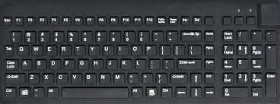

Slide 8
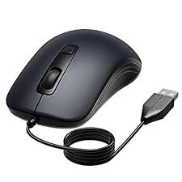
Mouse
Mouse is the most popular pointing device.
It is a cursor-control device having a small palm size box with a round ball at its base, which senses the movement of the mouse and sends corresponding signals to the CPU when the mouse buttons are pressed.
Two buttons - left and the right button and a wheel is present between the buttons, which control the position of the cursor on the screen, but it cannot be used to enter text into the computer.

Slide 9
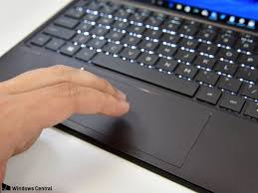
Touchpad
A touch pad is a device for pointing (controlling input positioning) on a computer display screen. It is an alternative to the mouse.
It is originally known as track pads.
A touch pad works by sensing the user's finger movement and downward pressure.

Slide 10

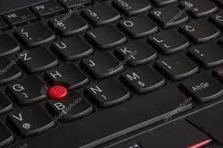
Pointing Stick
It resembles a pencil eraser.
It can be touched, as it is embedded near the middle of the keyboard.
A pointing stick is considered more efficient than a mouse, but a mouse is a more efficient pointer than the pointing stick.

Slide 11
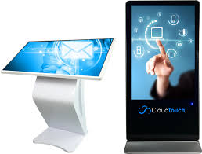
Touch Screen
Receive input from the movement of the finger to control operations of the computer.
Fingers transfer electrical currents to the computer.
It is covered with a plastic layer.

Slide 12
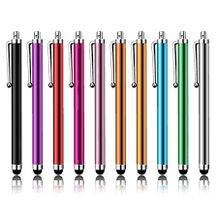
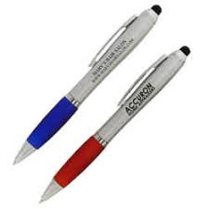
Stylus (Pen)
It is a latin word which means stake or pointed object
Small pen like device used to enter data by reacting to a touch-sensitive screen or film.
It allow a user to input handwriting specific pieces of information like signatures.

Slide 13
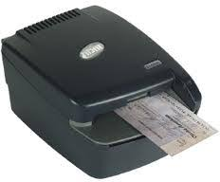
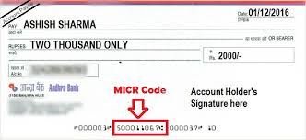
Magnetic Ink Card Reader (MICR)
MICR input device is generally used in banks as there are large number of cheques to be processed every day.
It translates characters written in magnetic ink into digital codes for processing.

Slide 14
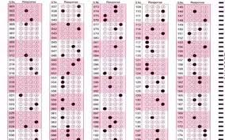
Optical Mark Recognition (OMR)
It scans a printed form or paper and reads the predefined places and makes record of where marks are made on the form

Slide 15
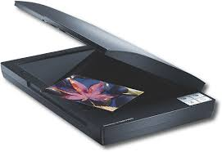
Digital Scanner
It translates images such as pictures or documents into digital form for processing

Slide 16
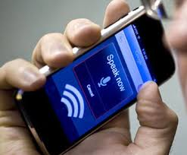
Voice Data Input
It converts the spoken word into digital form for processing

Slide 17
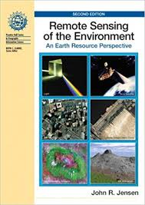
Sensor
It collects data directly from the environment for input to a computer

