Slide 1

CHEMOSELECTIVITY

Slide 2



Slide 3

Regioselective Reactions:
Where the reaction occurs

Slide 4


No selectivity –
both OH and NH₂ reacted

Slide 5



Chemoselectivity

Slide 6
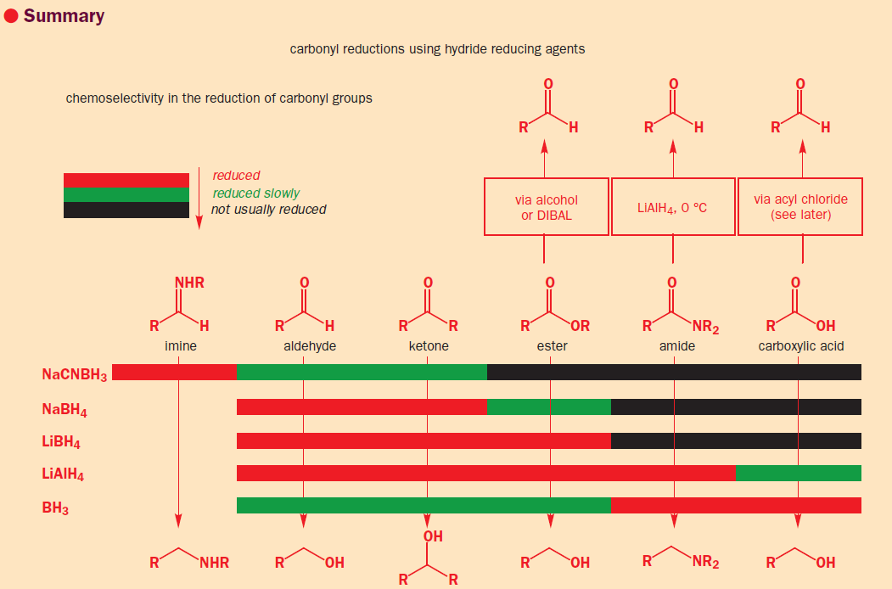
Chemoselectivity : REDUCTION OF CARBONYL COMPOUNDS

Slide 7



Slide 8

Protection of aldehyde/ketone

Slide 9
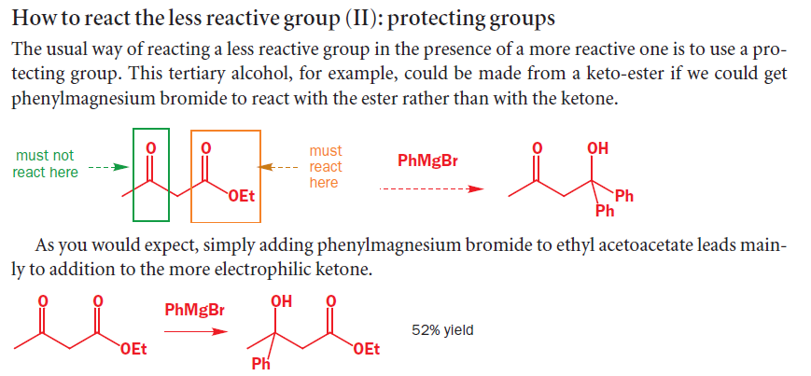

Example 1

Slide 10


Example 2

Slide 11



Protection of OH group - TBDMS

Slide 12



Protection of OH group - THP

Slide 13


Protection of OH group - Bn
Example 1

Slide 14
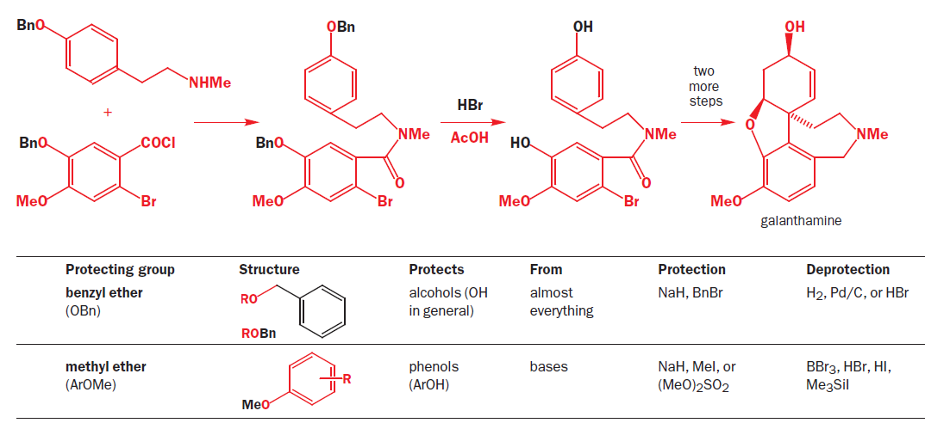
Protection of OH group - Bn
Example 2

Slide 15


Protection of OH group - Bn
Example 3

Slide 16


Summary

Slide 17



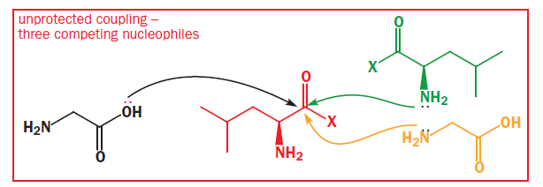
Protection of COOH / NH₂ groups

Slide 18
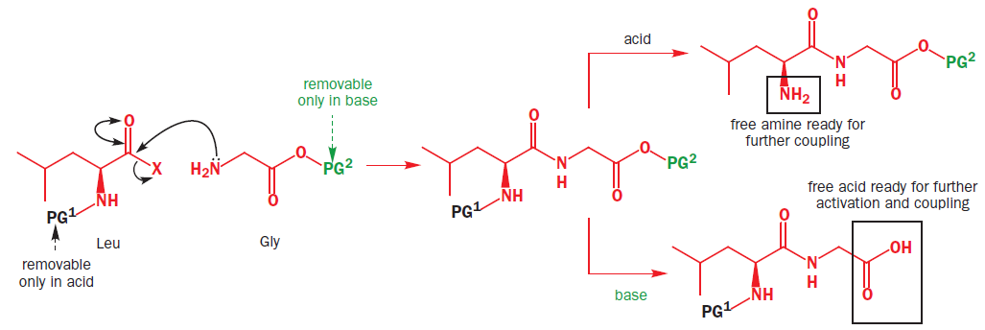

Slide 19



Protection of COOH - Esterification

Slide 20

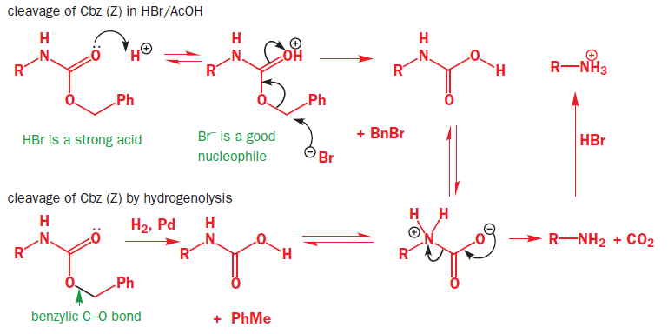
Protection of NH₂ group

Slide 21




Slide 22

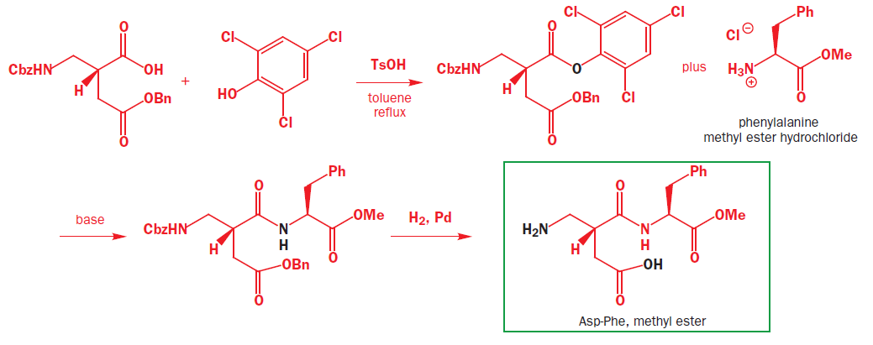

Slide 23



Protection of NH₂ group

Slide 24
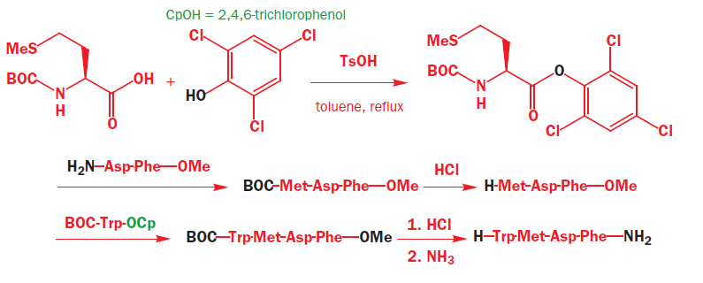
Protection of COOH - Esterification

Slide 25
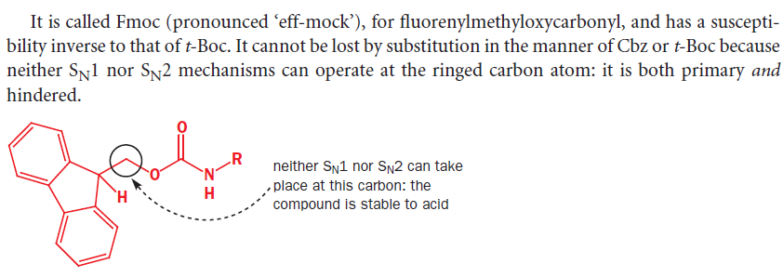

Slide 26



Slide 27
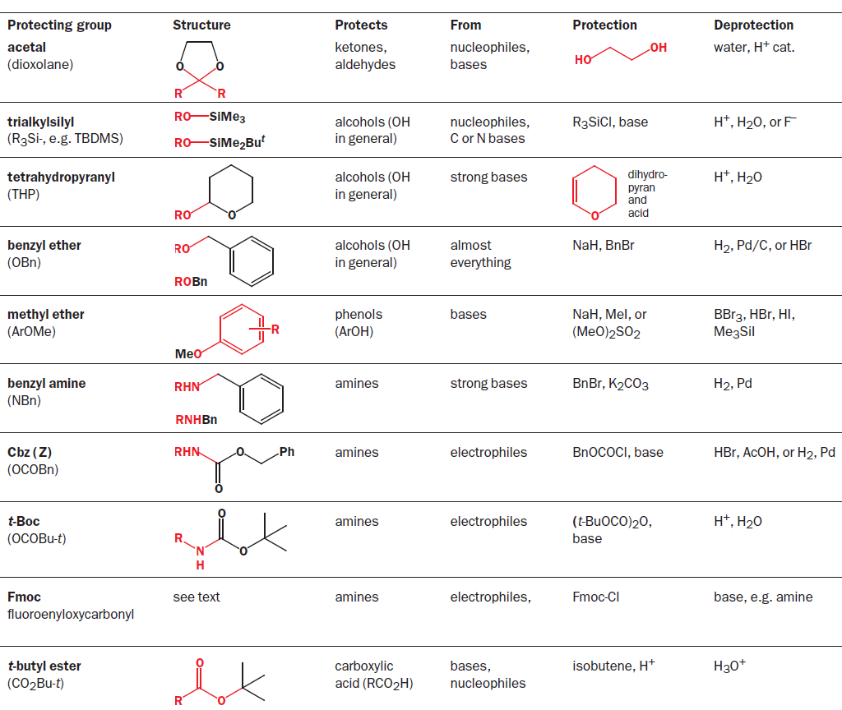
Summary

Slide 28
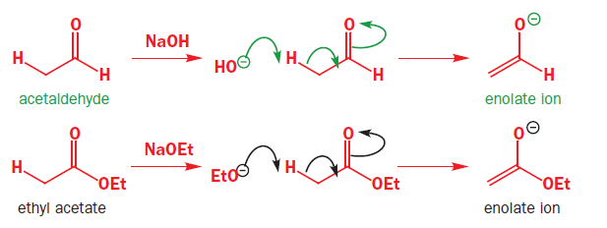
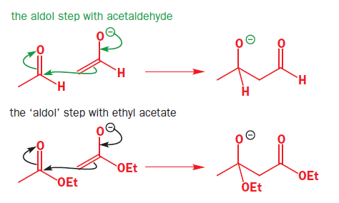


Slide 29
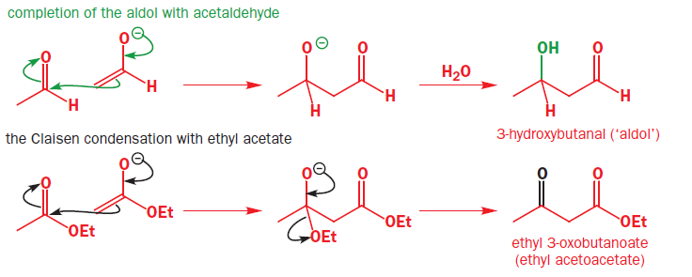



Slide 30




Slide 31



Slide 32


Slide 33





Slide 34
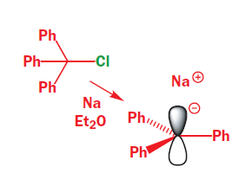


Slide 35





Slide 36



Slide 37






Slide 38







Slide 39



Slide 40


Predict the product .

Slide 41




Slide 42




Slide 43



Slide 44



Slide 45



Slide 46





Slide 47





Slide 48


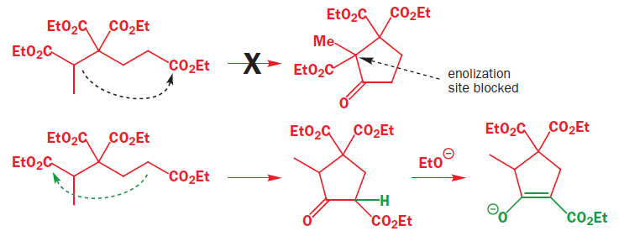

Slide 49





Slide 50
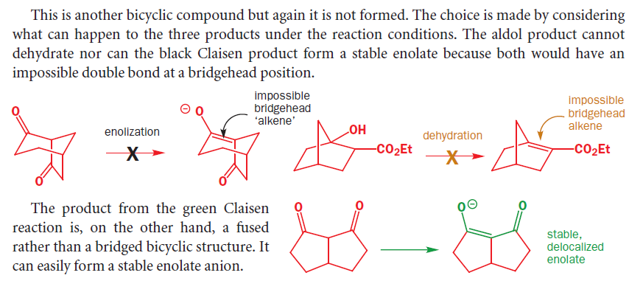

Slide 51




Slide 52



