Slide 1
POLYMERS

Slide 2
Poly means MANY and MER means repeating unit.
Polymers are macromolecules formed by joining of repeating structural units on a large scale.
The repeating structural units are called Monomers.
Polymerisation: The process of formation of polymers.
CLASSIFICATION OF POLYMERS BASED ON SOURCE
Semi synthetic
Eg :Cellulose nitrate, cellulose acetate
Synthetic(man made)
Eg : Plastics, Nylon, Buna-s etc
Natural(occur in nature)
Eg : Protein, cellulose, starch etc

Slide 3
CLASSIFICATION BASED ON STRUCTURE
Linear polymers(long chains)
Eg : High density polythene,
Poly vinyl chloride.
Branched chain(chain with branches)
Eg : Low density polythene
Cross linked or Network polymer
(string covalent bond between chains)
Eg : Bakelite , Melamine

Slide 4
Elastomers
weakest intermolecular forces
Eg : Rubber, buna-S etc
Fibres
Strongest inter molecular forces.
Eg : Nylon, Polyesters, terylene etc
Thermoplastic can be remoulded by
heating and cooling
Eg : Polythene , PVC etc
Thermosetting Plastic cannot be reused
Eg : Bakelite urea formaldehyde
CLASSIFICATION BASED ON MOLECULAR FORCES

Slide 5
Classification of Polymers
Based on mode of polymerization
Mode of polymerization
Addition polymers
Condensation polymers

Slide 6
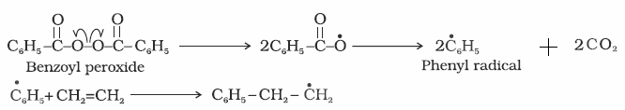
Addition polymers
Polymers are formed by the repeated addition of monomers with double and triple bonds
Mechanism of free radical polymerisation
Step 1: Chain initiating step

Slide 7
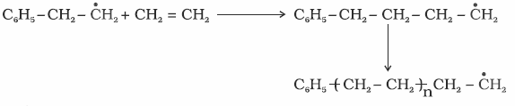
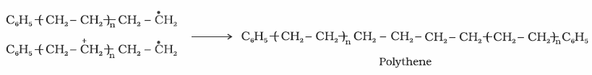
Step 2: Chain propagation
Step 3: Chain termination

Slide 8
EVALUATION QUESTIONS
1.Distinguish between homopolymer and copolymer with one example each.
2. Arrange the following polymers in the increasing order of molecular forces
Polyester
Polythene
Bakelite
Rubber
3.Explain the free radical mechanism of addition polymerisation.

Slide 9
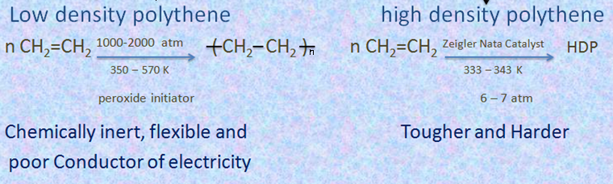
(8) Preparation of some important addition polymers
(a) Polythene (two types)

Slide 10

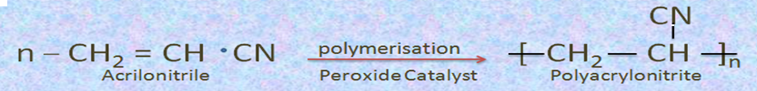
(b)Teflon( Polytetrafluoroethene)
Nonstick coating chemically inert and resistance to attack by reagents.
(c) Polyacrylonitrile
(Good resistance to stain, chemicals, insects and fungi)
Substitute for wool in making commercial fibers as orlon or acrilan.

Slide 11
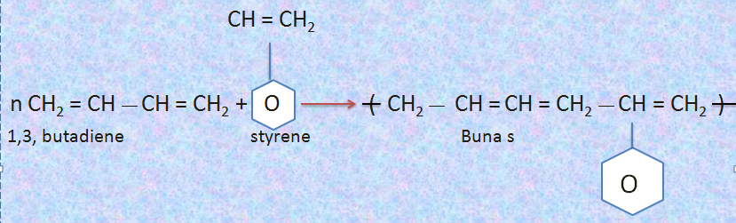
(d) Buna S
( A Copolymer of 1, 3, butadiene and styrene )
Good substitute for natural rubber used for making foot wear components, cable insulator etc…

Slide 12
(e) Natural Rubber (cis-1,4,poly isoprene)
n- CH2 = C —CH2 (—CH2—C = CH—CH2—)n
| |
CH3 CH3
2-Methyl 1,3 butadiene poly isoprene
(e)Neoprene (poly chloroprene) (Synthetic rubber)
Cl Cl
| polymerisation |
n CH2 = C — CH = CH2 (—CH2 — C = CH—CH2—)n
Chloroprene Neoprene
(2-chloro 1,3-butadiene)
Vulcanisation of rubber
To improve upon the physical properties of natural rubber, it is heated with sulphur and an appropriate additive at 373 – 415 K. so that sulphur forms cross links at double bonds and thus rubber gets stiffened.

Slide 13
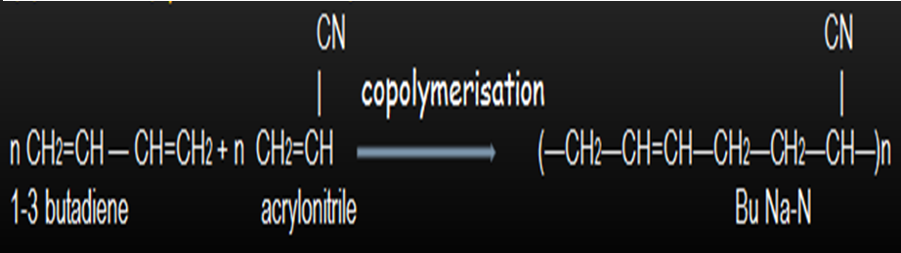
(f) Buna-N (synthetic rubber)

Slide 14
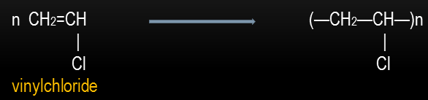
(g) Poly Vinyl Chloride P V C

Slide 15
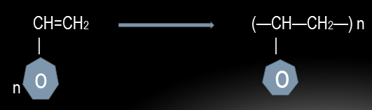
(h) Poly styrene

Slide 16
CONDENSATION POLYMERS
This involves repetitive condensation between two bifunctional monomers, with loss of some simple molecules such as water, alcohol etc.
Eg: Polyamides, polyesters, phenol formaldehyde polymer, melamine formaldehyde polymer etc.

Slide 17
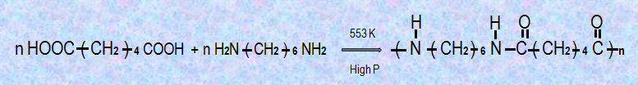
1. Polyamides: Nylon 6,6 and nylon 6
Nylon 6,6
Monomers- Hexamethylene diamine and adipic acid

Slide 18
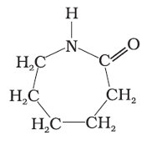
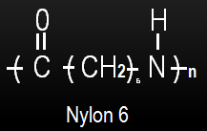
B)Nylon 6
Obtained by heating caprolactum with water
533-543 K
H20

Slide 19
15. Poly esters : Terelene and glyptal
A) Terelene
Monomers- Terephthalic acid and ethylene glycol
Terelene

Slide 20
B) Glyptal
Monomers- Phthatic acid and ethylene glycol.

Slide 21
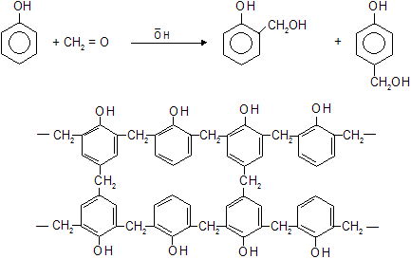
Phenol Formaldehyde Polymer(Bakelite).
phenol
formaldyhyde
o - hydroxymethylphenol

Slide 22
Melamine Formaldehyde Polymer
N
N
H₂N
NH₂
H₂N
NH.CH₂ – OH
N
+ H.CHO
N
N
N
N
NH₂
N
NH₂
H₂N
N
NH – CH₂ –)
Resin intermediate
N
N
NH₂

Slide 23
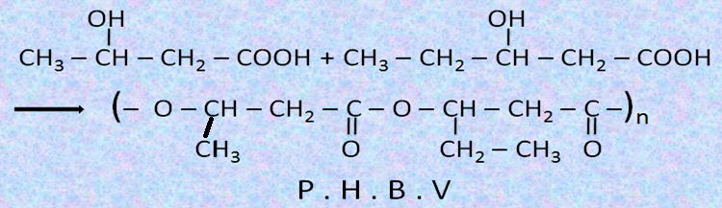
Bio Degradable Polymers
1.P.H.B.V (Poly B – hydroxy – Co – B hydroxy valerate P . H . B . V )
Monomers – 3 – hydroxy butanoic acid + 3 hydroxy pentanoic acid.

Slide 24
Questions
1.Give the structure and name of the monomers of the following addition polymers. Give one use of each polymer.
* Teflon
* Buna-s
* Natural rubber
* Neoprene
* Buna-n
* poly vinyl chloride
2. What is meant by vulcanization of rubber?
3.With the help of suitable equations explain the formation of following polymers
* Nylon6
* Nylon6,6
* Terelene
* Glyptal
* Bakelite
* Melamine formaldehyde polymer
4. What are biodegradable polymers ?Give one example for it . Explain its method of preparation.

