Slide 1
Inheritance
B.FathimaMary
Dept. of Commerce CA
SJC
Trichy-02

Slide 2
What is inheritance?
Inheritance is one of the key features of Object-oriented programming in C++. It allows user to create a new class (derived class) from an existing class(base class).

Slide 3
Why inheritance should be used?
Suppose, in your game, you want three characters - a maths teacher, a footballer and a businessman.
Since, all of the characters are persons, they can walk and talk. However, they also have some special skills. A maths teacher can teach maths, a footballer can play football and a businessman can run a business.
You can individually create three classes who can walk, talk and perform their special skill as shown in the figure below.

Slide 4

Without Using Inheritance

Slide 5
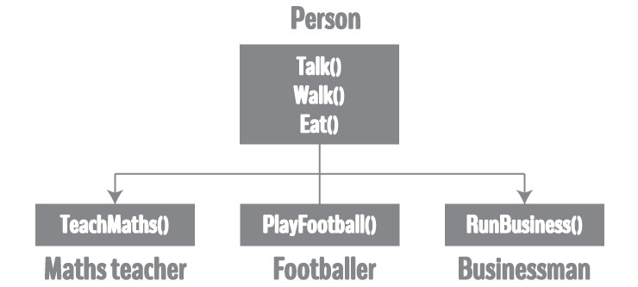
Using inheritance

Slide 6
Implementation of Inheritance in C++ Programming
class Person
{
... .. ...
};
class MathsTeacher : public Person
{ ... .. ...
};
class Footballer : public Person
{ .... .. ...
};

Slide 7
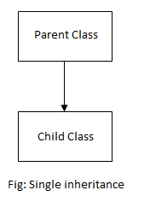
Single Inheritance
When a single class is derived from a single parent class, it is called Single inheritance. It is the simplest of all inheritance.
For example,
Animal is derived from living things
Car is derived from vehicle
Typist is derived from staff

Slide 8
Syntax of Single Inheritance
class base_classname {
properties;
methods;
};
class derived_classname : visibility_mode base_classname
{
properties;
methods;
};

Slide 9
class AddData //Base Class
{
protected:
int num1, num2;
public:
void accept()
{
cout<<"\n Enter First Number : ";
cin>>num1;
cout<<"\n Enter Second Number : ";
cin>>num2;
}
};
class Addition: public AddData //Class Addition – Derived Class
{
int sum;
public:
void add()
{
sum = num1 + num2;
}
void display()
{
cout<<"\n Addition of Two Numbers : "<<sum;
}
};
int main()
{
Addition a;
a.accept();
a.add();
a.display();
return 0;
}

Slide 10
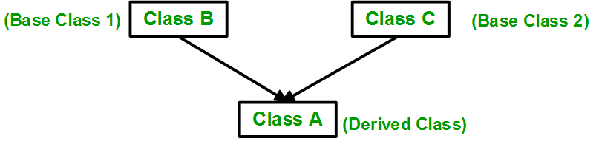
Multiple Inheritance
Multiple Inheritance is a feature of C++ where a class can inherit from more than one classes. i.e one sub class is inherited from more than one base classes.

Slide 11
Syntax
class subclass_name : access_mode base_class1, access_mode base_class2, ....
{
//
body of subclass
};

Slide 12
Multiple Inheritance
// first base class
class Vehicle {
public:
Vehicle()
{
cout << "This is a Vehicle" << endl;
}
};
// second base class
class FourWheeler {
public:
FourWheeler()
{
cout << "This is a 4 wheeler Vehicle" << endl;
}
};
// sub class derived from two base classes
class Car: public Vehicle, public FourWheeler {
};
// main function
int main()
{
// creating object of sub class will
// invoke the constructor of base classes
Car obj;
return 0;
}

Slide 13
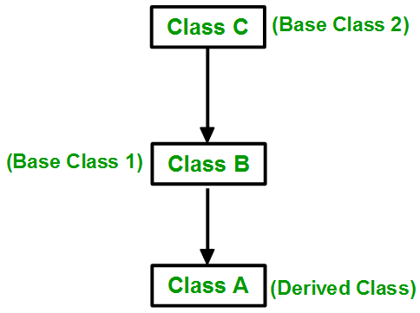
Multilevel Inheritance
Multilevel Inheritance: In this type of inheritance, a derived class is created from another derived class.

Slide 14
Multilevel Inheritance
// base class
class Vehicle
{
public:
Vehicle()
{
cout << "This is a Vehicle" << endl;
} };
class fourWheeler: public Vehicle
{ public:
fourWheeler()
{
cout<<"Objects with 4 wheels are vehicles"<<endl;
} };
// sub class derived from two base classes
class Car: public fourWheeler{
public:
car()
{
cout<<"Car has 4 Wheels"<<endl;
} };
// main function
int main()
{
//creating object of sub class will nvoke the constructor of base classes
Car obj; return 0; }

Slide 15
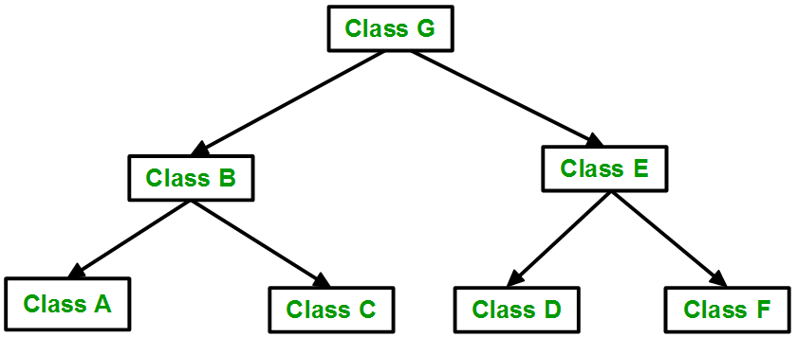
Hierarchical Inheritance:
Hierarchical Inheritance: In this type of inheritance, more than one sub class is inherited from a single base class. i.e. more than one derived class is created from a single base class.

Slide 16
Hierarchical Inheritance:
// base class
class Vehicle
{
public:
Vehicle()
{
cout << "This is a Vehicle" << endl;
} };
// first sub class
class Car: public Vehicle
{ };
// second sub class
class Bus: public Vehicle
{ };
// main function
int main()
{
// creating object of sub class will
// invoke the constructor of base class
Car obj1;
Bus obj2; return 0;
}

Slide 17
Hybrid Inheritance
Hybrid (Virtual) Inheritance: Hybrid Inheritance is implemented by combining more than one type of inheritance. For example: Combining Hierarchical inheritance and Multiple Inheritance.
Below image shows the combination of hierarchical and multiple inheritance:

Slide 18
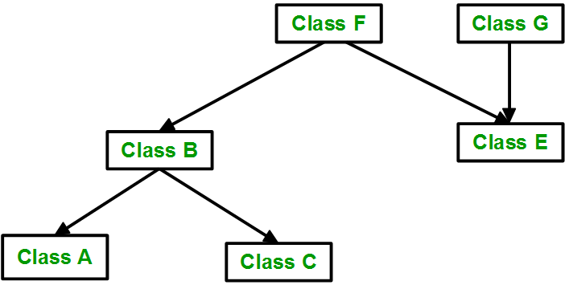
Hybrid Inheritance

Slide 19
Hybrid Inheritance
// base class
class Vehicle
{
public:
Vehicle()
{
cout << "This is a Vehicle" << endl;
}
};
//base class
class Fare
{
public:
Fare()
{
cout<<"Fare of Vehicle\n";
}
};

Slide 20
Hybrid Inheritance
// first sub class
class Car: public Vehicle
{
};
// second sub class
class Bus: public Vehicle, public Fare
{
};
// main function int main()
{
// creating object of sub class will
// invoke the constructor of base class
Bus obj2;
return 0;
}

