Slide 1
Introduction of ERP
J. Arputha Sahaya Raj
Assistant Professor,
PG Department of Commerce CA
St. Joseph’s College (Autonomous), Trichy-2

Slide 2
What is Enterprise ?
An enterprise is a group of people with a common goal, which has certain resources at its disposal to achieve this goal.
In enterprise way the entire organization is considered a system and all departments are its sub system, each sub system knows what others are doing , why they are doing and what should be done to move the company towards common goal.

Slide 3
What is ERP ?
Enterprise resource planning (ERP) is a systems that integrate internal and external management of information across an entire organization—taking on finance/accounting, manufacturing, sales and service, customer relationship management, etc.
ERP systems automate this activity with an integrated software application. Ex : SAP,Oracle…
ERP facilitates information flow between all business functions inside the organization, and manages connections to outside stakeholders.

Slide 4
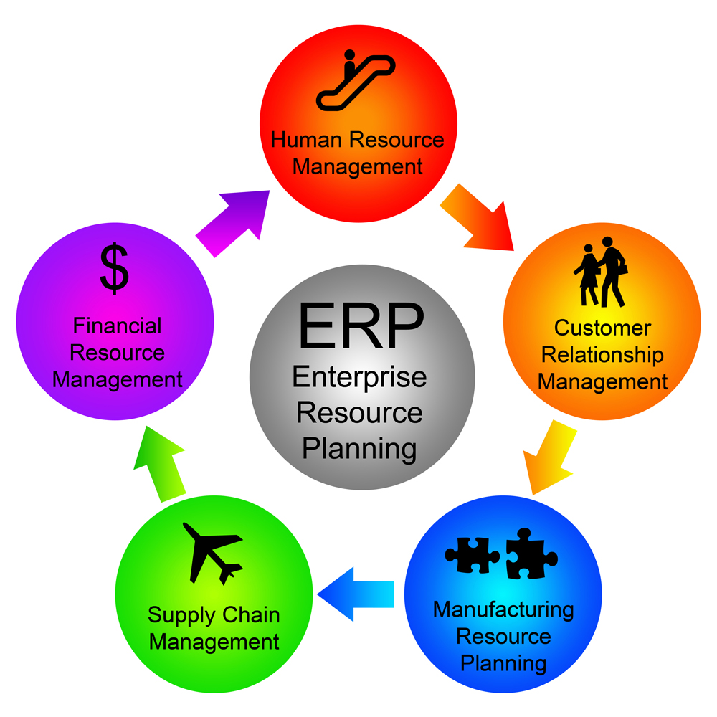
ERP includes functions like

Slide 5
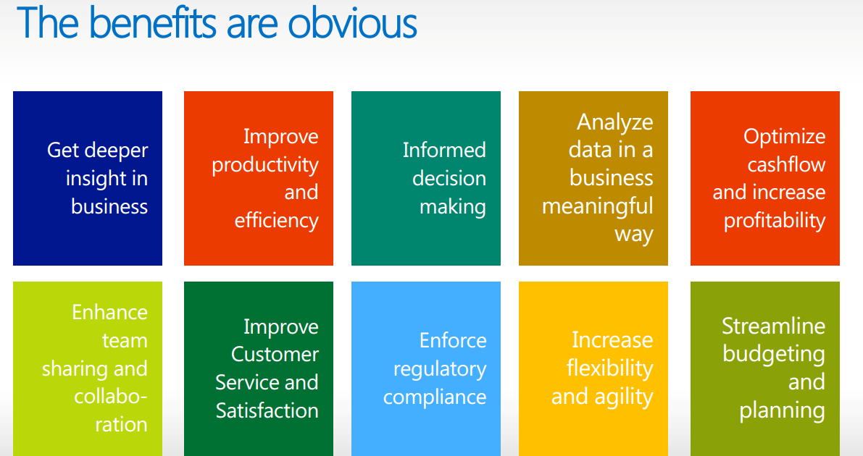

Slide 6
ERP challenges
Low Expertise
Budgetary Constraints
Minimal project resources
Incapable decision support resources

Slide 7
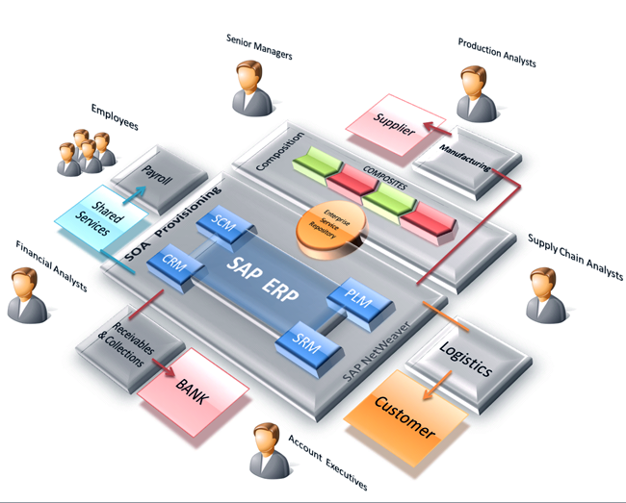
Example of SAP ERP

Slide 8
What is Business Process ?
Is a collection of activities that takes one or more kind of input and creates an output that is of value to the customer.
The customer wants a good quality product, delivered to him at a competitive price as fast as possible.
Difference with Business function is that business process cuts across more than one business function to get a task done.

Slide 9
What is IMI ?
An information systems can be designed so that accurate and timely data are shared between functions areas. These system called Integrated Information Systems.
Its using ‘input-process-output’ cycle.
Today, an information system is an organized combination of people, hardware, software, communication networks and data resources that collects, collates, transforms and disseminates information in an organization.
These are problems in traditional MIS system.
  1. No any inter communication with the other department.
  2. At provides information when at the time procedure built.

Slide 10
Continue…
It consists of three elements
  People
  Procedure
  Data
People follows procedure to manipulate data to procedure information.
IMI have three characteristic of information are accuracy, relevancy and timeliness.

Slide 11
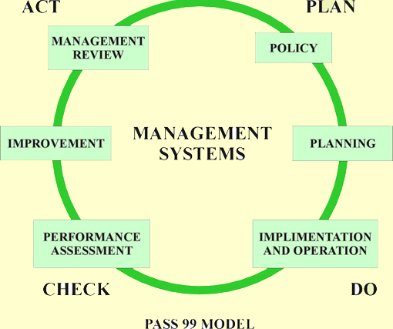
IMI

Slide 12
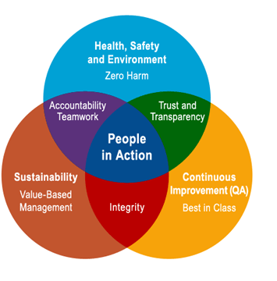
Why IMI ?

Slide 13
What is Business Modeling ?
A business model describes the basis of how an organization creates, delivers, and captures value (economic, social, cultural, or other forms of value).
A business model consisting of the business process is developed based on the goals, objectives and strategic plans of the organization.
It represents as one large system showing the interconnections and interdependencies of the various sub-system and business process.
It is integrated system. A Datamodel of the system created from the business model.

Slide 14
Continue…
Based on business model ERP is designed.
Business Model is basically represented as graphical form using flow chart and flow diagram.

Slide 15
Business Model
plant
material
invoice
contract
Customer order

Slide 16
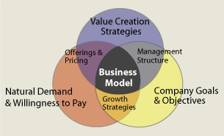
Why Business Model ?

Slide 17
What is IDM ?
Data Model is the creation of an integrated data model as all the employees from the different departments get access to the integrated data and this will help in better decision-making.
IDM will reduce redundancy and provides update information to entire organization.
The integrated database will reduce data redundancy and give all employees access to the updated and up-to-the minute information about the entire organization.
When designing the data model for the ERP system, is the information integration and the process/ procedure computerization.
The data model should reflect the entire organization and should successfully depict and integrate the data structures of the entire organization.
Maintaining and managing the integrated data constantly updated and up-to-date is one of the biggest challenges of ERP implementation and operation.

Slide 18
Continue…
For integrated database to be effective
  Clearly depict organization
  Reflect day to day transaction
  Update continuously
  Should give snap-shot of organization any time
Integrated model is derived from BM
Major parts :
  Information integration
  Process/Procedure automation

Slide 19
Thank you

