Slide 1
Restriction Fragment Length Polymorphism (RFLP)
BY
Mr.P.G.GEEGI, ASST.PROF, DEPT OF BIOCHEMISTRY
St,JOSEPH’S COLLEGE,TRICHY.
Course title: MOLECULAR DIAGNOSTICS (UNIT-II)
CLASS: I M.Sc BIOCHEMISTRY.

Slide 2
It is a method used by molecular biologists to follow a particular sequence of DNA as it is passed on to other cells. RFLPs can be used in many different settings to accomplish different objectives .It is a difference in homologous DNA sequences that can be detected by the presence of fragments of different lengths after digestion of the DNA samples in question with specific restriction endonucleases. RFLP, as a molecular marker, is specific to a single clone/restriction enzyme combination.

Slide 3
Each organism inherits its DNA from its parents. Since DNA is replicated with each generation, any given sequence can be passed on to the next generation. An RFLP is a sequence of DNA that has a restriction site on each end with a "target" sequence in between. A target sequence is any segment of DNA that bind to a probe by forming complementary base pairs that hybridizes with one or more fragments of the digested DNA sample after they were separated by gel electrophoresis, thus revealing a unique blotting pattern characteristic to a specific genotype at a specific locus.

Slide 4
RFLP probes are short, single- or low-copy genomic DNA or cDNA clones are typically used. They are frequently used in genome mapping and in variation analysis (genotyping, forensics, paternity tests, hereditary disease diagnostics). Most RFLP markers are co-dominant (both alleles in heterozygous sample will be detected) and highly locus-specific. The RFLP method is a direct test in which genomic DNA is isolated from biological material and analyzed without any prior amplification via the polymerase chain reaction (PCR).

Slide 5
The basic technique for detecting RFLPs involves fragmenting a sample of DNA by a restriction enzyme, which can recognize and cut DNA wherever a specific short sequence occurs. The resulting DNA fragments are then separated by length by agarose gel electrophoresis, and transferred to a membrane via the Southern blot procedure. Hybridization of the membrane to a labeled DNA probe then determines the length of the fragments which are complementary to the probe.
.

Slide 6
An RFLP occurs when the length of a detected fragment varies between individuals. Each fragment length is considered an allele, and can be used in genetic analysis. RFLP analysis may be subdivided into single- (SLP) and multi-locus probe (MLP) paradigms. Usually, the SLP method is preferred over MLP because it is more sensitive, easier to interpret and capable of analyzing mixed-DNA samples Briefly, DNA is extracted and cleaved into small fragments using a selected restriction endonuclease and polymorphic variation in the lengths of the resulting restriction fragments is used to distinguish between individuals.

Slide 7
The analysis of a relatively small number (4-6) of highly polymorphic regions or loci within the human genome, commonly referred to as minisatellites or variable number of tandem repeats (VNTRs), is sufficient to generate DNA profiles that are virtually individual specific. Although the RFLP method is quickly being replaced by PCR-based typing methods, some forensic laboratories still rely heavily on RFLP typing. Moreover, RFLP typing continues to be a dominant technology for many paternity testing laboratories.

Slide 8
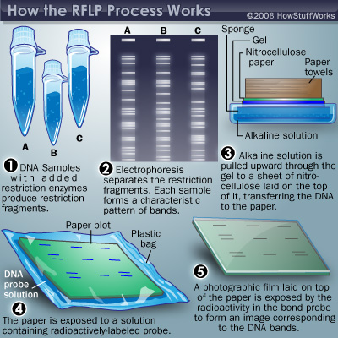

Slide 9
Applications
In genome mapping and genetic disease analysis: In this analysis, the DNA of members of a family afflicted by the disease, and look for RFLP alleles that show a similar pattern of inheritance .Once a disease gene was localized, RFLP analysis of other families could reveal who was at risk for the disease.
Useful in the identification of crime- by genetic fingerprinting.
In the determination of paternity.
In the characterization of genetic diversity or breeding patterns in animal populations.

Slide 10
REFERENCES
https://en.wikipedia.org/wiki/Restriction_fragment_length_polymorphism.
https://www.news-medical.net/.../Restriction-Fragment-Length-Polymorphism-(RFLP).
https://www.thermofisher.com/.../restriction-fragment-length-polymorphism-rflp-anal.

