Slide 1
Down stream Processing

Slide 2
Recovery of products
Definition: the isolation and purification of biotechnological product to a form suitable for its intended use.
Culture is harvested at the optimal timing cells are separated from the medium downstream processing.
Biotechnological products include: whole cells, organic acids, amino acids, solvents, antibiotics, industrial enzymes, therapeutic proteins, vaccines, etc.
The complexity of the processing steps is determined by the required purity, which in turn, is determined by its application.
Separation principles also depend on the size and nature of products.

Slide 3
Recovery of fermentation products may be difficult and costly.
Recovery costs of microbial products may vary from 15% to 70% of total production cost.
The major problem currently faced in product recovery is the large-scale purification of biologically active molecules.

Slide 4
If a fermentation broth at the time of harvesting, it is discovered that the product may be present at a low concentration (typically 0.1–5 g dm−3) in an aqueous solution that contains intact microorganisms, cell fragments, soluble and insoluble medium components, and other metabolic products.
The product may also be intracellular, heat labile, and easily broken down by contaminating microorganisms.
All these factors tend to increase the difficulties of product recovery.
To ensure good recovery or purification, speed of operation may be a factor because of the labile nature of a product.

Slide 5
The choice of recovery process is based on the following criteria:
1. The intracellular or extracellular location of the product.
2. The concentration of the product in the fermentation broth.
3. The physical and chemical properties of the desired product (as an aid to select separation procedures).
4. The intended use of the product.
5. The minimal acceptable standard of purity.
6. The impurities in the fermenter broth.
7. The marketable price for the product.

Slide 6
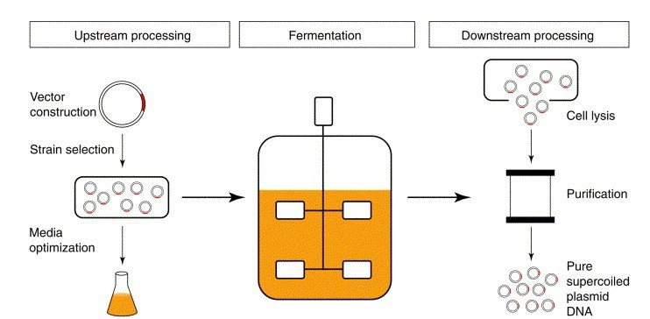
Product

Slide 7
Down Stream Processing
The various process used for actual Recovery and purification of biosynthetic products from a fermentation or any other industrial process together constitute a downstream processing.
The various stages of processing that occur after the completion of the fermentation or bioconversion stage, including separation, purification, and packaging of the product.

Slide 8
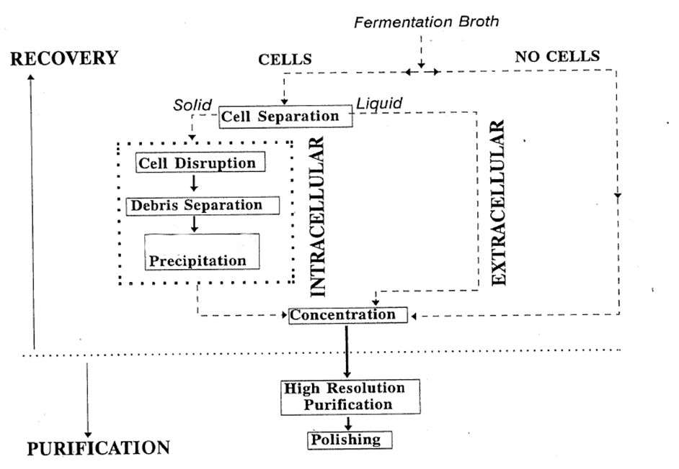
General Steps of Down Stream Processing

Slide 9
Stages in Downstream Processing
Removal of Insolubles
Product Isolation
Product Purification
Product Polishing

Slide 10
The main objective of the first stage for the recovery of an extracellular product is the removal of large solid particles and microbial cells usually by centrifugation or filtration.
In the next stage, the broth is fractionated or extracted into major fractions using ultrafiltration, reverse osmosis, adsorption/ion-exchange/gel filtration or affinity chromatography, liquid–liquid extraction, two phase aqueous extraction, supercritical fluid extraction, or precipitation.
Afterward, the product containing fraction is purified by fractional precipitation, further more precise chromatographic techniques and crystallization to obtain a product, which is highly concentrated and essentially free from impurities.
Finally, the finished product may require drying.

Slide 11
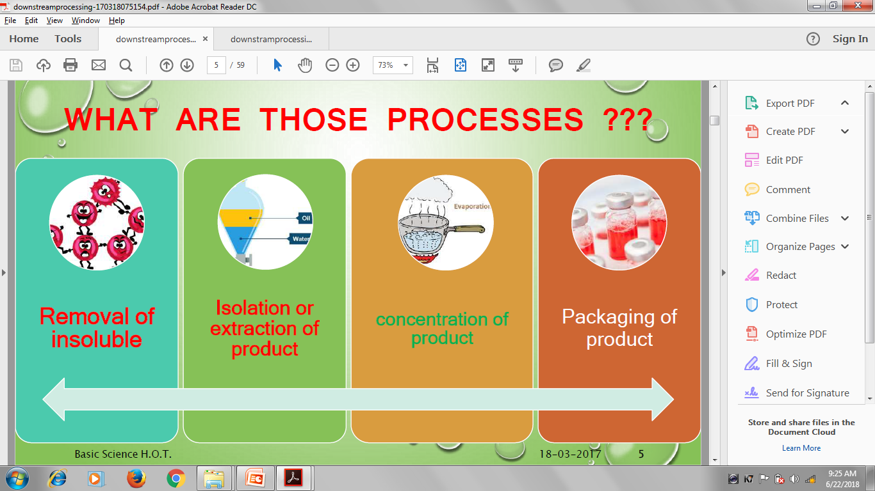

Slide 12
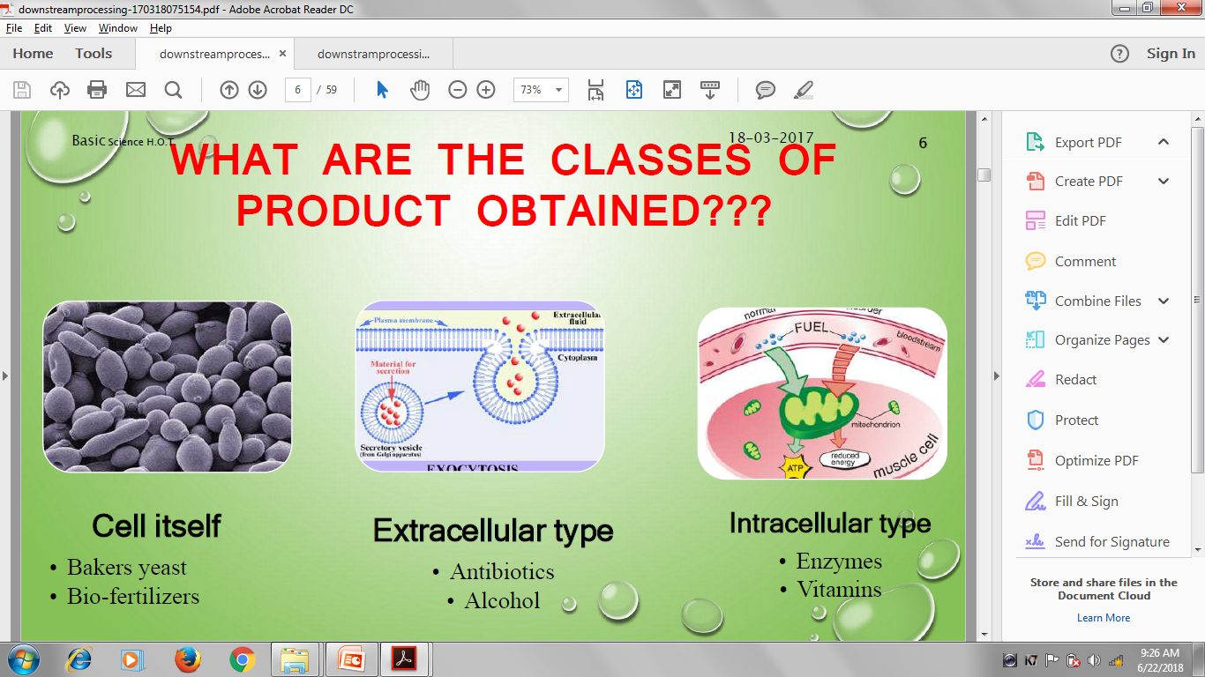

Slide 13
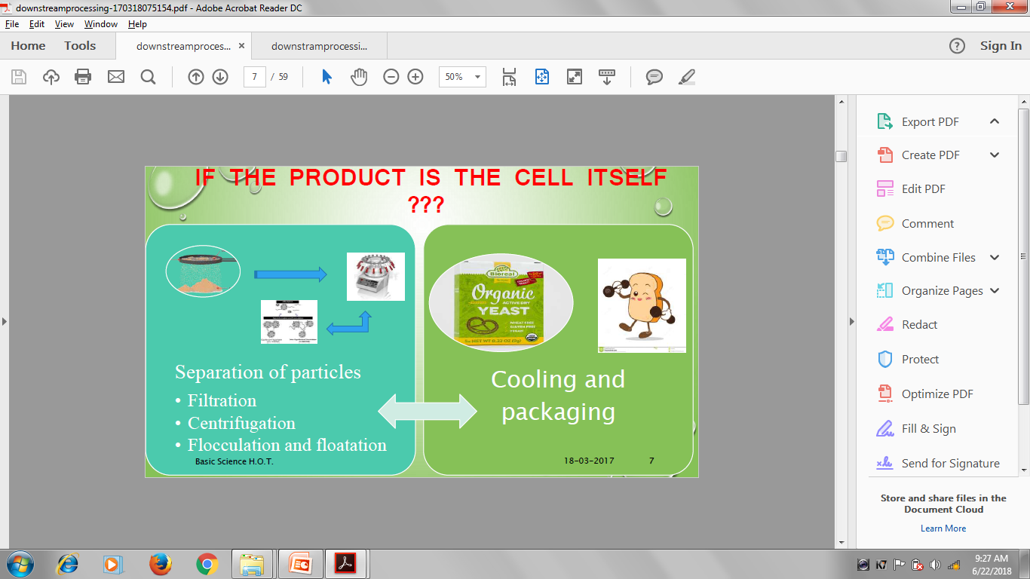

Slide 14
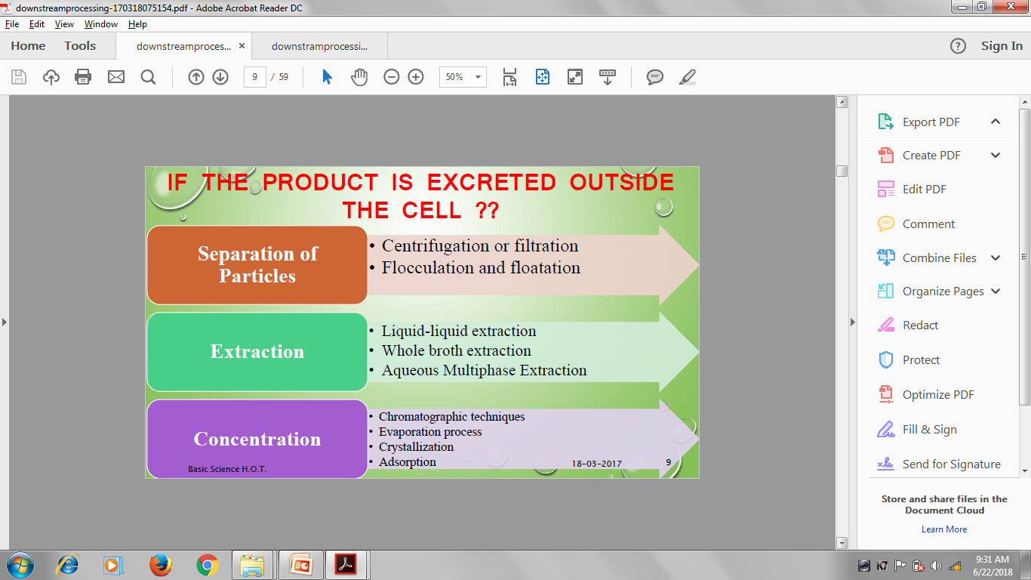

Slide 15
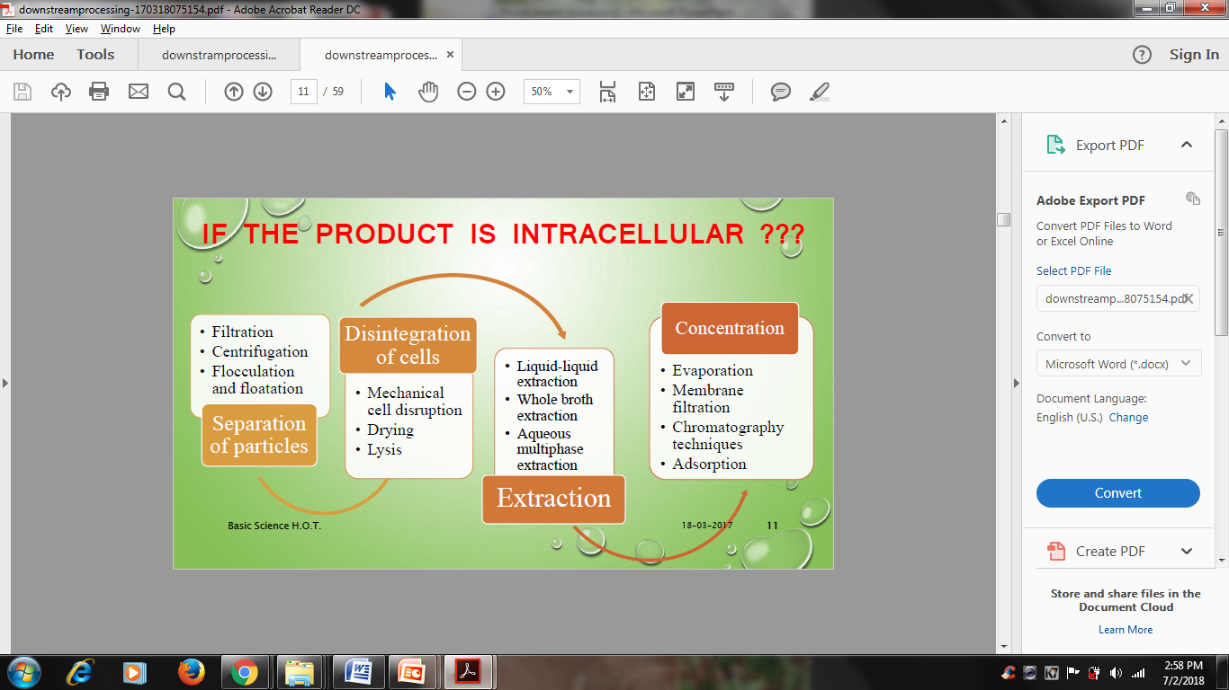

Slide 16
Removal of Insolubles
Separation of cells, cell debris or other particulate matter
Typical operations to achieve this:
1) Filtration
2) Centrifugation
3) Sedimentation
4) Flocculation a process where a solute comes out of solution in the form of floc or flakes.
5) Precipitation

Slide 17
Product Isolation
Removal of those components whose properties vary markedly (impurities) from that of the desired product.
Water is the chief impurity
a) Isolation steps are designed to remove it
b) Reducing the volume
c) Concentrating the product.
d)Liquid –liquid extraction, adsorption, ultrafiltration, and precipitation are some of the unit operations involved.

Slide 18
Product Purification
Done to separate those contaminants that resemble the product very closely in physical and chemical properties.
Expensive to carry out
Require sensitive and sophisticated equipment
Significant fraction of the entire downstream processing expenditure.
Examples of operations include affinity, size exclusion, reversed phase chromatography, crystallization and fractional precipitation.

Slide 19
Product Polishing
End with packaging of the product in a form that is stable, easily transportable and convenient.
Crystallization
Desiccation
Lyophilization
Spray drying
May include:
Sterilization of the product
Remove or deactivate trace contaminants which might compromise product safety viruses or depyrogenation

Slide 20
Precipitation
Precipitation may be conducted at various stages of the product recovery process.
It is a particularly useful process as it allows enrichment and concentration in one step, thereby reducing the volume of material for further processing.
It is possible to obtain some products (or to remove certain impurities) directly from the broth by precipitation, or to use the technique after a crude cell lysate has been obtained.

Slide 21
An older but effective method used at this stage is salting out of proteins, followed by the recovery of precipitated proteins by centrifugation.
Precipitation is achieved by the addition of inorganic salts at high ionic strength and usually in the form of solid or saturated solutions of ammonium sulphate.
Ammonium sulphate is popular due to its high solubility, low toxicity and low cost but it can liberate ammonia at high pH and is corrosive to metal surfaces, e.g., centrifuges.
The solubility of the salt varies with temperature, so strict temperature control is required.
Addition of organic solvents, such as acetone, ethanol and isopropanol at low temperature reduces protein solubility and the dielectric constant of the medium resulting in precipitation of the proteins.

Slide 22
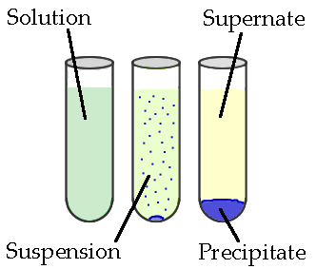
Formation of a solid in a solution during a chemical reaction.
Solid formed is called the precipitate and the liquid remaining above the solid is called the supernate.

Slide 23
“Salting out”
Salts such as ammonium and sodium sulfate are used for the recovery and fractionation of proteins.
The salt removes water from the surface of the protein revealing hydrophobic patches, which come together causing the protein to precipitate.
The most hydrophobic proteins will precipitate first, thus allowing fractionation to take place. This technique is also termed “salting out.”

Slide 24
Typical agents used in precipitation render the compound of interest insoluble, and these include:
Organic solvents-
  Dextrans can be precipitated out of a broth by the addition of methanol.
  Chilled ethanol and acetone can be used in the precipitation of proteins mainly due to changes in the \properties of the solution.
Nonionic polymers
  Polyethylene glycol (PEG) can be used in the precipitation of proteins and are similar in behavior to organic solvents.
Polyelectrolytes
  They can be used in the precipitation of a range of compounds, in addition to their use in cell aggregation.
Protein binding dyes
  Triazine dyes bind to and precipitate certain classes of protein
Heat treatment as a selective precipitation and purification step for various thermostable products and in the deactivation of cell proteases

Slide 25
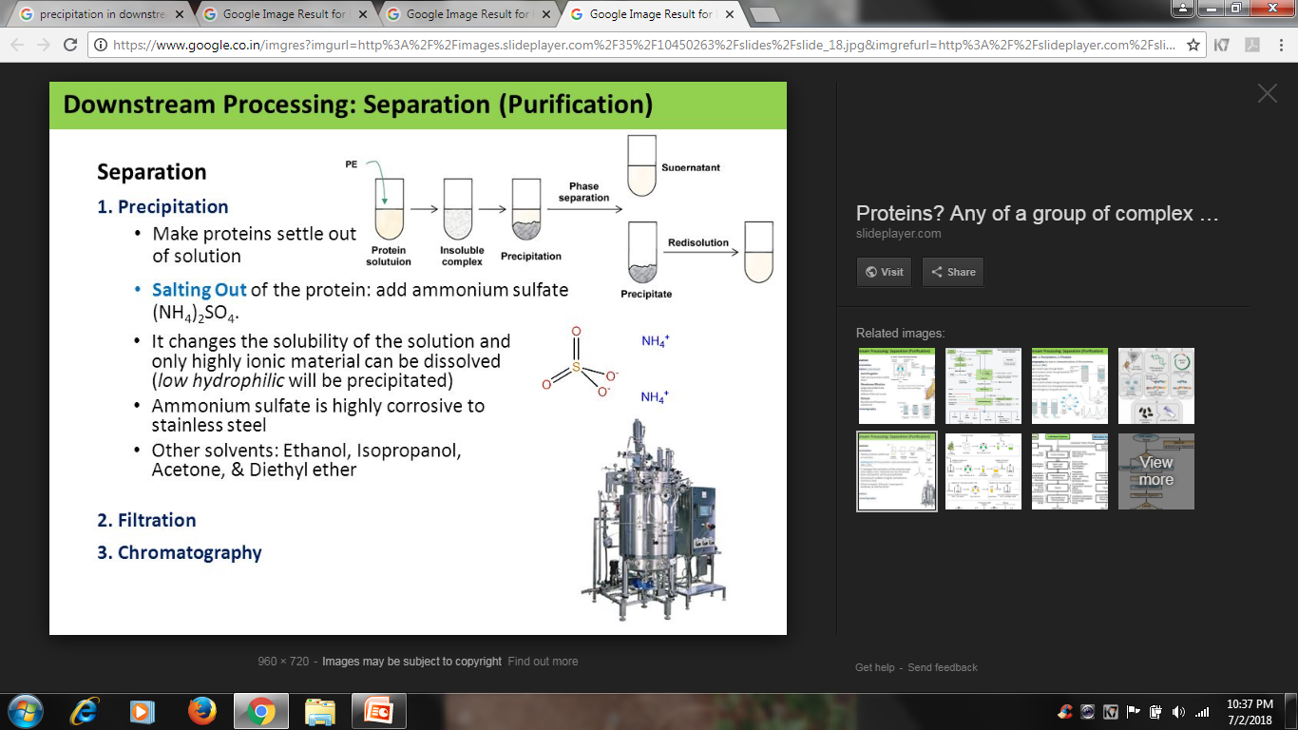
Centrifugation

