Slide 1
PRESENTATION ON SPSS
By
A.Arul Xavier
Department of mathematics

Slide 2
What is in this workshop
SPSS interface: data view and variable view
How to enter data in SPSS
How to import external data into SPSS
How to clean and edit data
How to transform variables
How to sort and select cases
How to get descriptive statistics

Slide 3
Data used in the workshop
We use 2009 Youth Risk Behavior Surveillance System (YRBSS, CDC) as an example.
YRBSS monitors priority health-risk behaviors and the prevalence of obesity and asthma among youth and young adults.
The target population is high school students
Multiple health behaviors include drinking, smoking, exercise, eating habits, etc.

Slide 4
SPSS interface
Data view
The place to enter data
Columns: variables
Rows: records
Variable view
The place to enter variables
List of all variables
Characteristics of all variables

Slide 5
Before the data entry
You need a code book/scoring guide
You give ID number for each case (NOT real identification numbers of your subjects) if you use paper survey.
If you use online survey, you need something to identify your cases.
You also can use Excel to do data entry.

Slide 6
Example of a code book
A code book is about how you code your variables. What are in code book?
Variable names
Values for each response option
How to recode variables

Slide 7
Enter data in SPSS 19.0
Columns: variables
Rows: cases
Under Data View

Slide 8
Enter variables
Click Variable View
Type variable name under Name column (e.g. Q01).
NOTE: Variable name can be 64 bytes long, and the first character must be a letter or one of the characters @, #, or $.
Type: Numeric, string, etc.
Label: description of variables.
2. Type variable name
4. Description of variable
3. Type: numeric or string
1. Click this Window

Slide 9
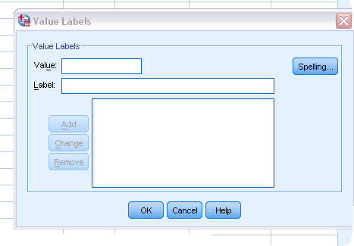
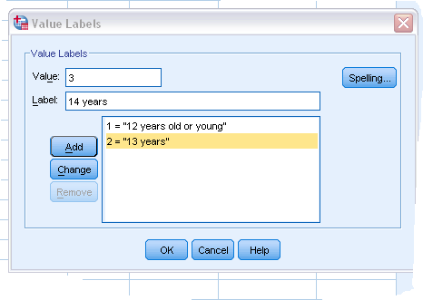
Enter variables
Based on your code book!

Slide 10
Enter cases
Two variables in the data set.
They are: Code and Q01.
Code is an ID variable, used to identify individual case (NOT people’s real IDs).
Q01 is about participants’ ages: 1 = 12 years or younger, 2 = 13 years, 3 = 14 years…
Under Data View

Slide 11
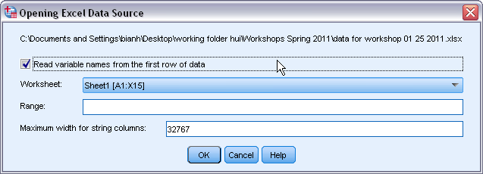
Import data from Excel
Select File Open Data
Choose Excel as file type
Select the file you want to import
Then click Open

Slide 12
Open Excel files in SPSS

Slide 13
Import data from CVS file
CVS is a comma-separated values file.
If you use Qualtrics to collect data (online survey), you will get a CVS data file.
Select File Open Data
Choose All files as file type
Select the file you want to import
Then click Open

Slide 14
Continue

Slide 15
Continue

Slide 16
Continue

Slide 17
Continue

Slide 18
Continue

Slide 19
Continue

Slide 20
Continue
Save this file as SPSS data

Slide 21
Clean data after import data files
Key in values and labels for each variable
Run frequency for each variable
Check outputs to see if you have variables with wrong values.
Check missing values and physical surveys if you use paper surveys, and make sure they are real missing.
Sometimes, you need to recode string variables into numeric variables

Slide 22
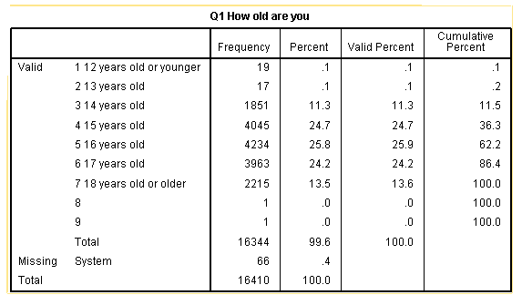
Continue
Wrong entries

Slide 23
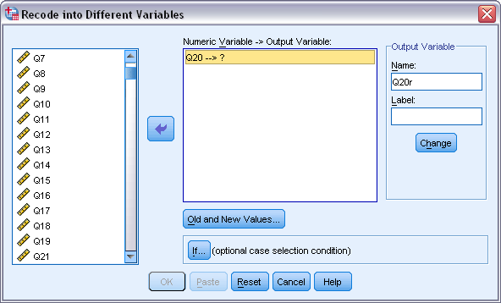
Variable transformation
Recode variables
Select Transform Recode into Different Variables
Select variable that you want to transform (e.g. Q20): we want
1= Yes and 0 = No
3. Click Arrow button to put your variable into the right window
4. Under Output Variable: type name for new variable and label, then click Change
5. Click Old and New Values

Slide 24
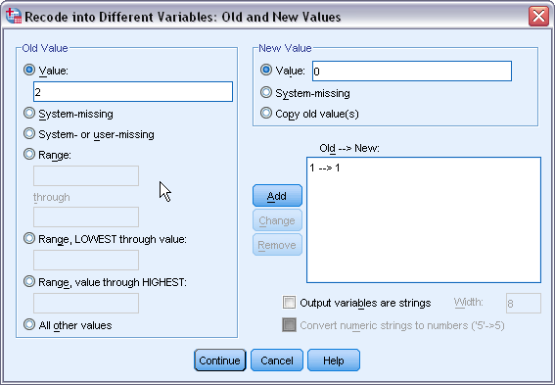
Continue
6. Type 1 under Old Value
and 1 under New Value,
click Add. Then type 2
under Old Value, and 0
under New Value, click
Add.
7. Click Continue after
finish all the changes.
8. Click Ok

Slide 25
Variable transformation
Compute variable (use YRBSS 2009 data)
Example 1. Create a new variable: drug_use (During the past 30 days, any use of cigarettes, alcohol, and marijuana is defined as use, else as non-use). There are two categories for the new variable (use vs. non-use). Coding: 1= Use and 0 = Non-use
Use Q30, Q41, and Q47 from 2009 YRBSS survey
Non-users means those who answered 0 days/times to all three questions.
Go to Transform Compute Variable

Slide 26
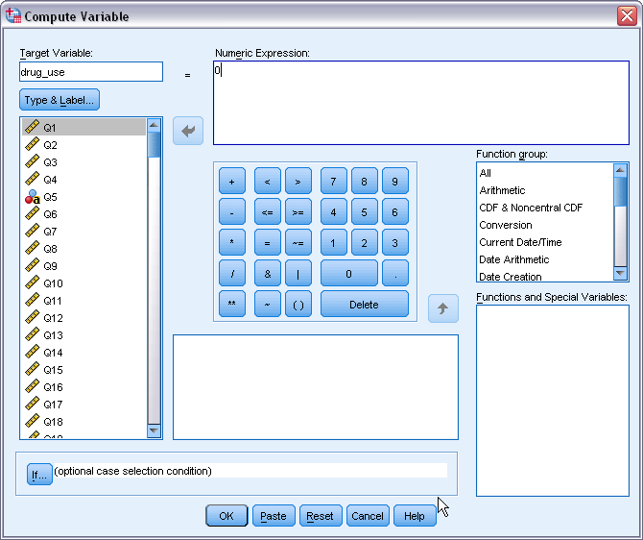
Continue
4. Type “drug_use” under
Target Variable
5. Type “0” under Numeric
Expression. 0 means
Non-use
6. Click If button.

Slide 27
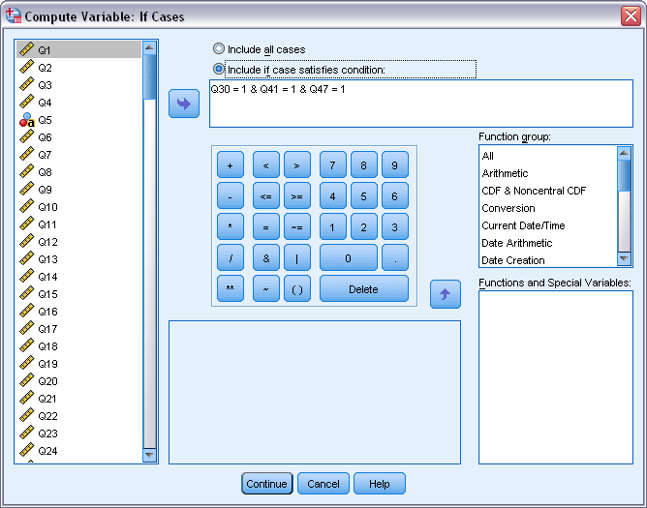
Continue
7. With help of that
Arrow button, type
Q30= 1 & Q41 = 1 & Q47= 1
then click Continue
8. Do the same thing for
Use, but the numeric
expression is different:
Q30> 1 | Q41> 1 | Q47>1
AND
OR

Slide 28
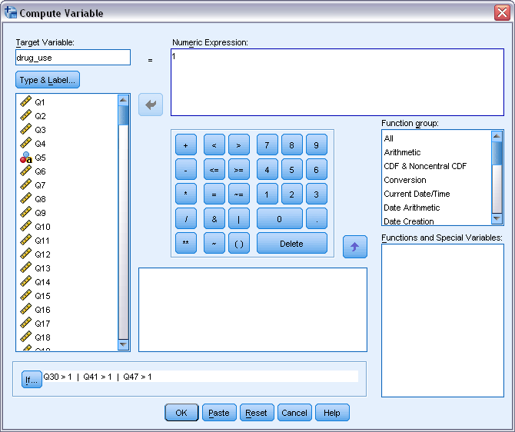
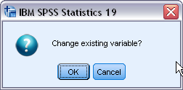
Continue
9. Click OK
10. After click OK,
a small window asks
if you want to
change existing
variable because
drug_use was already
created when you
first define non-use.
11. Click ok.

Slide 29
Continue
Compute variables
Example 2. Create a new variable drug_N that assesses total number of drugs that adolescents used during the last 30 days.
Use Q30 (cigarettes), 41 (alcohol), 47 (marijuana), and 50 (cocaine). The number of drugs used should be between 0 and 4.
First, recode all four variables into two categories: 0 = non-use (0 days), 1 = use (at least 1 day/time)
Four variables have 6 or 7 categories

Slide 30
Continue
4. Recode four variables: 1 (old) = 0 (new), 2-6/7 (old) = 1 (New).
5. Then select Transform Compute Variable

Slide 31
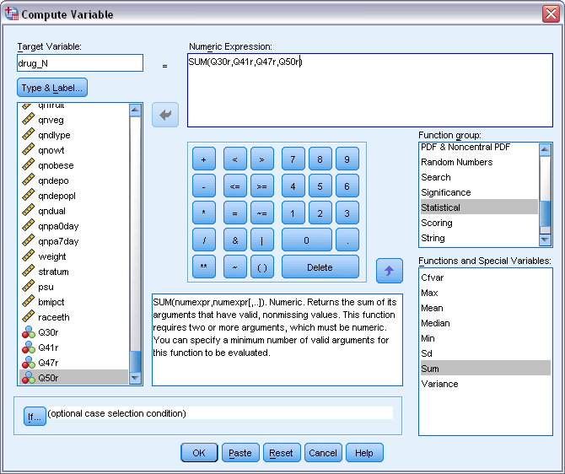
Continue
6. Type drug_N under Target Variable
7. Numeric Expression: SUM (Q30r,Q41r,Q47r,Q50r)
8. Click OK

Slide 32
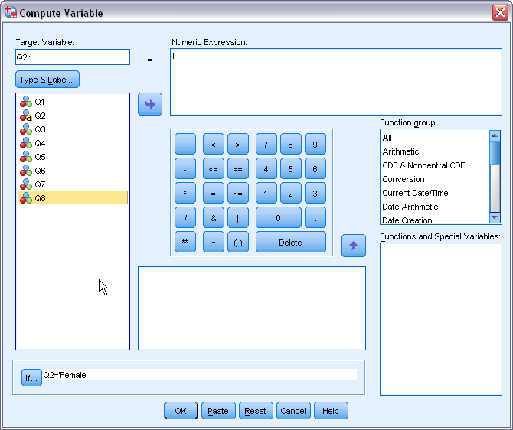
Continue
Compute variables
Example 3: Convert string variable into numeric variable
Enter 1 at Numeric Expression.
Click If button and type Q2 = ‘Female’
Then click Ok.
Enter 2 at Numeric Expression.
Click If button and type Q2 = ‘Male’
Then click Ok

Slide 33
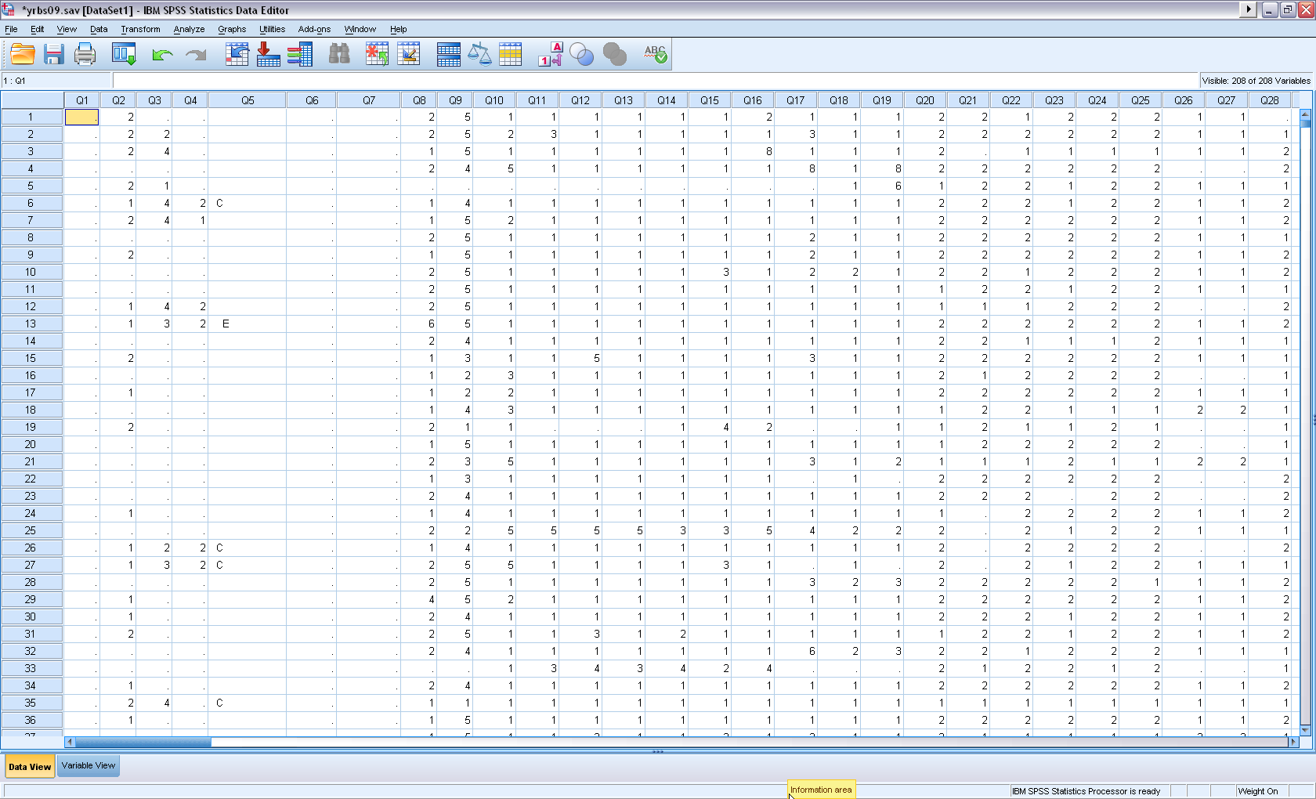
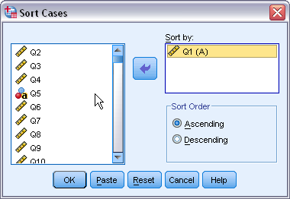
Sort and select cases
Sort cases by variables: Data Sort Cases
You can use Sort Cases to find missing.

Slide 34
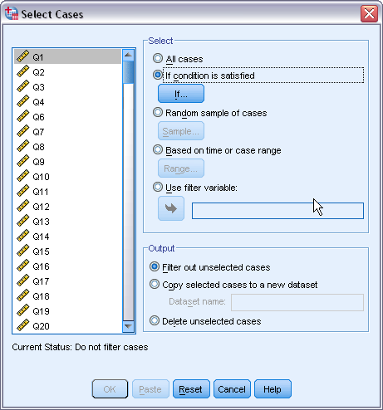
Sort and select cases
Select cases
Example 1. Select Females for analysis.
Go to Data Select Cases
Under Select: check the second one
Click If button

Slide 35
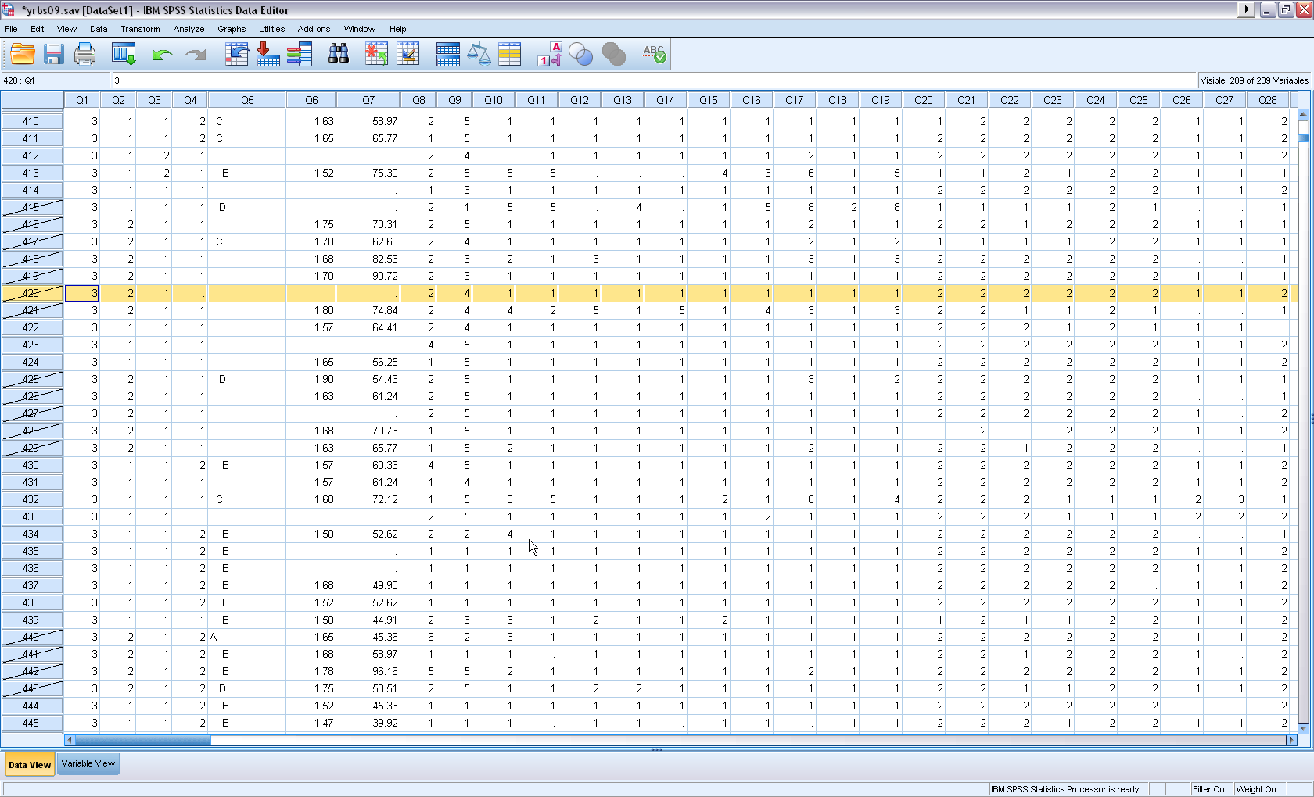
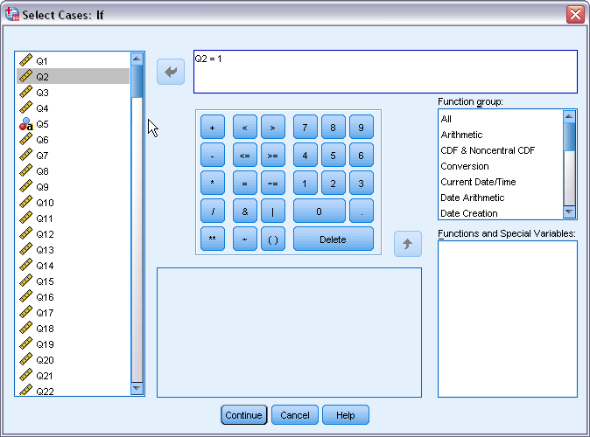
Continue
4. Q2 (gender) = 1,
1 means Female
5. Click Continue
6. Click Ok
Unselected cases :
Q2 = 2

Slide 36
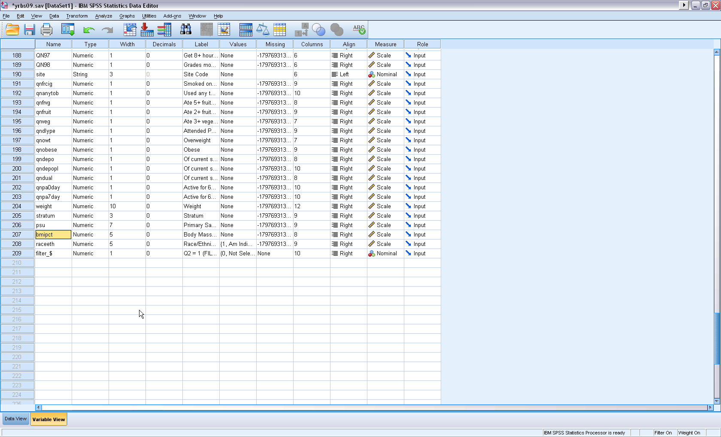
Sort and select cases
7. You will see a new variable: filter_$ (Variable view)

Slide 37
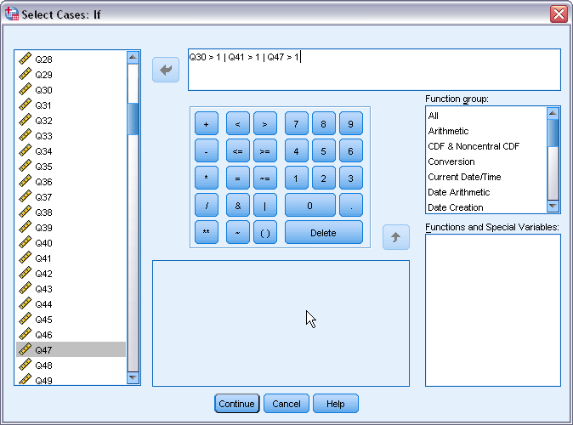
Sort and select cases
Select cases
Example 2. Select cases who used any of cigarettes, alcohol, and marijuana during the last 30 days.
Data Select Cases
Click If button
Type Q30 > 1 | Q41 > 1 | Q47 > 1, click Continue

Slide 38
Basic statistical analysis
Descriptive statistics
Purposes:
Find wrong entries
Have basic knowledge about the sample and targeted variables in a study
Summarize data
Analyze Descriptive statistics Frequency

Slide 39
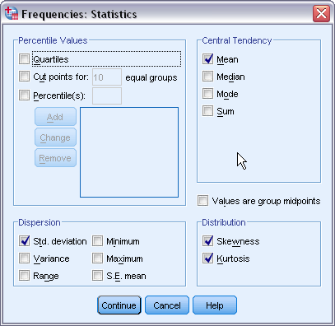
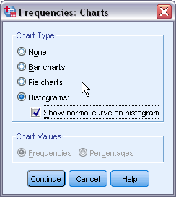
Continue

Slide 40
Frequency table

Slide 41
1. Skewness: a measure of the
asymmetry of a distribution.
The normal distribution is
symmetric and has a skewness
value of zero.
Positive skewness: a long right tail.
Negative skewness: a long left tail.
Departure from symmetry : a
skewness value more than twice
its standard error.
2. Kurtosis: A measure of the extent
to which observations cluster around
a central point. For a normal
distribution, the value of the kurtosis
statistic is zero. Leptokurtic data
values are more peaked, whereas
platykurtic data values are flatter and
more dispersed along the X axis.
Normal Curve

Slide 42
THANK YOU
THANK YOU

